Slide 1
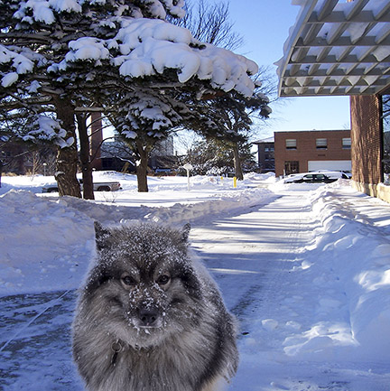
Manipulated photography
for mass media

Slide 2
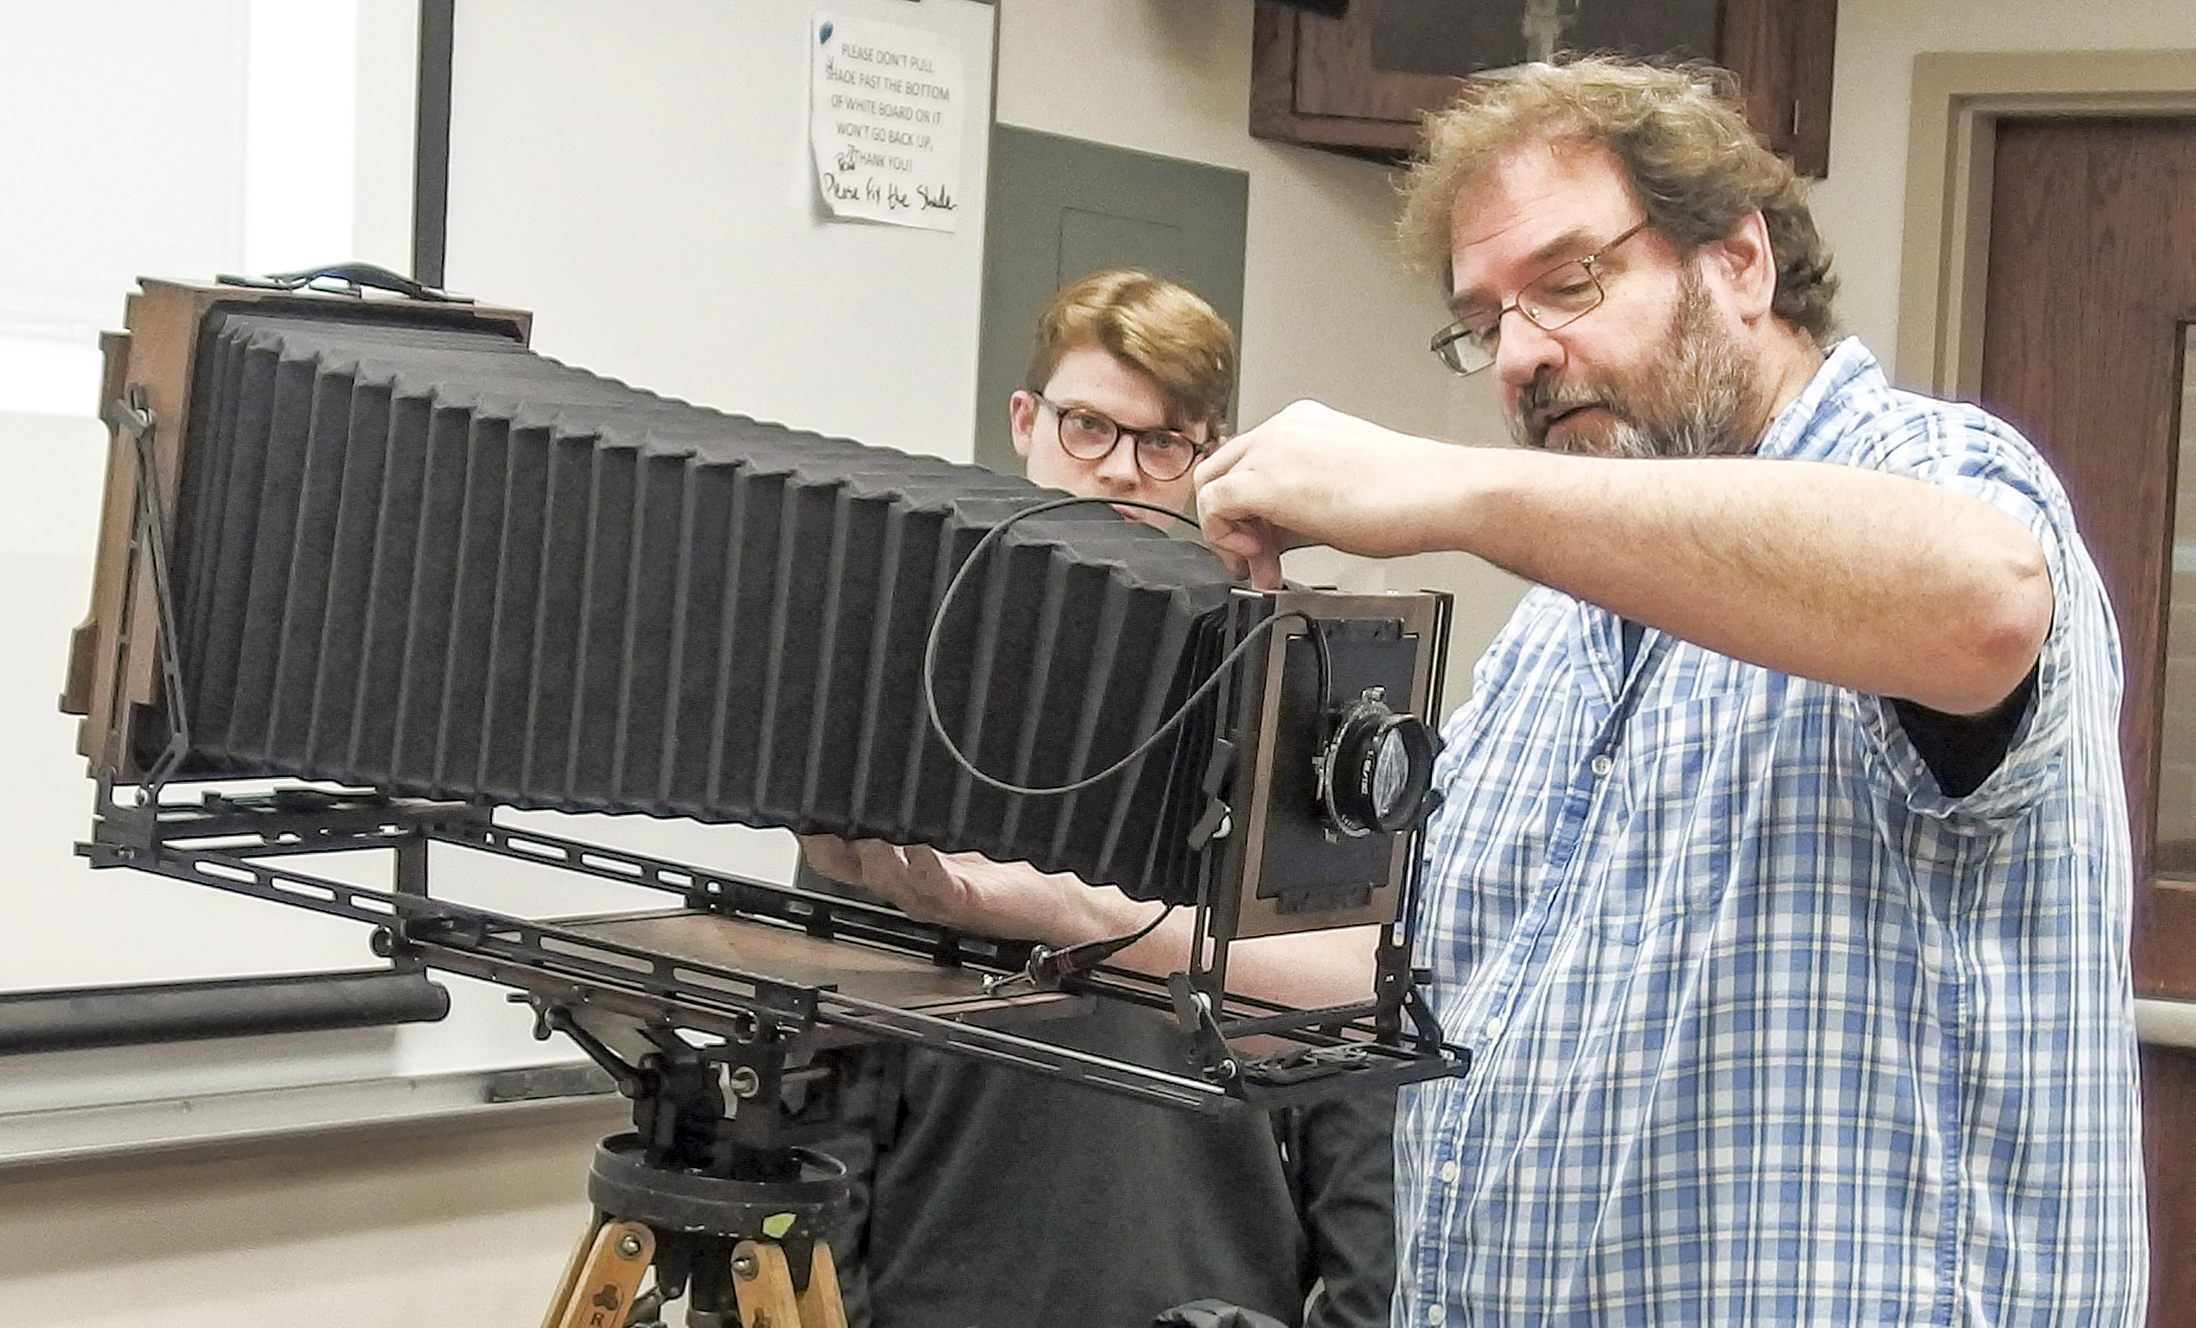
Ethical beginnings
Mass media photography (and photojournalism) are defined as non-fiction photography: people doing things in a natural setting.
We try to avoid posing people.
We don’t try to control the situation.
We attend an event, photograph what is there, try to portray fairly what we see.

Slide 3
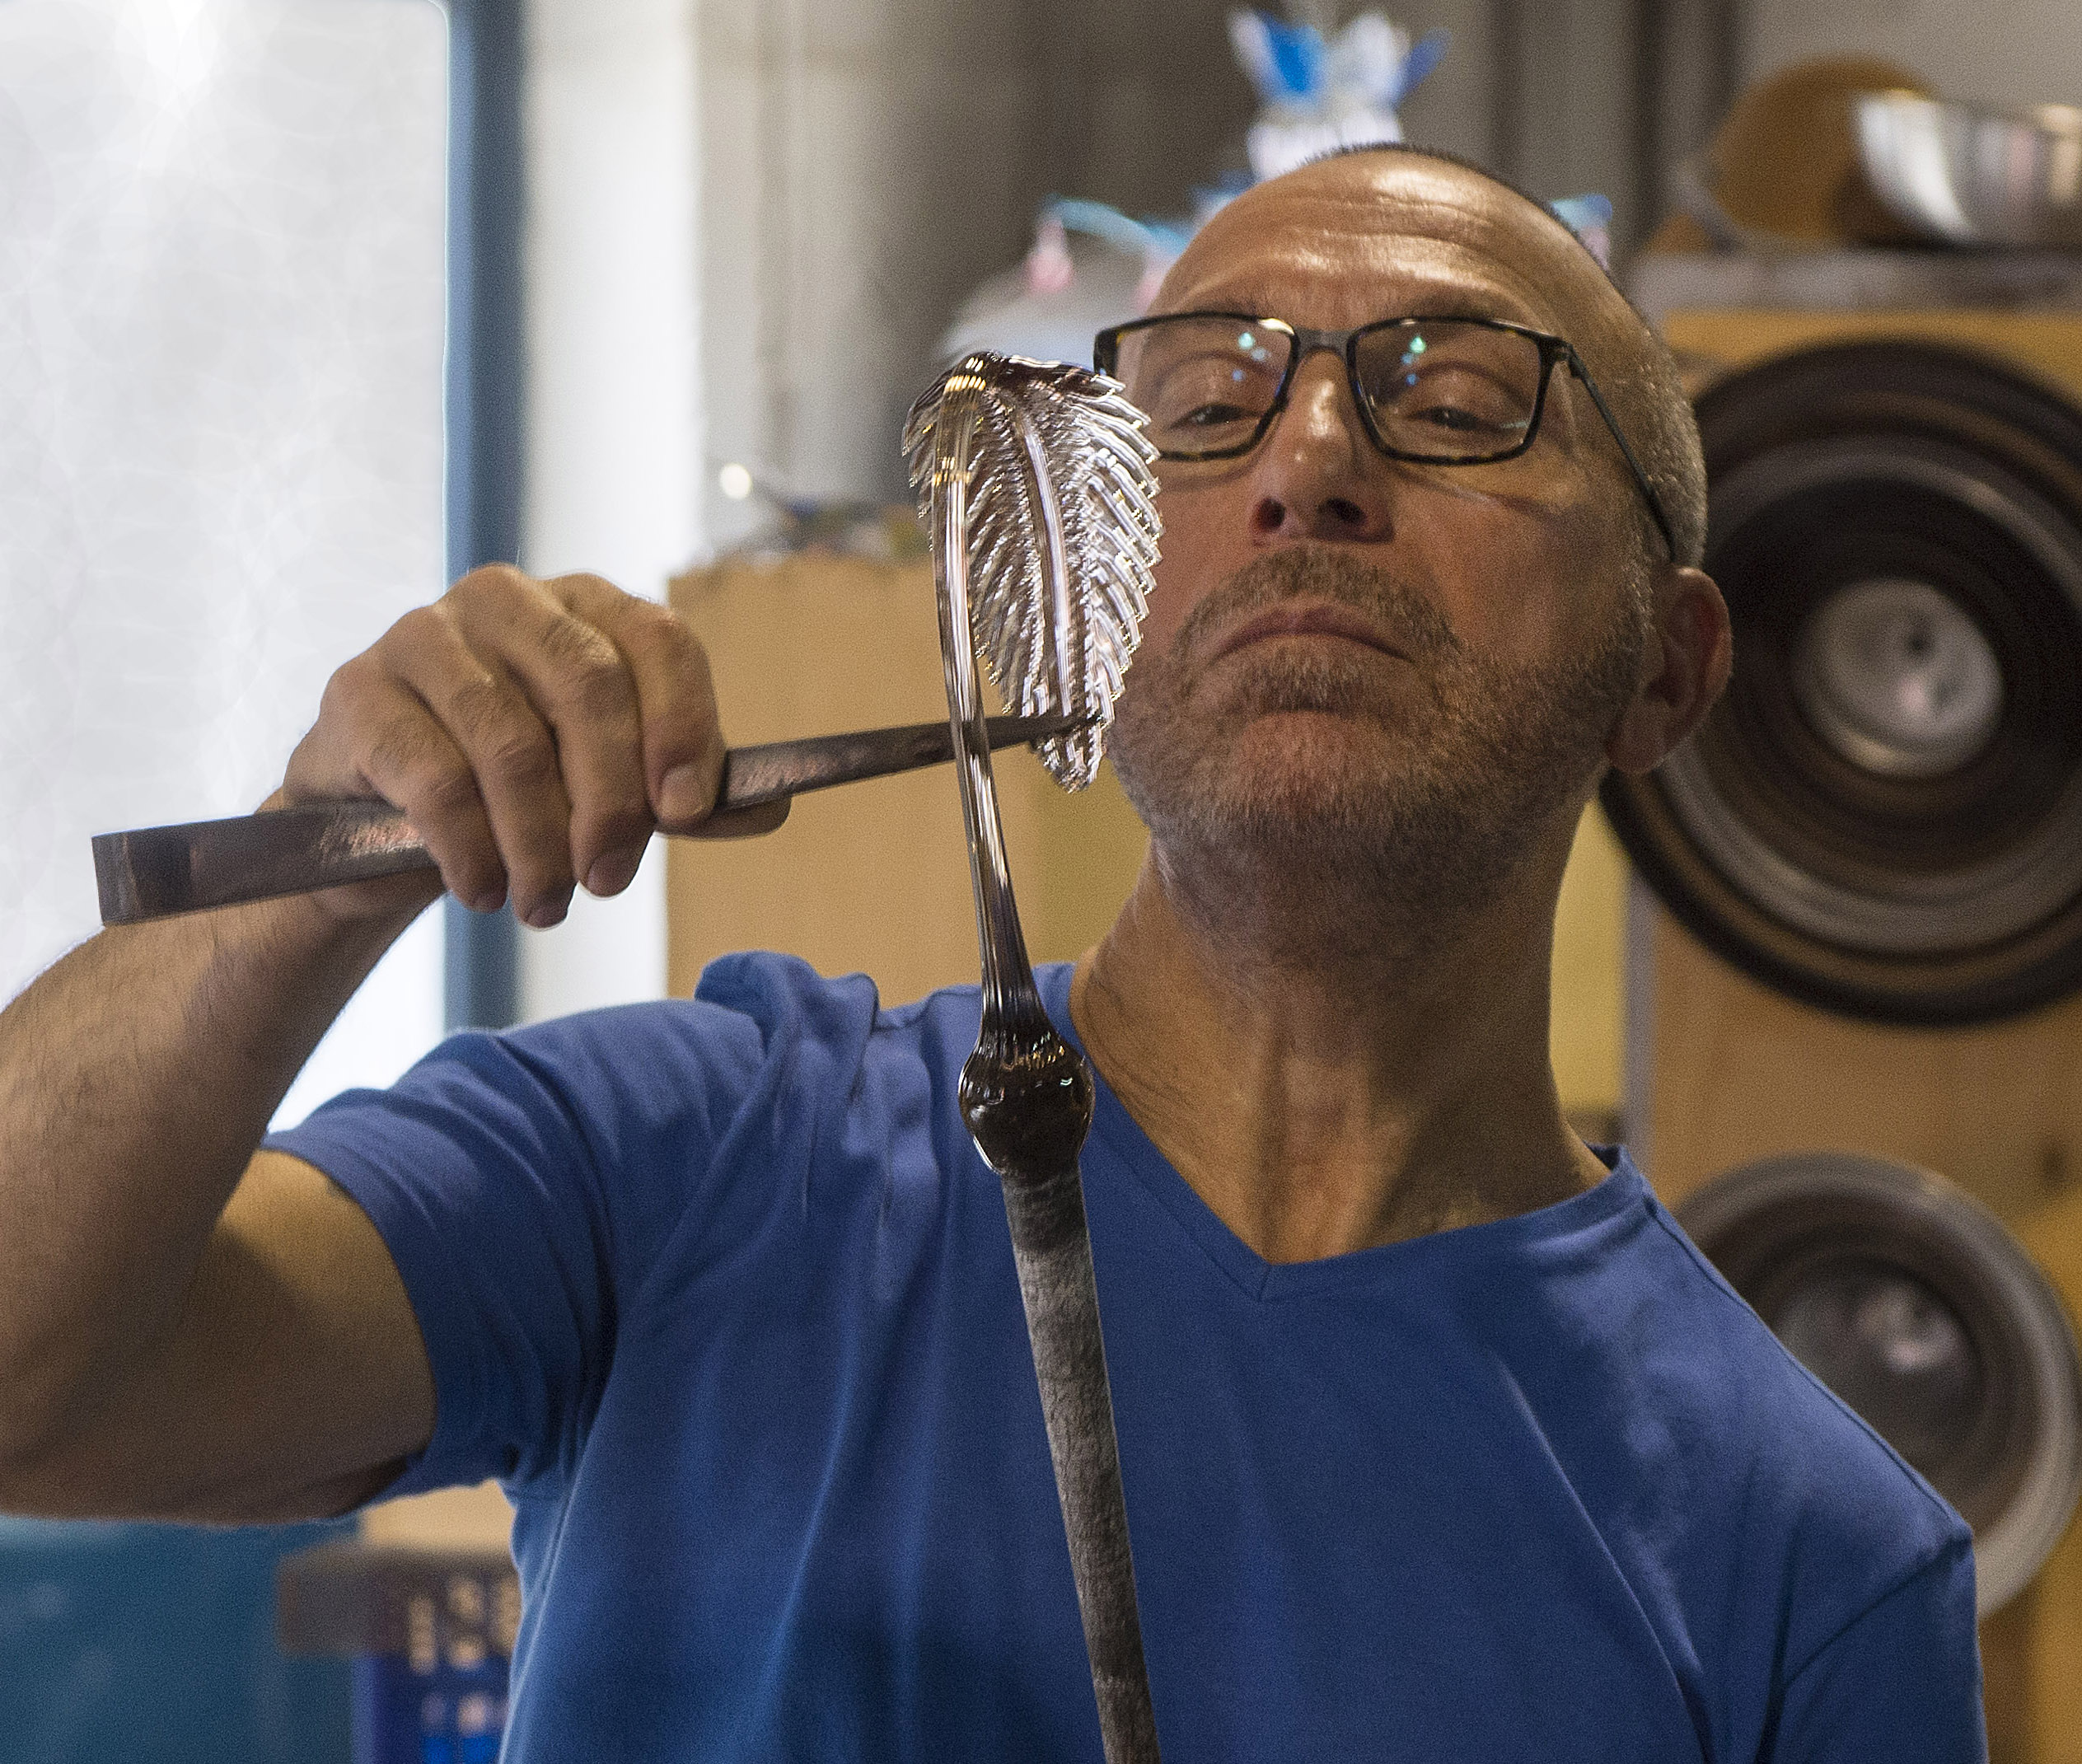
Ethical control
But even within this ideal, we consider some control over the image to be acceptable.
We choose to photograph something in a certain way that we think fairly reflects the event. This is as a journalist writes using a certain angle.
We control a photograph by what we include and leave out, either in the camera or later cropping.
We control exposure, darkening, lightening, sharpening.

Slide 4
Ethical control
Is this manipulation of the image? Yes.
But it is passive manipulation: we are cropping and choosing angles, but we are not controlling the action of a scene.
But what if you need to take a photo that’s not part of a news story, or not even journalism?
Then we move into the area of controlled, or manipulated images.

Slide 5
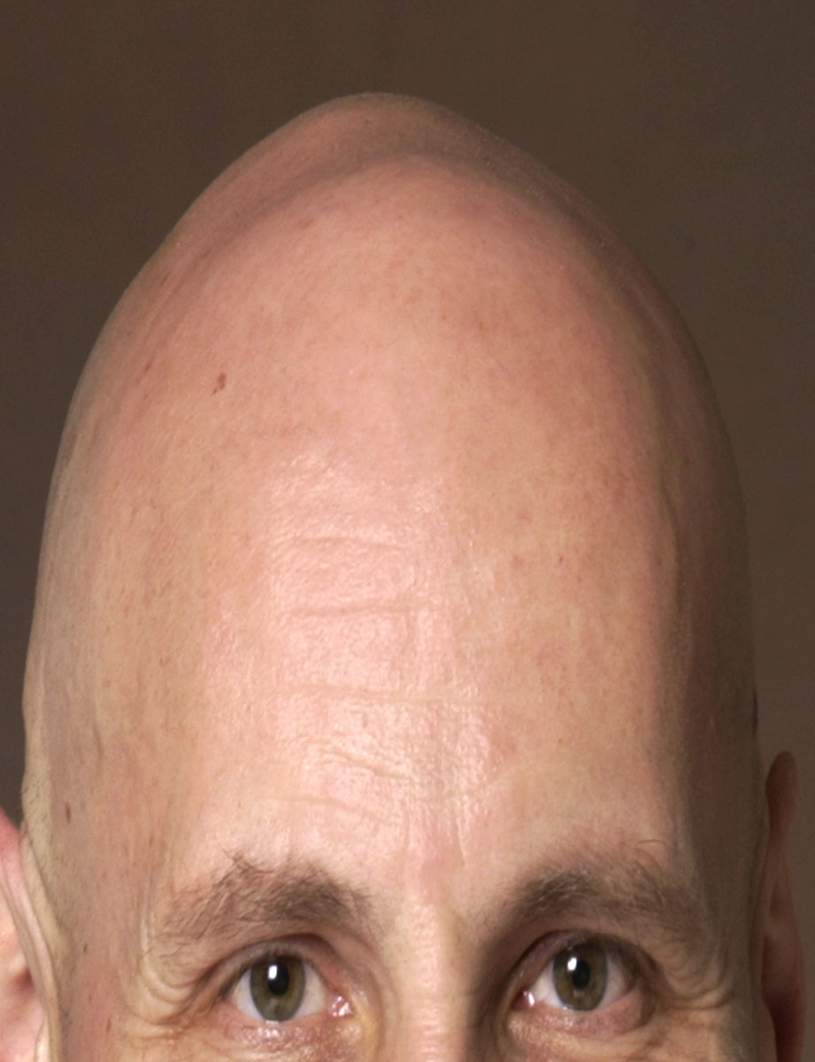
Controlled images
You can provide manipulated images for a feature story. That is, a non-news event.
This is distortion for an illustration (the “egghead” professor).

Slide 6
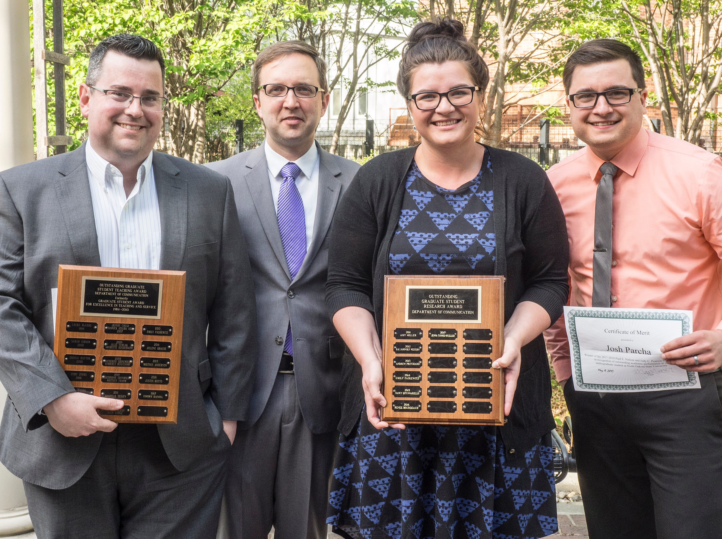
Two ways to manipulate
Subject manipulation.
Scene manipulation.
Or both.

Slide 7
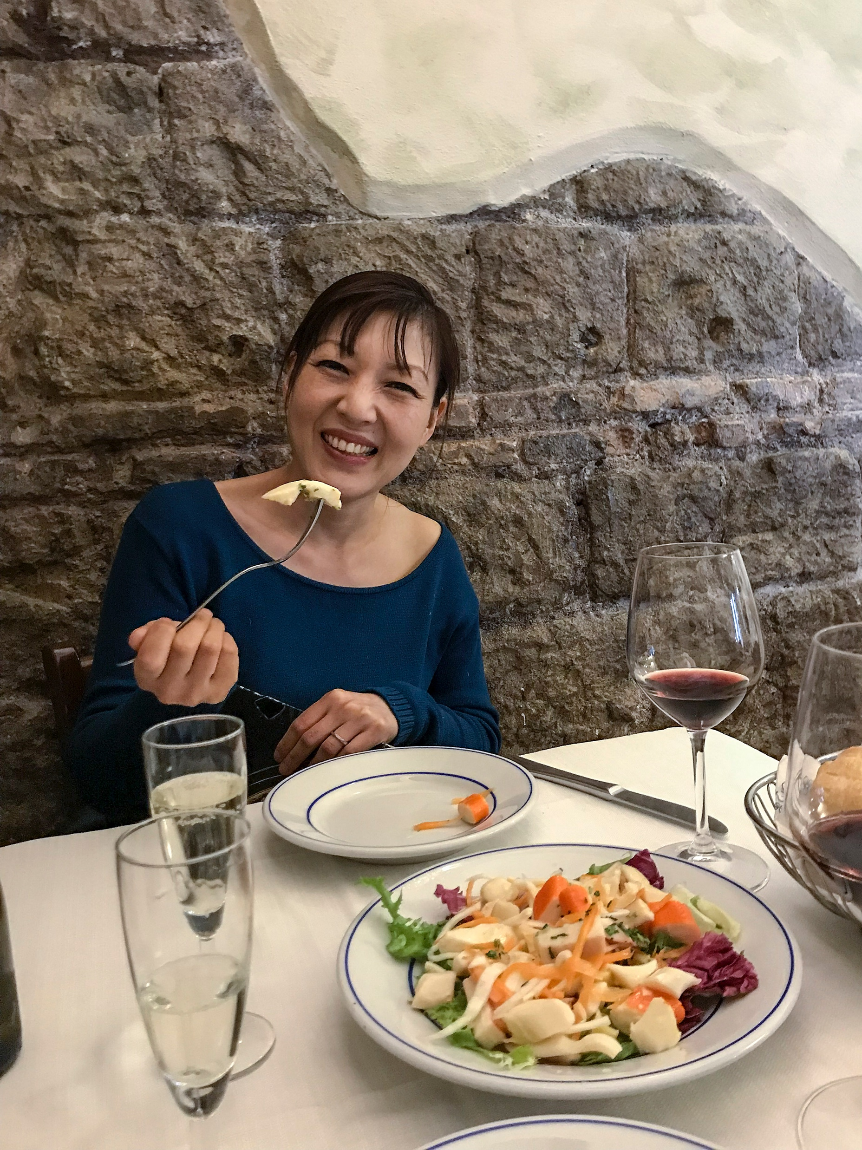
Subject manipulation
You control your subject by asking that person to do something.
The control may be casual: “Just walk down the street as you usually do and I’ll take your picture.”
Or the control may be more formal: “Sit here, straight back, lift food with fork, turn my way, look toward the camera.”

Slide 8
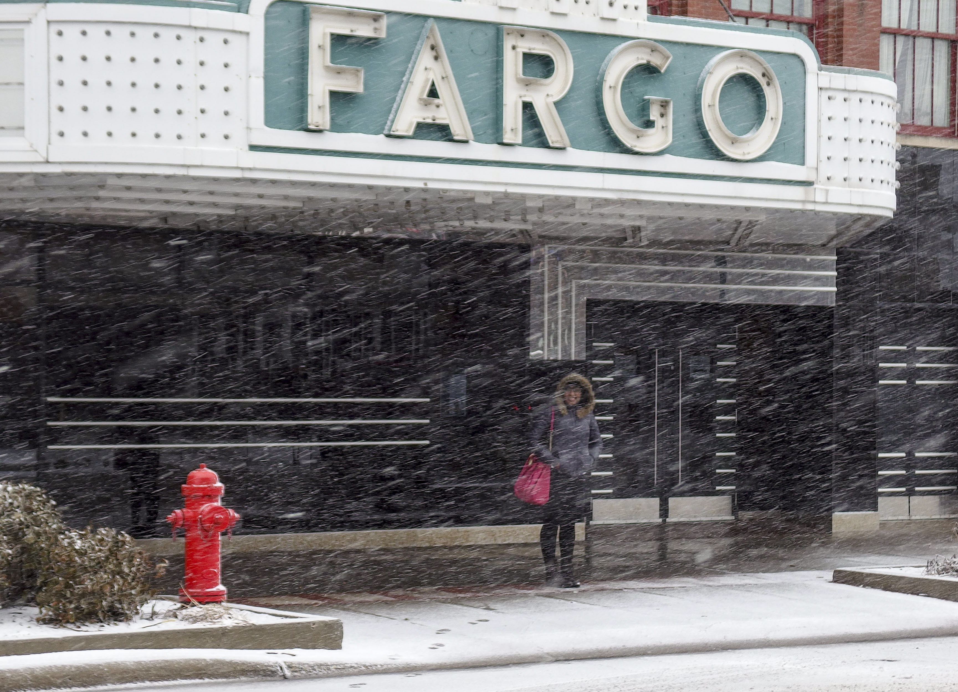
Scene manipulation
You control the environment, including the background, objects and people in the scene, lighting of the scene.
You may add an hat or purse for color, or an interesting background object to give context.
You move things around.

Slide 9
Illustrations
When you control the subject or environment, you create a photo illustration. That is, a photo to show a story, advertising or public relations concept.
This does not mean the subject is formally posed. But it could.
Within this idea we can make three separations: editorial photography, public relations photography and advertising photography.

Slide 10
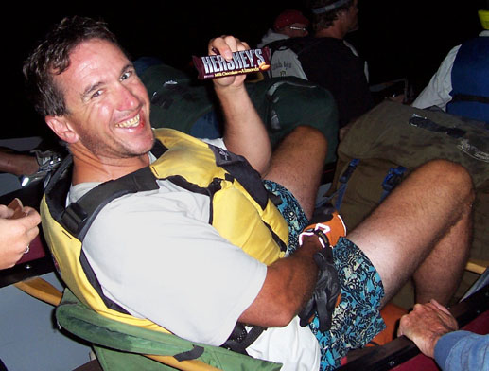
Editorial illustrations
In mass media this generally covers these areas:
portraits;
food;
travel.

Slide 11
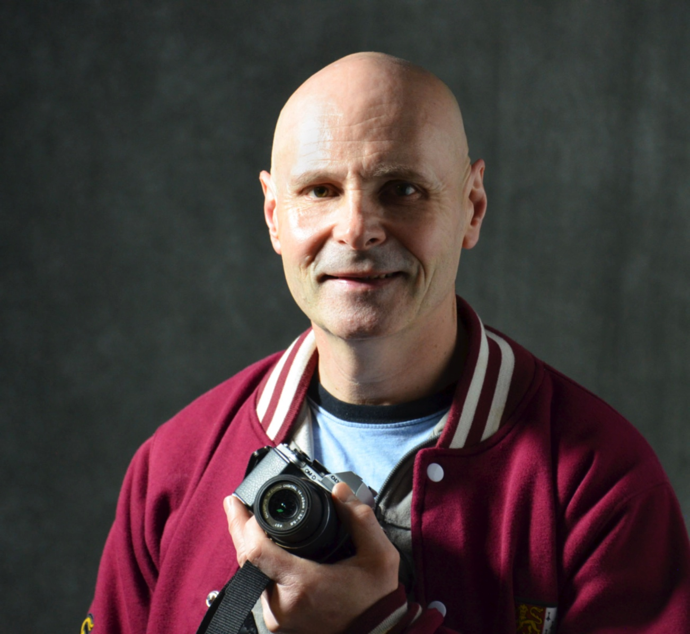
Portraits
A portrait can be a mugshot. That is, a formal studio portrait.

Slide 12
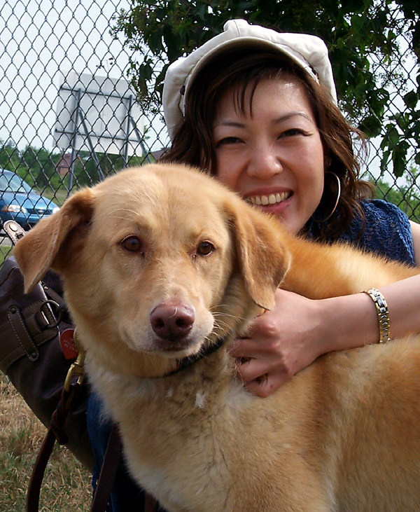
Portraits
Or it can be an environmental portrait, an informal photo of someone doing something.
In both cases, however, the subject is manipulated.

Slide 13
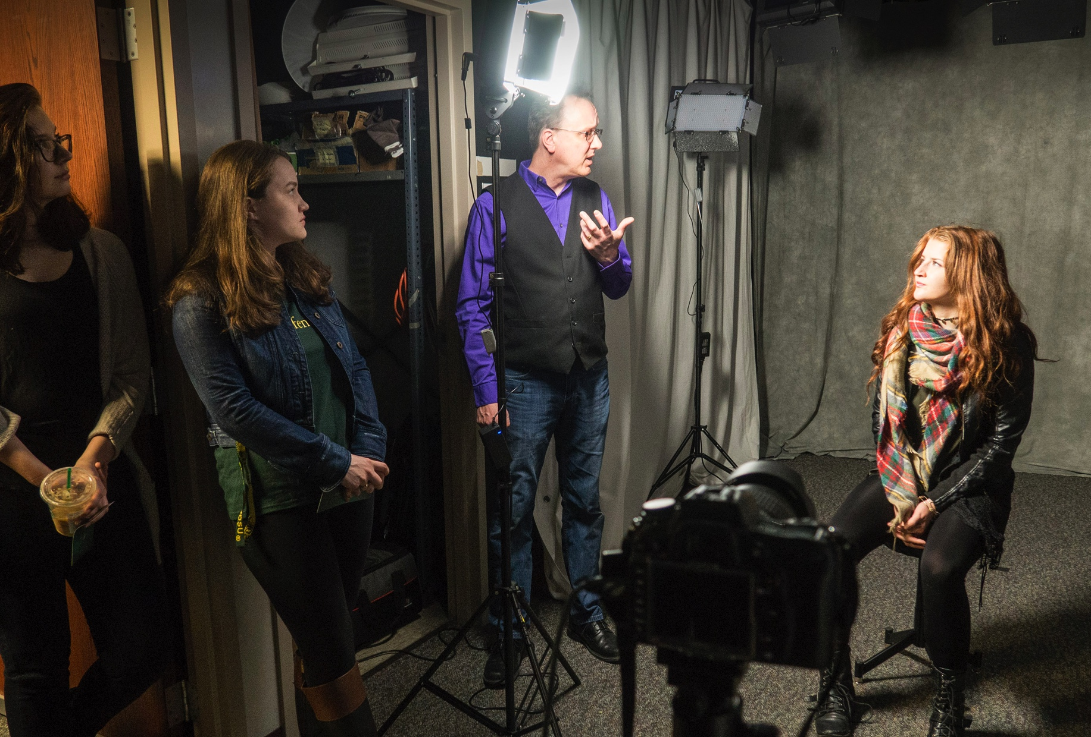
Lighting manipulation
Usually in a manipulated portrait the lighting is also manipulated, often in a studio.

Slide 14
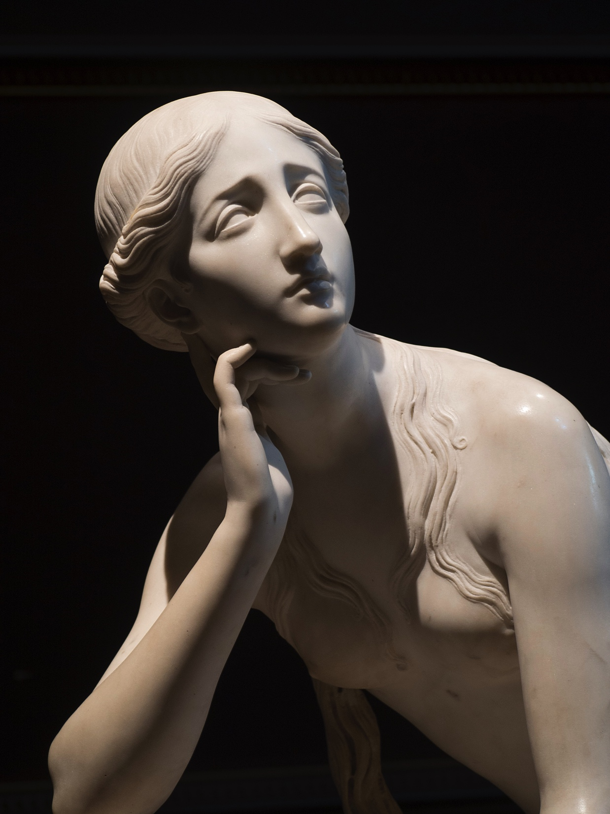
Lighting manipulation
Back light or fill light will give more uniform lighting than is usually available in the real world.
In straight photojournalism we look for this lighting in our environment, and choose an angle to use it.
In manipulated photography we can set up lights and use flash.

Slide 15
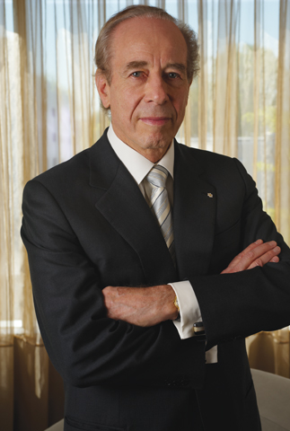
Manipulated portraits
Usually we try to pose people so they appear natural. They don’t necessarily look at the camera.
Often, though, in an environmental portrait we feature a subject doing something he wouldn’t really do very often.
A classic example of this is the bank president or CEO sitting on the edge of a desk with his arms folded.

Slide 16
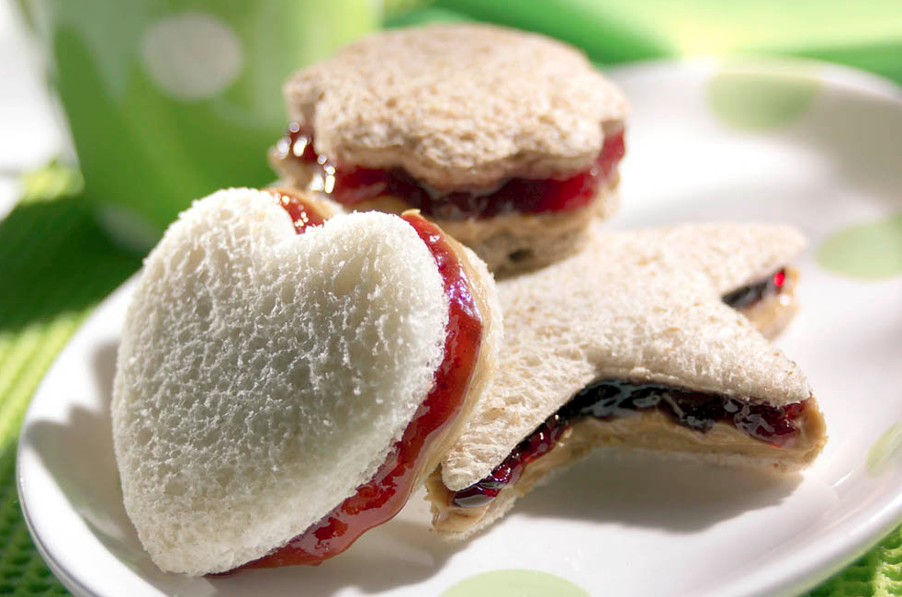
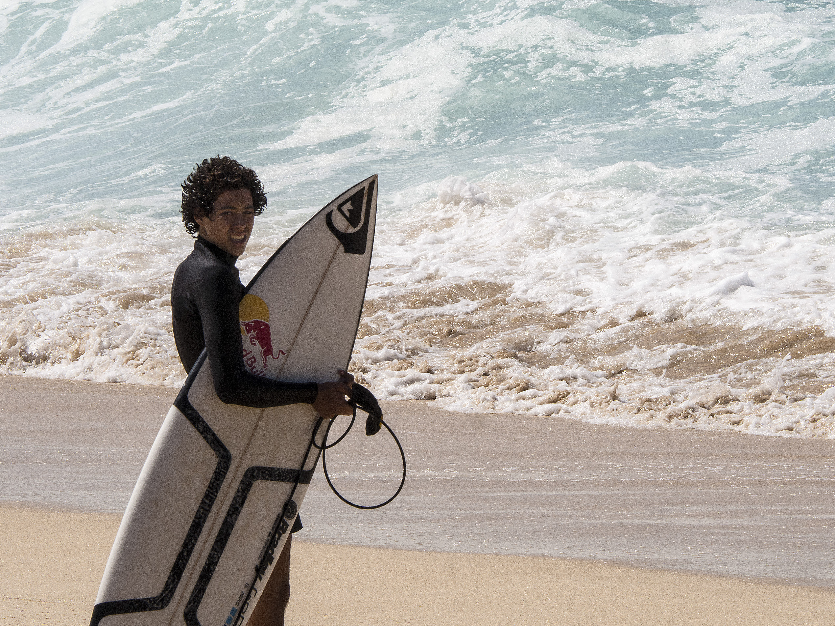
Food and travel
Food shots are carefully manipulated to light the food in a way that makes it look appetizing.
Travel feature photography may be less manipulated, but often people are posed doing things in an exotic environment, like splashing on the beach.

Slide 17
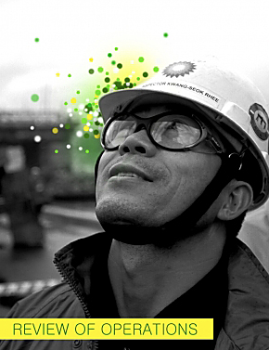
Public relations
Public relations photography emphasizes persuasive images designed to reflect positively the person or group photographed.
Corporate annual reports and press releases often feature this style of photojournalism.

Slide 18
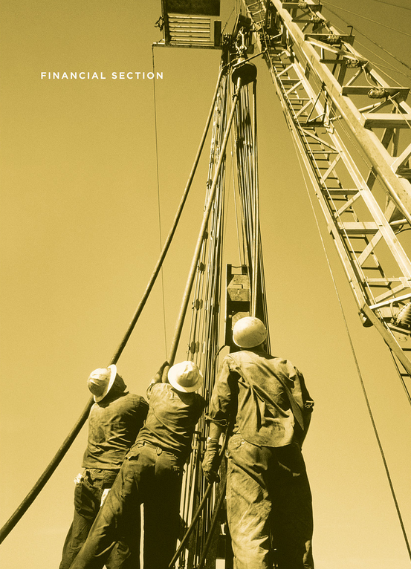
Public relations
Photographers often have little say in setting up these photos.
They are designed to reflect what the public relations director wants to portray.

Slide 19
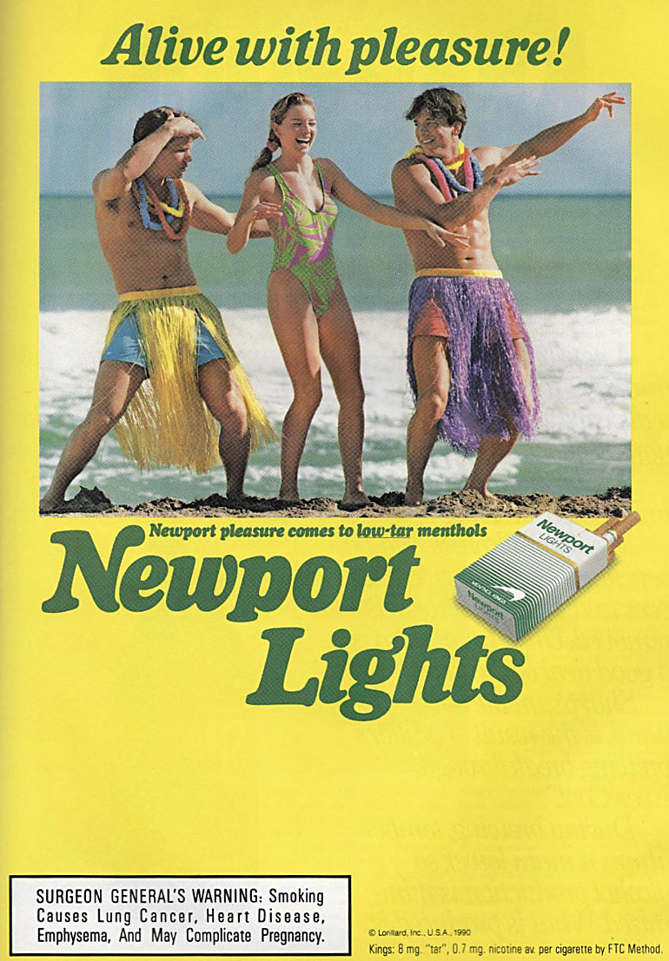
Advertising
Advertising photography is tightly controlled, and paid for by a client.
It’s usually not simple product photography.
Advertising photography often tries to attach a lifestyle ideal to a product.
Cigarette and alcohol ads are notorious for this.

Slide 20
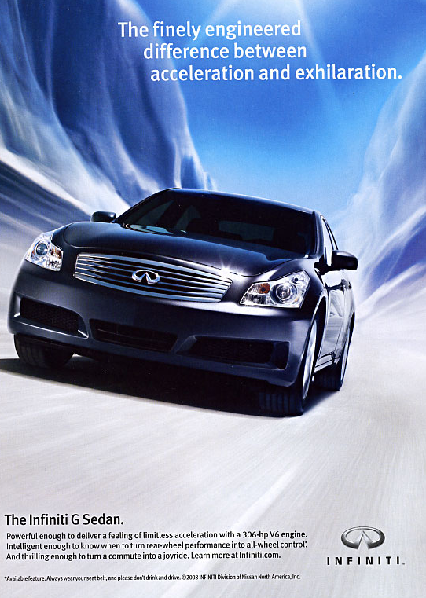

Advertising photography
Products are shown in the most positive way possible. Cars look faster. Food looks better.

Slide 21
Control of advertising
Advertising does have limits set by U.S. Trade Law. Beyond that, it’s a question of ethics.
How far can you go manipulating mass media photography for illustrations?
The answer depends....

Slide 22
Boundaries
You could do an illustration for, say, a story on meditation showing a composite image of someone in a dream world.
But could you do an illustration for a story on politics using a composite image of a politician surrounded by starving children?
Manipulation has ethical boundaries.

Slide 23
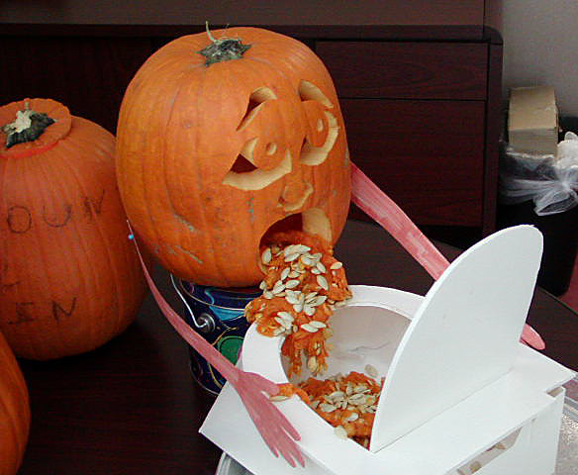
Good taste
Manipulation also is bounded by the ethics of good taste. How about this to illustrate a feature looking at off-campus student Halloween party drinking?

Slide 24
Everyday manipulation
The truth is most photography is manipulated to some extent.
When we say “smile” in snaps we are manipulating our subject.
When we turn on our flash we are manipulating the scene.
How about some of the photos below. Manipulated? And if so, how?

Slide 25
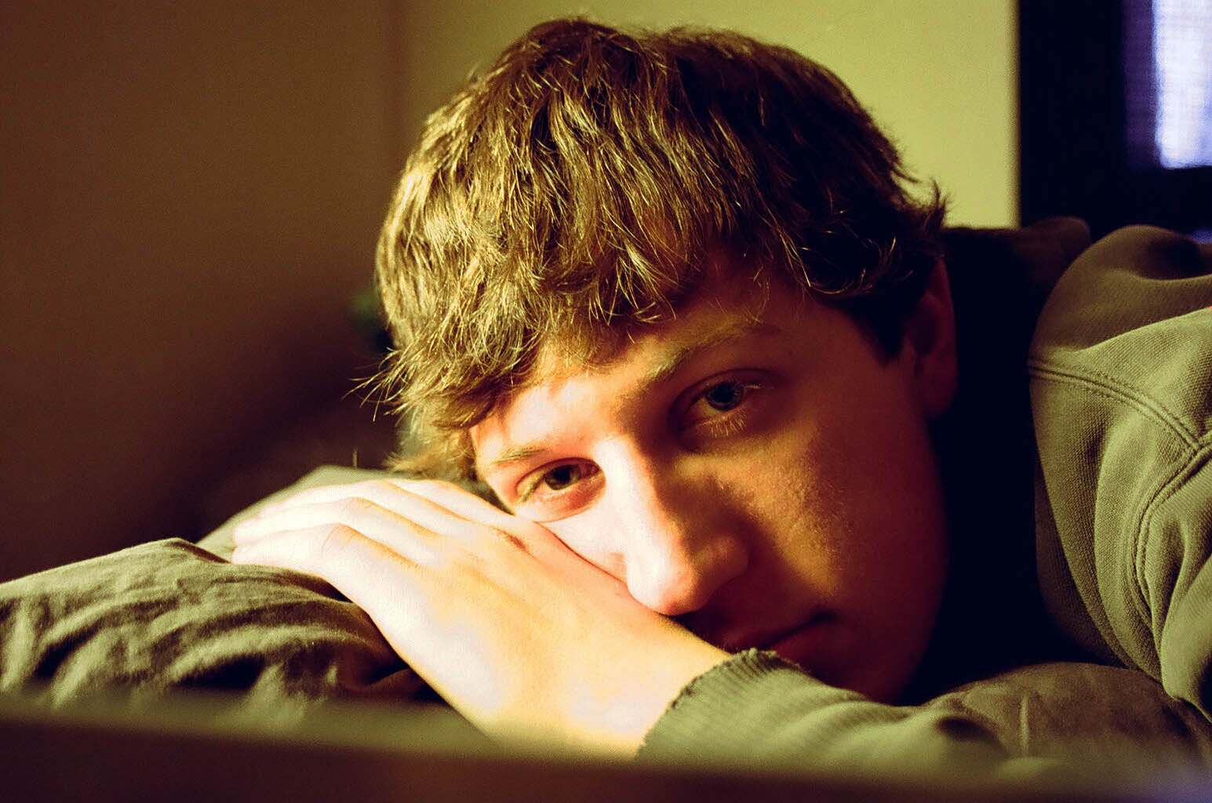
Manipulated?
Manipulated? How?

Slide 26
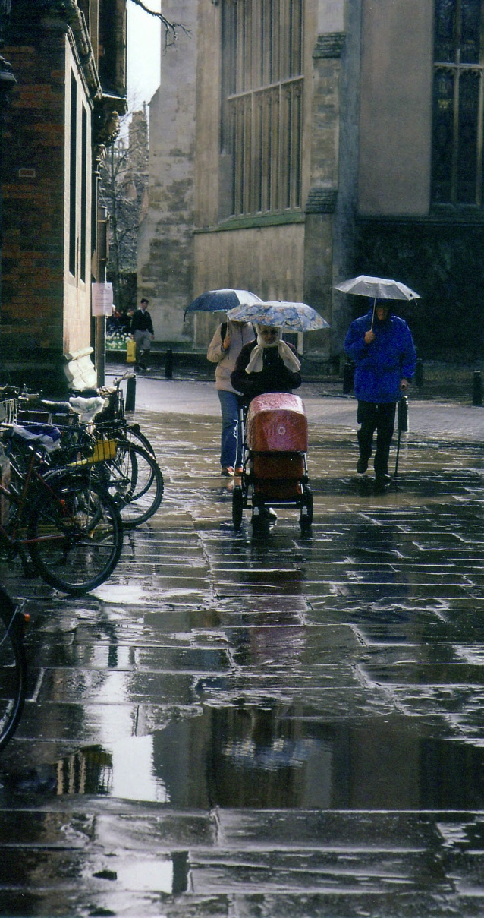
Manipulated?
Manipulated? How?

Slide 27
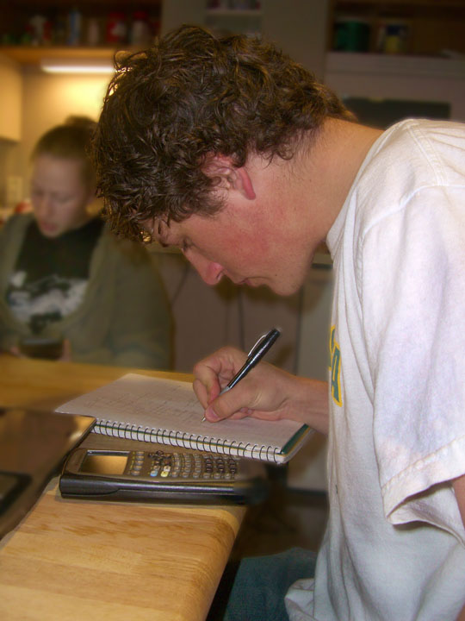
Manipulated?
Manipulated? How?

Slide 28
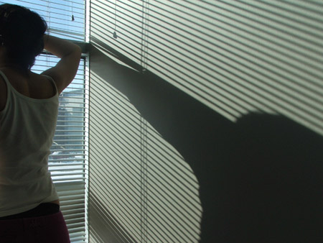
Manipulated?
Manipulated? How?

Slide 29
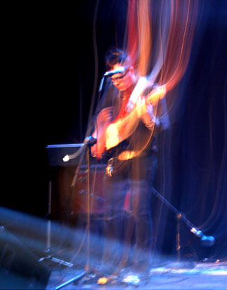
Manipulated?
Manipulated? How?

Slide 30
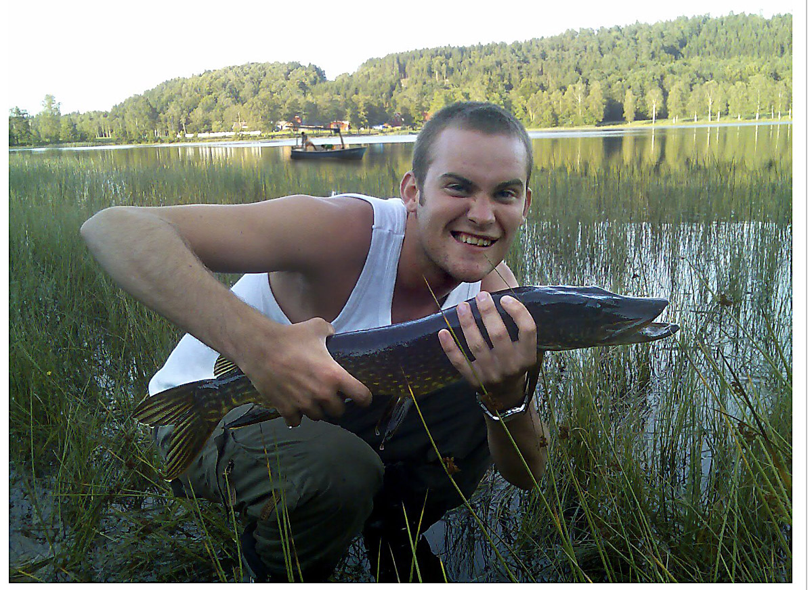
Real or fake?
Can you identify a fake image? Research shows many people can’t.

Slide 31
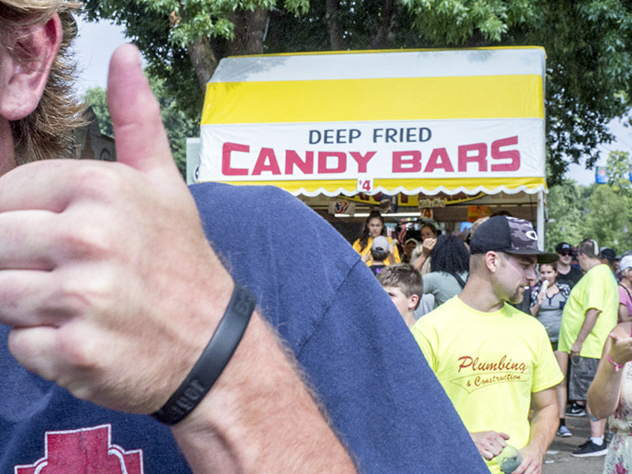
Real or fake?
Minnesota State Fair from my collection: real or fake?

Slide 32

Real or fake?
Fake! I deleted the plumbing company brand name.

Slide 33
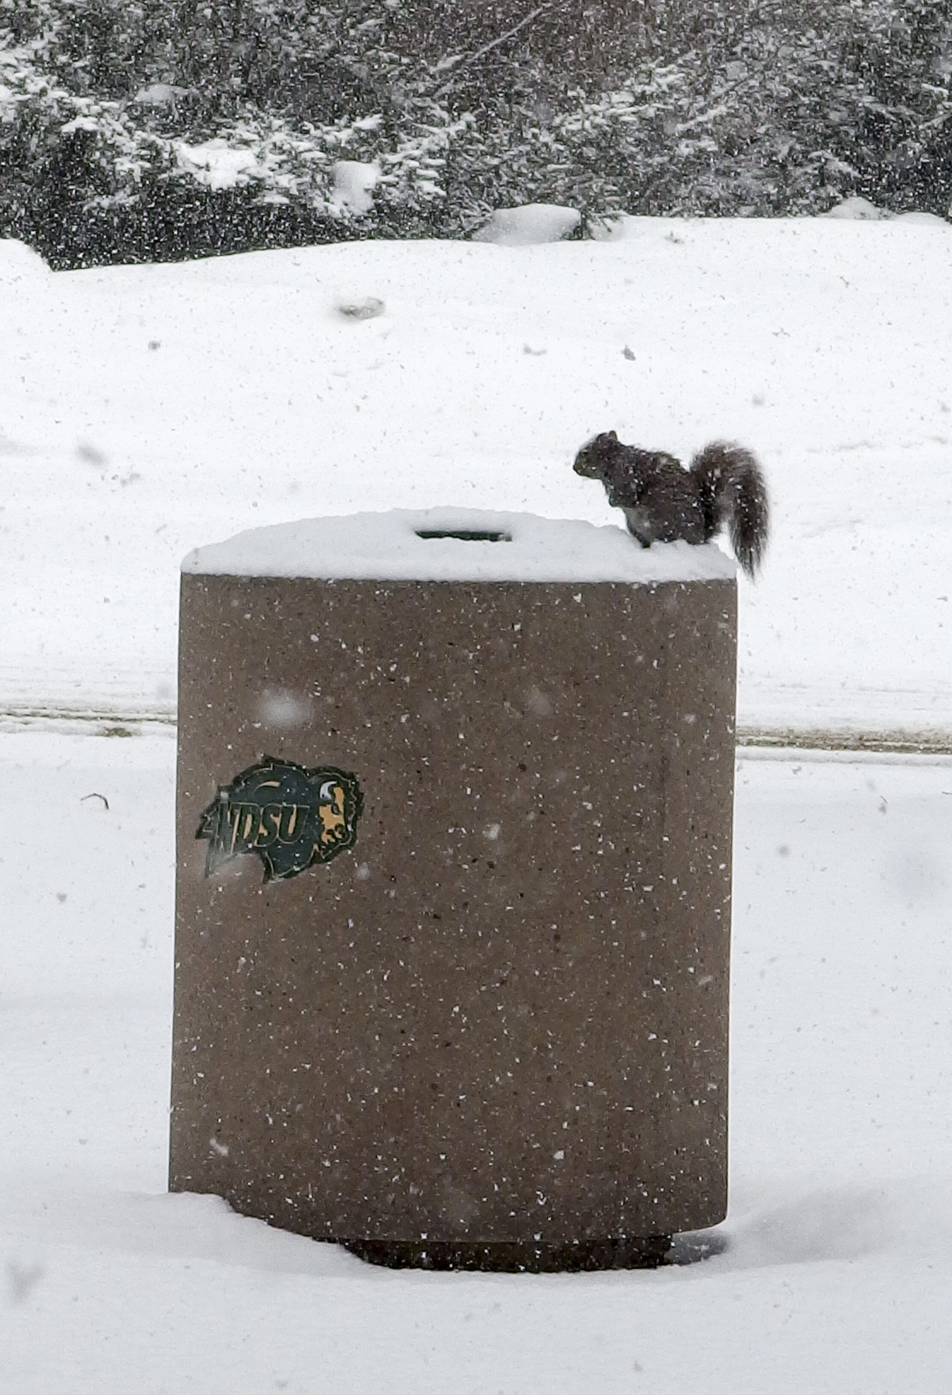
Real or fake?
Winter at NDSU. Real or fake?

Slide 34
Real or fake?
Real! The squirrel was actually perched on the trash bin.

Slide 35
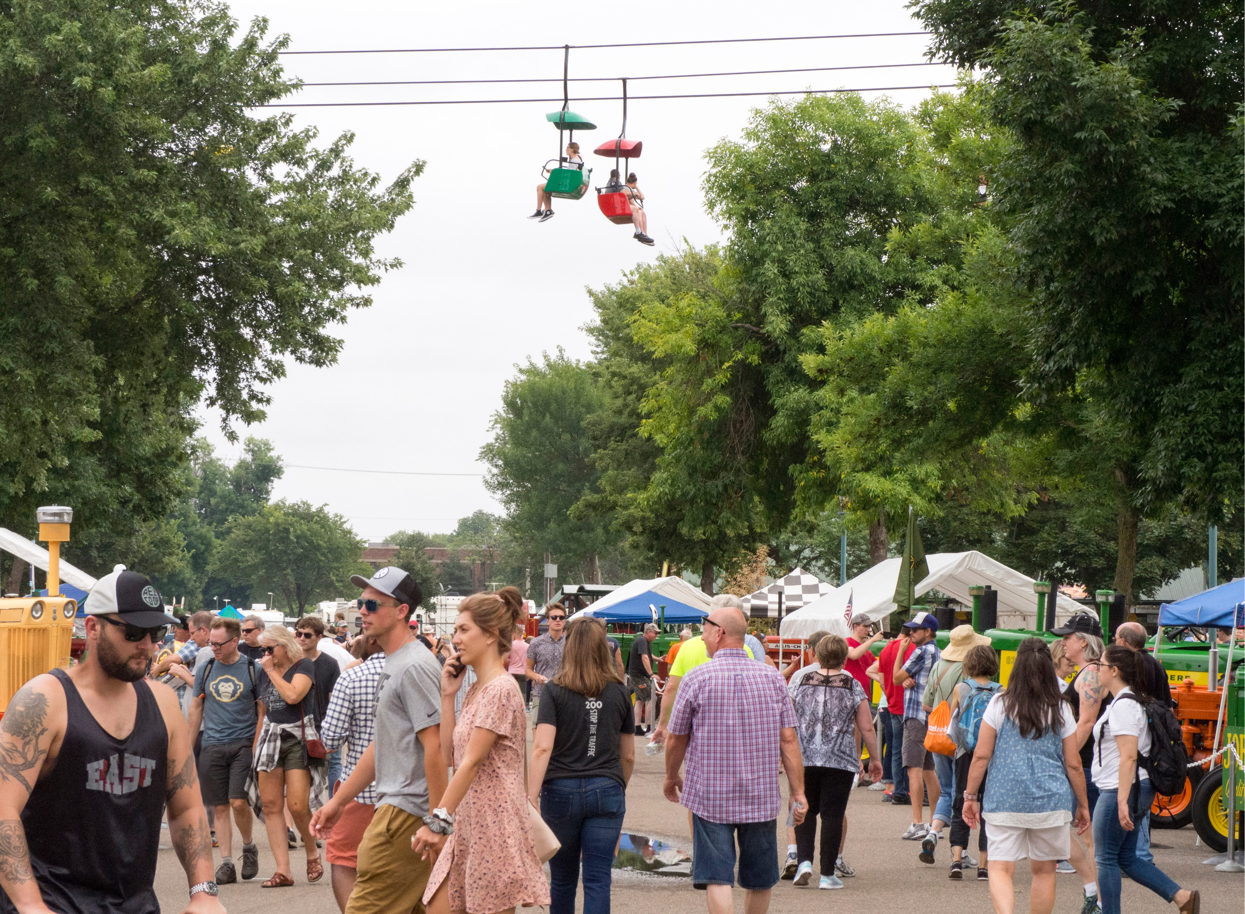
Real or fake?
Back to the state fair: real or fake?

Slide 36
Fake! But why?
What is faked in this photo?

Slide 37
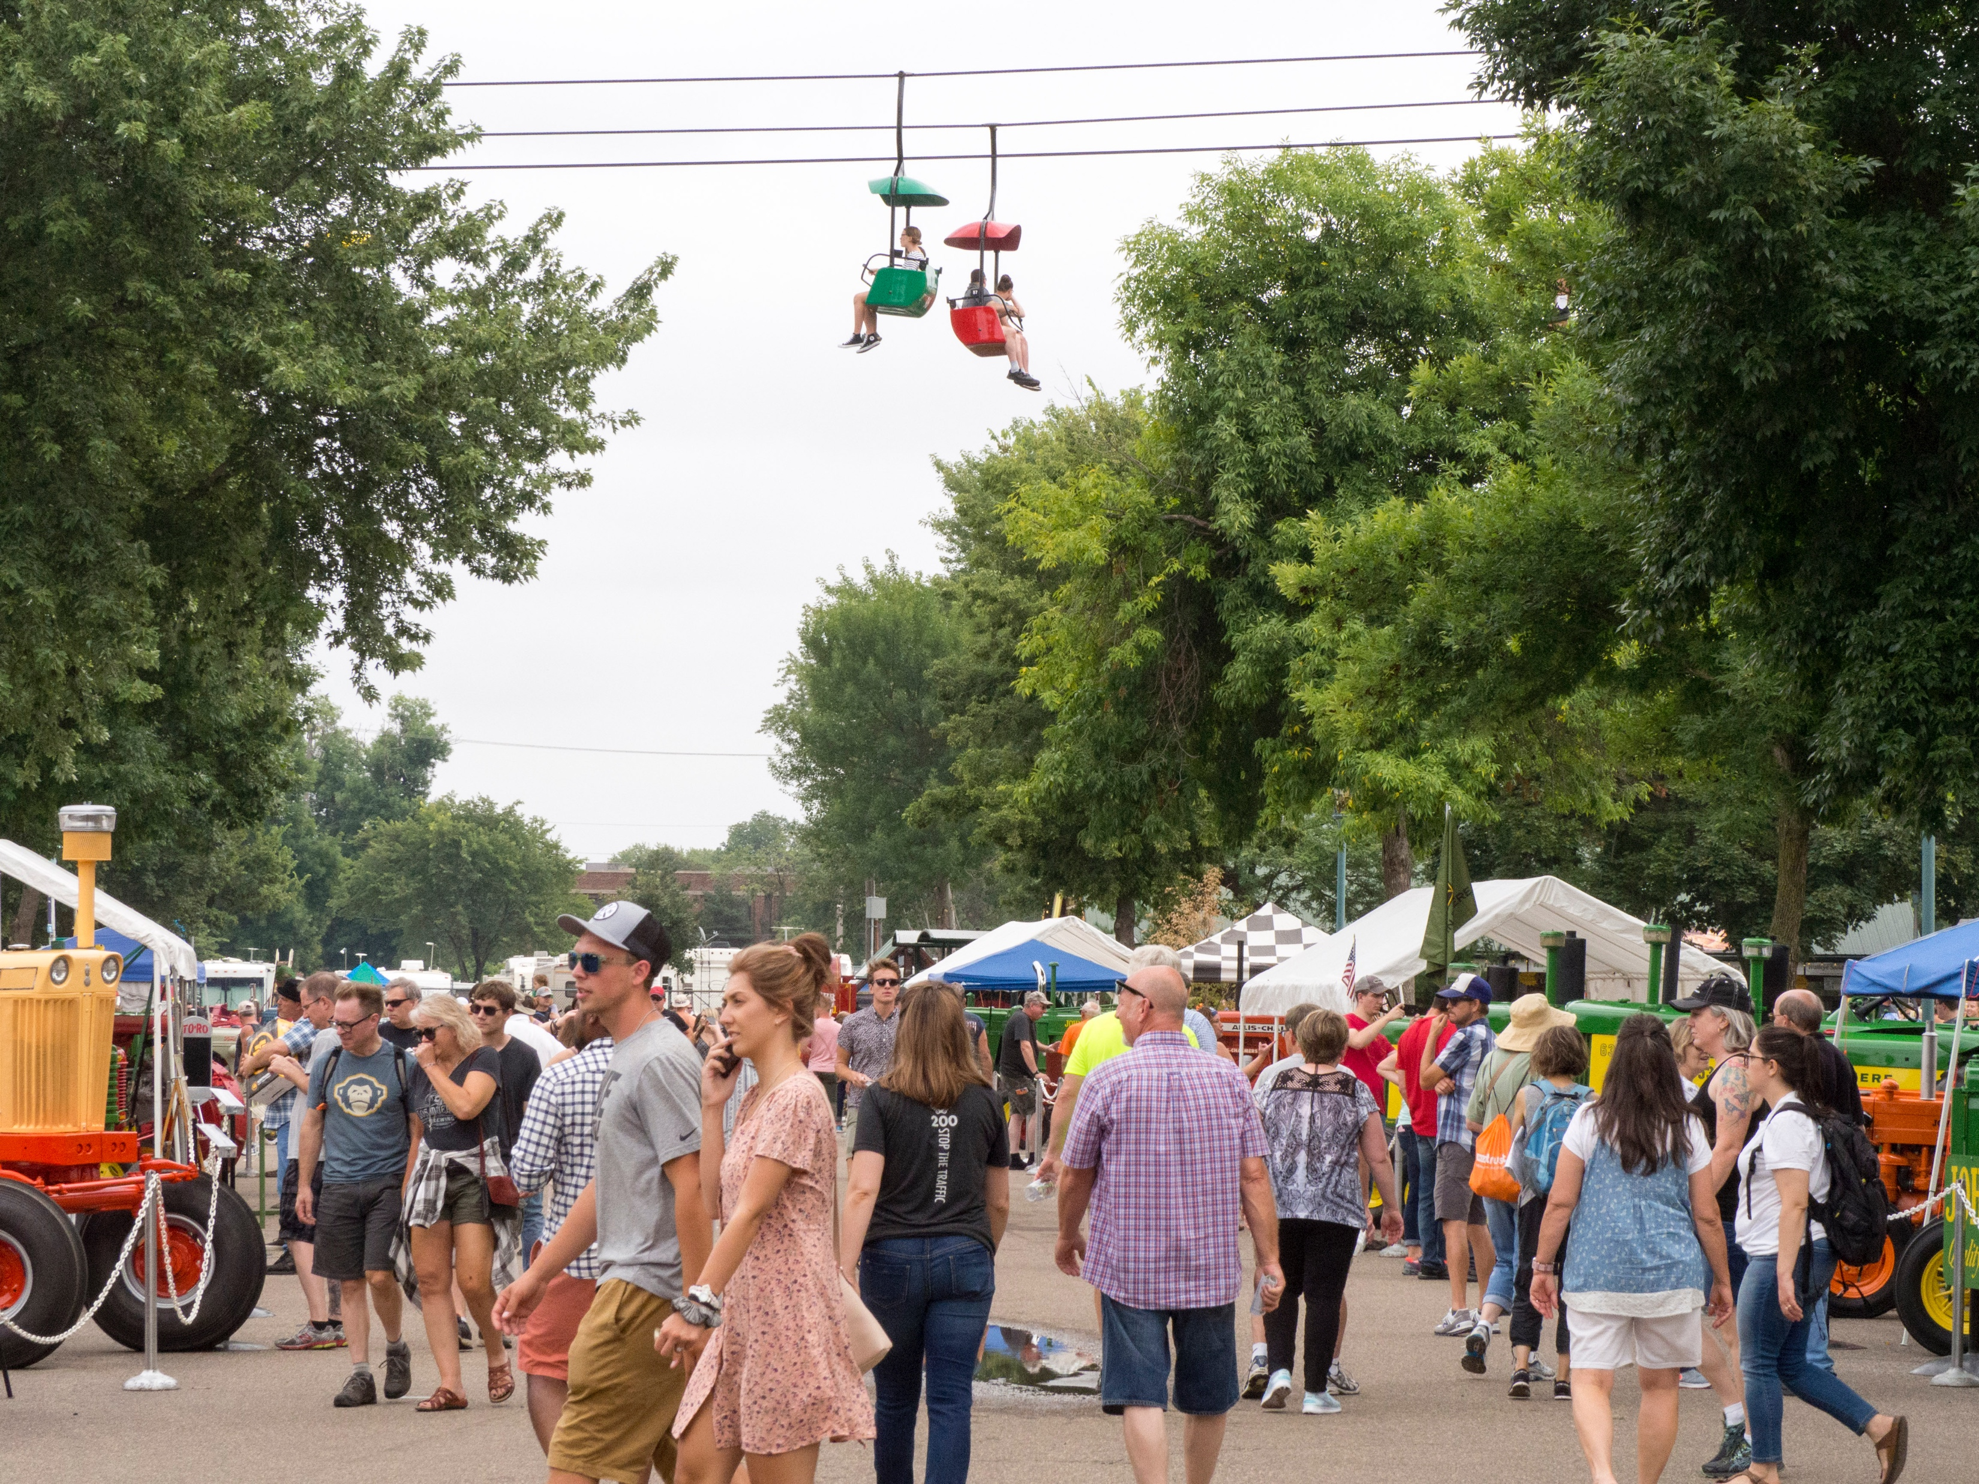
Fake
Many would guess that the chairlifts were added. Actually, it was the man in the left foreground

Slide 38
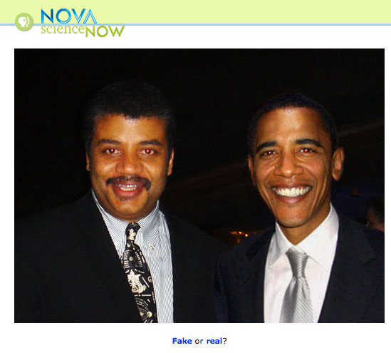
Manipulation
The pro world of media photography. Fake or real? http://www.pbs.org/wgbh/nova/sciencenow/0301/03-for-01.html

Slide 39
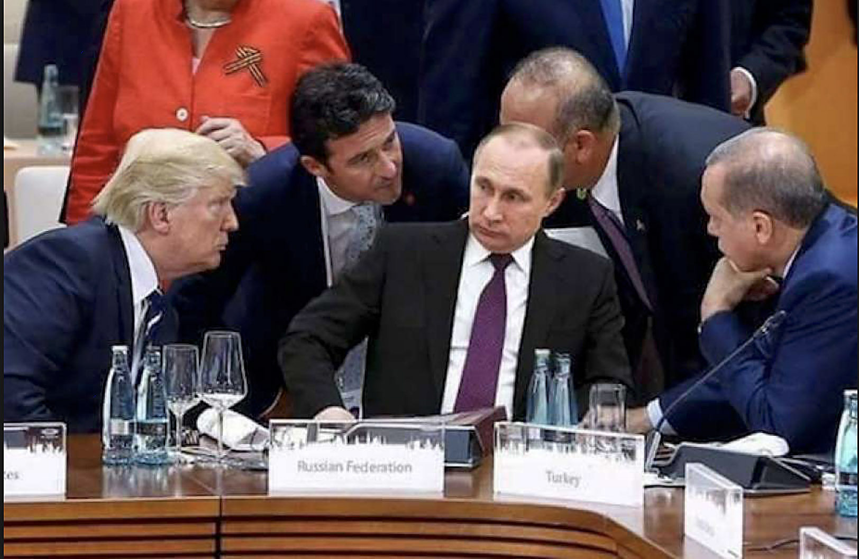
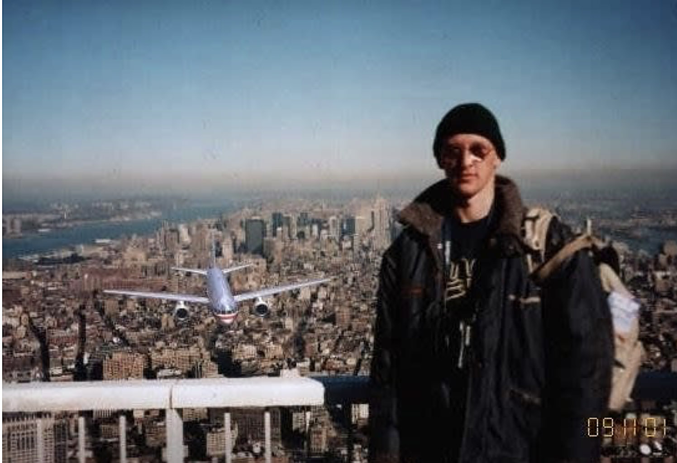
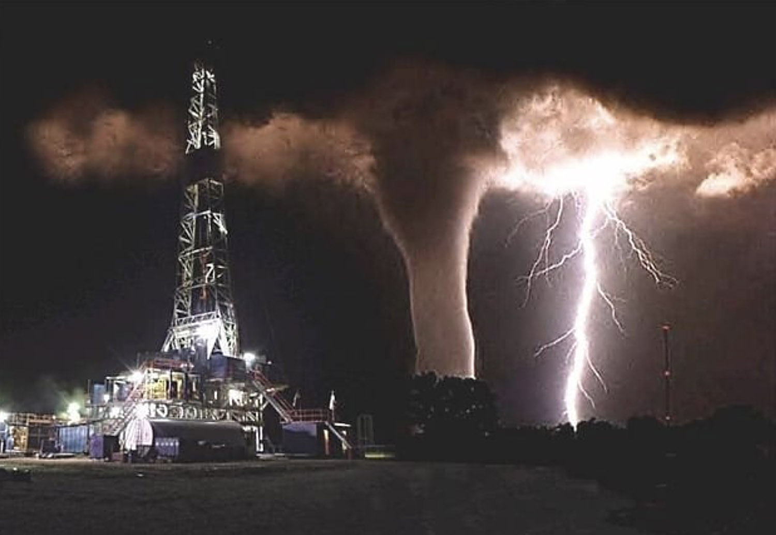
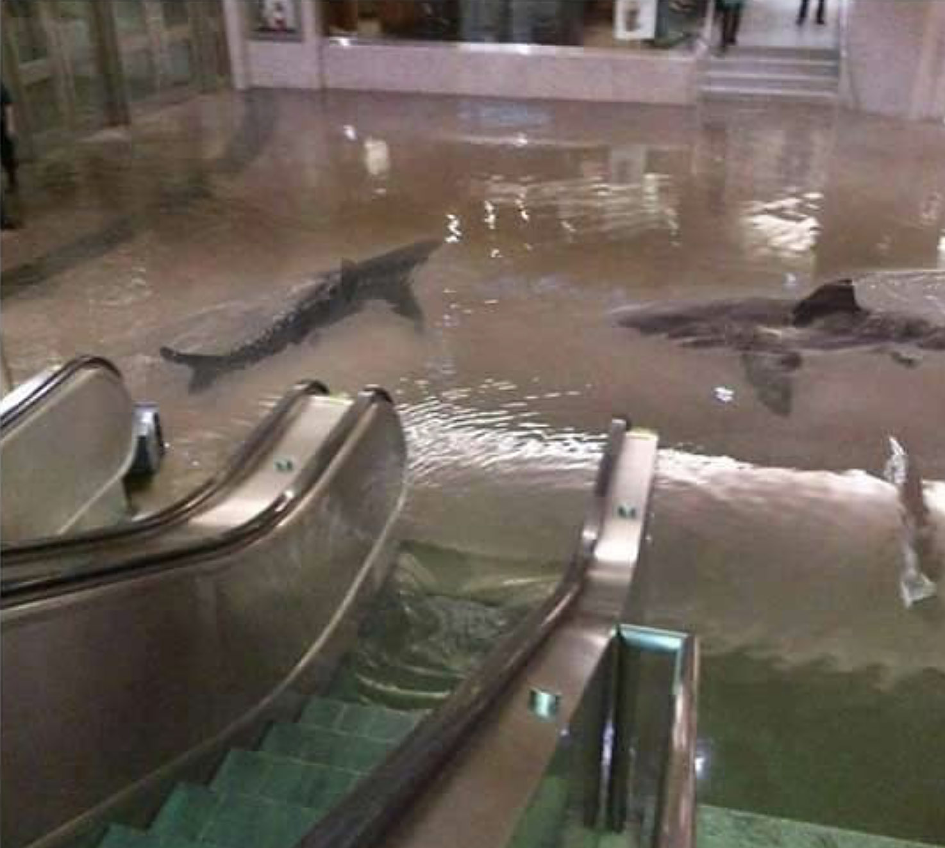
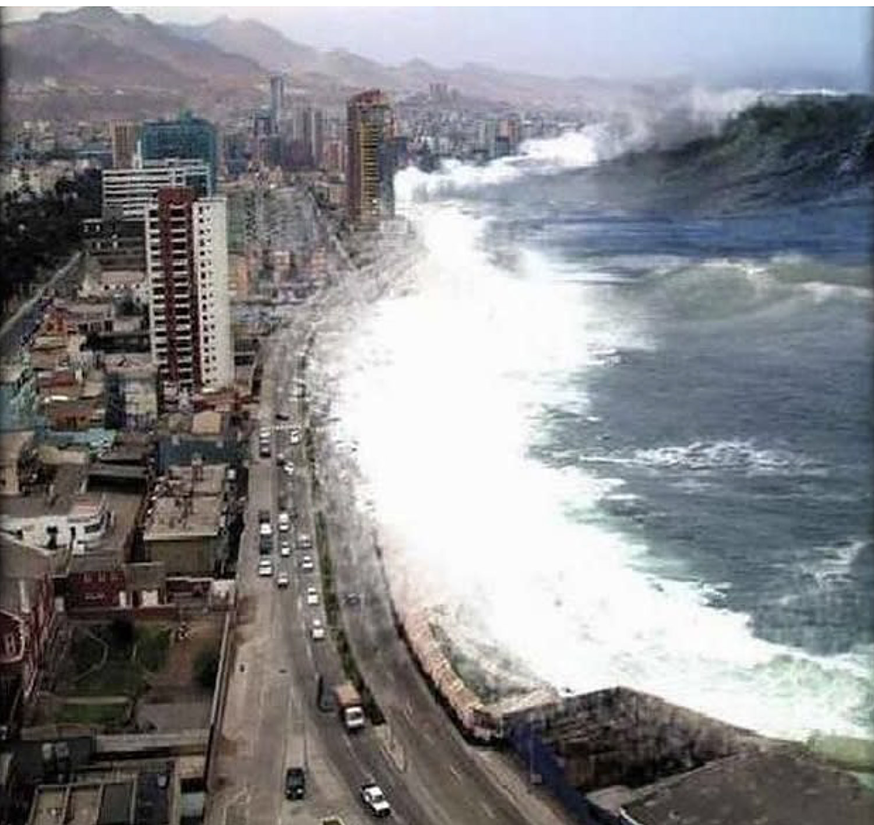
Fakes on social media
Here are some of the more famous fakes that went viral on social media.

