Slide 1
The end
Tips for mass media writers

Slide 2
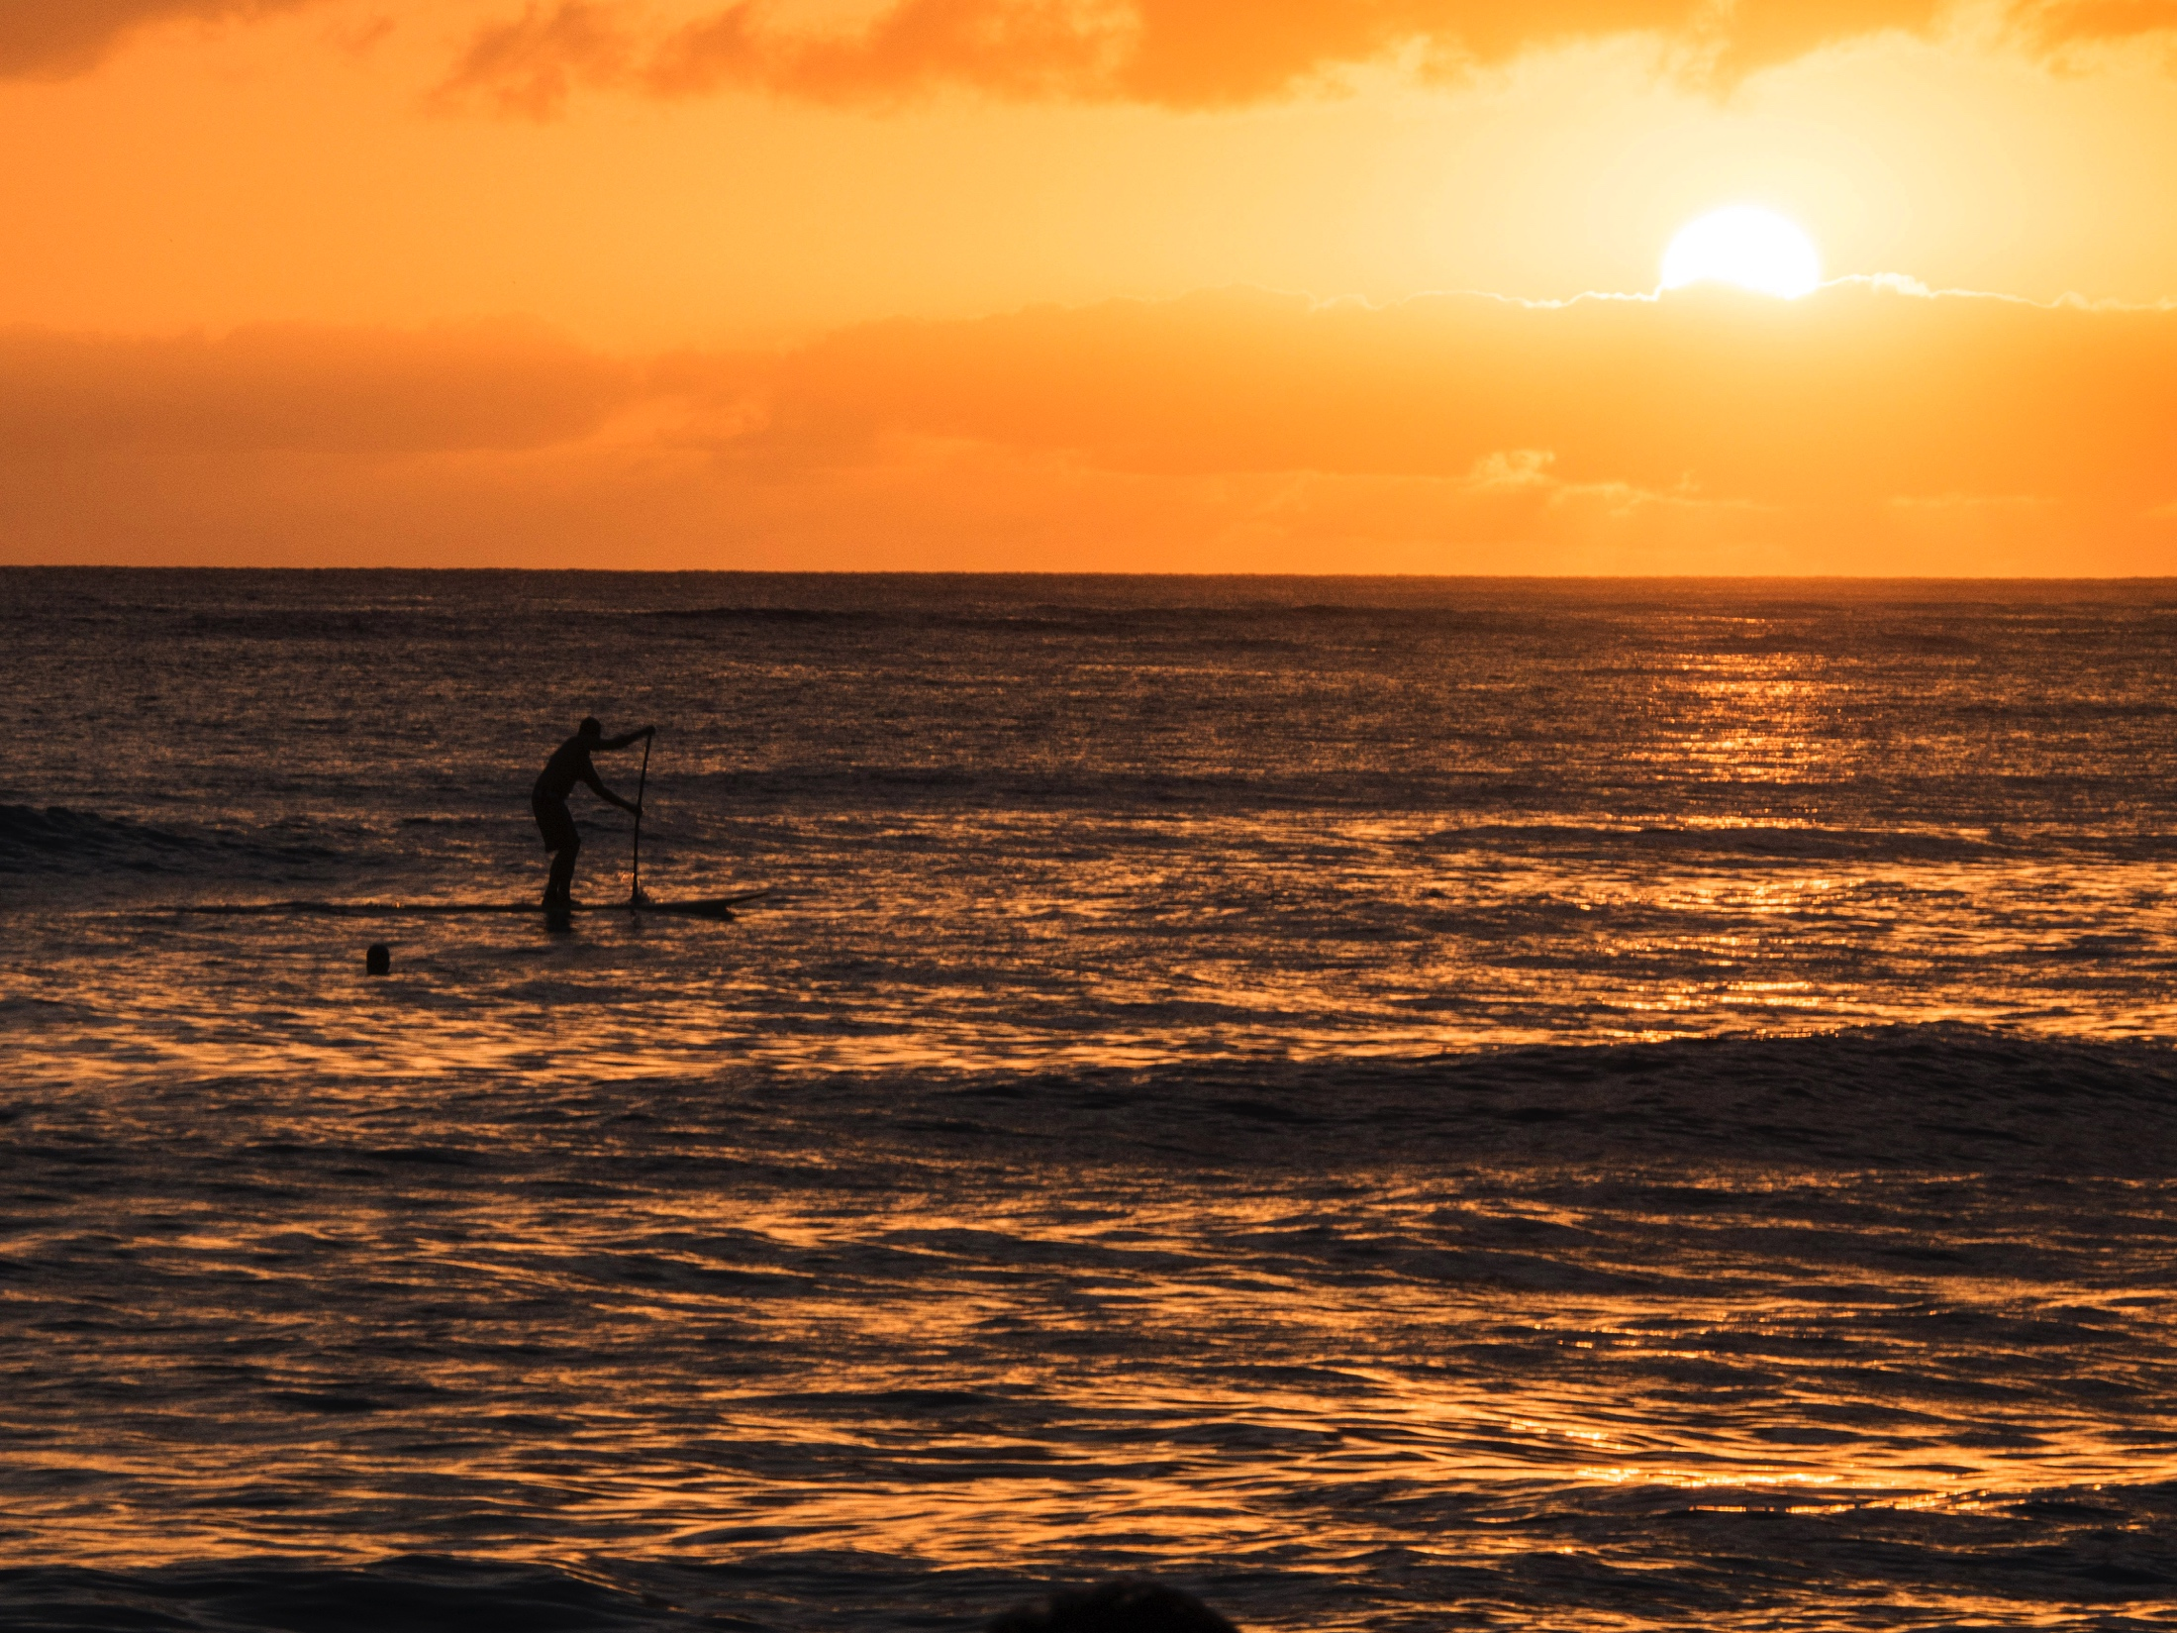
What about the end?
I talk mostly about leads, I’ll admit. Because if we don’t snag readers in at the beginning, you really don’t have to worry about an end, do we?
But what about those readers who actually stick it out with you for your entire story?

Slide 3
When to end
Actually, the reader my not stay with you. If you come up with expectations of an ending, but then don’t follow through, there’s a good risk a reader will throw away the rest in exasperation.
The old quote about the end is that, well, there’s nothing much to say about it, except that most writers don’t get there soon enough.
I’m not so sure about that, though….

Slide 4
The old I II III
In grade school many of us were taught formal writing by outline.
I. Beginning.
II. Middle.
III. End.
Subpoints could be indicated under each, such as IIa, IIb, etc. But we’d get back to the end sooner or later.

Slide 5
When would you get to Point III?
Well, you’d know it when you heard it. Such as:
“In sum,”
“To conclude,”
“Therefore,”
“What can we learn from this?”
So when we push the reader over to this direction, then, of course, formal writing would obligate us to reiterate our points and emphasize again what the reader needs to gain from them.
The bad thing about this is that the typical reader of mass media usually won’t get that far. When you reach the obvious conclusion, methodically laid out, he’ll have already skipped on to something less plodding.

Slide 6
Knowing How to end
So instead of that kind of boring wrap-up, maybe we need to consider something different for the end, just as we do for the beginning.
In fact, a good ending can not only be lively in itself, but it can help make more interesting the whole article above it.
People tend to remember the last thing they read—so if the ending is good, that’s what people may remember about your writing.

Slide 7

The perfect ending
It surprises the reader.
Yet it seems just right.
It brings the curtain down, metaphorically: someone says something funny or insightful, the lights go out, the curtain comes down, and wow, it’s over! Surprise!

Slide 8
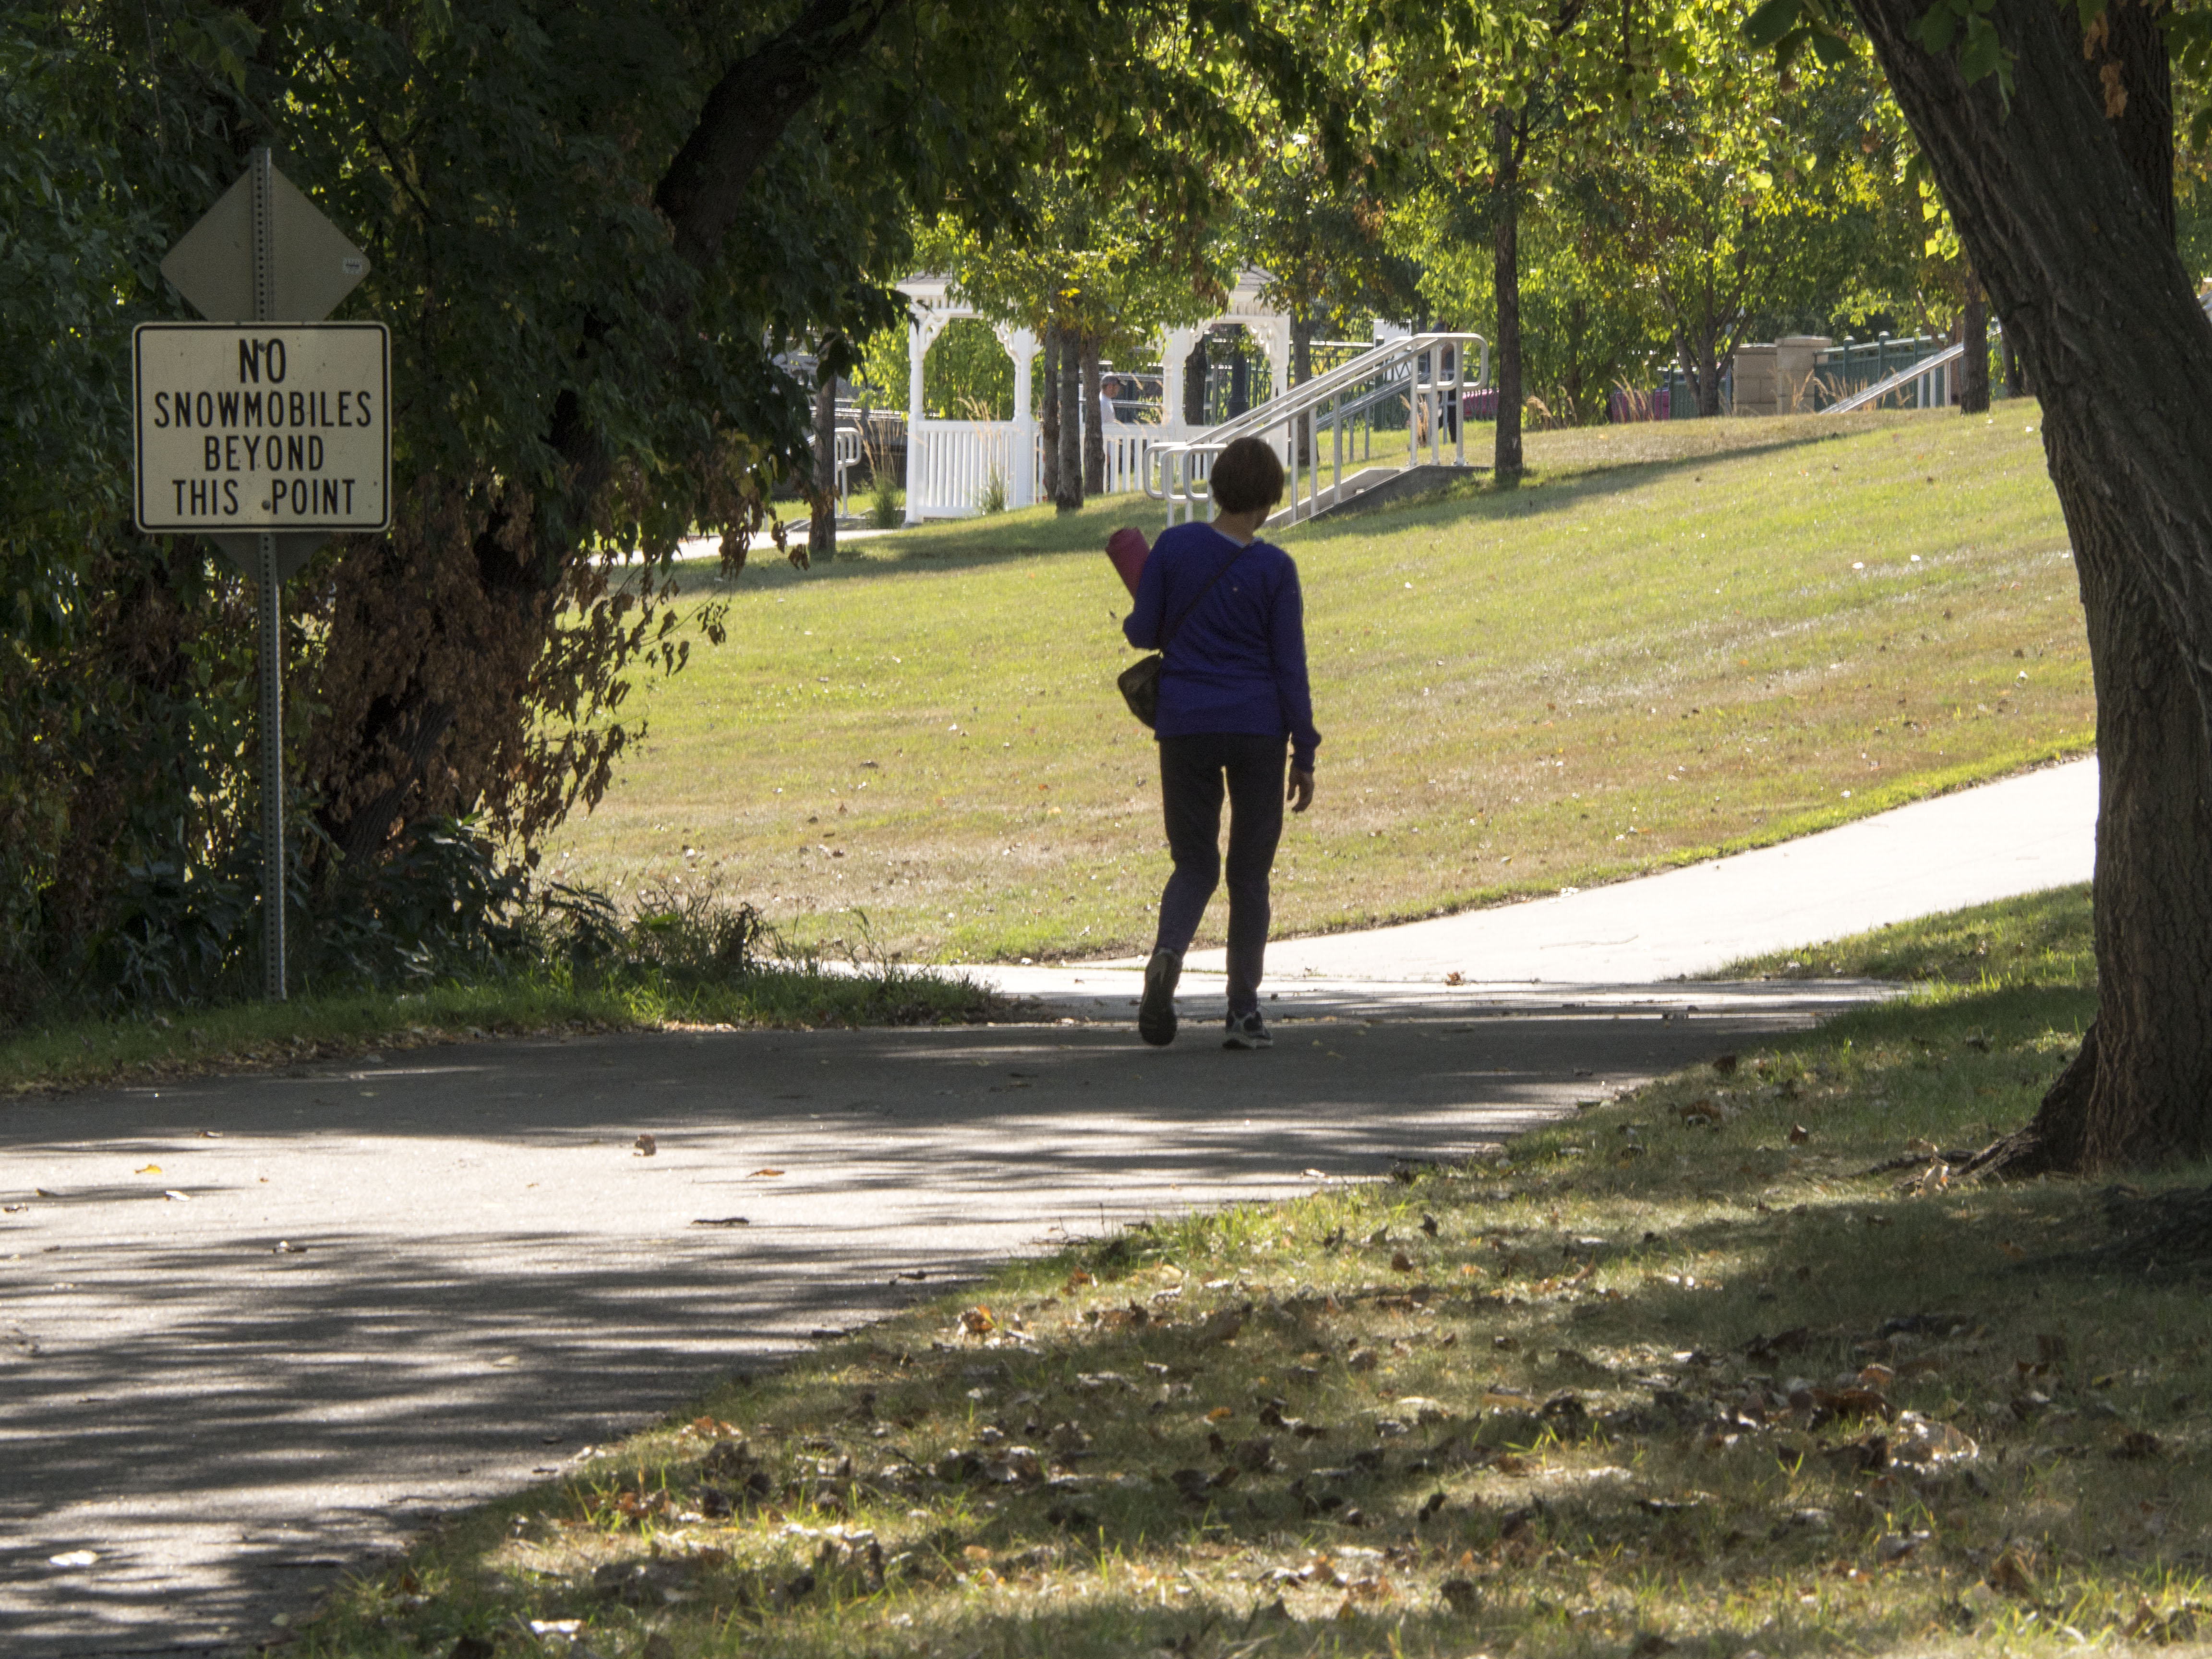
Rule number one for endings
When you’re ready to stop, stop.
How do you know when you’re ready to stop? You’ve presented the facts, you’ve made your point.

Slide 9
Finding the end: the quote
It will take you a paragraph or so to bring the reader to the end. Consider a provocative thought or funny line that seems to sum up.
Often that best ending will be a quote.
If such a quote jumps out as you go through your notes, mark it for later use.
If it doesn’t, go back and look for one.

Slide 10
Endings
A good ending, if we go backwards and read it first, ought to make reader wish he or she had read the rest of the story. Here are some examples:
“London has a phoenix quality,” she said. “It’s a generating city. Something will start happening.”
“I don’t talk about the camps,” said Wiesel. “None of us do. I had a friend from my home town; we studied together till the last day. I see him today, but we don’t talk about it. For one thing, there is the fear of not being believed, but mostly there is the fear that the experience will be reduced, made into something acceptable, perhaps forgotten.”

Slide 11
Endings
A question is asked that he doesn’t like. He laughs and answers, “You are on a wild-goose chase.” He seems pleased with that expression. He says it again. And again. “You are chasing wild gooses.” He smiles triumphantly.

Slide 12
Endings
One question strayed from the subject of music: As an early devotee of health foods, how did he feel about today’s food fads? He put up both hands and shook he head with a small smile. “Music,” he said, “Is all I am”

Slide 13
Endings
Alice Longworth can still laugh at herself and laughing at herself gives her license to laugh at others.
“When they start comparing you to the Washington Monument,” she says, “you just have to open your eyes and take a good look at yourself.”

Slide 14
Endings
To John Sexton, “the one good thing” about his lost years in the war is that it taught him to “really love life. I’m just so happy to be alive.”
But this is tempered by an aching sense of loss and impotence: “I want to accomplish something,” says John Sexton. “I just feel so wasted. I just feel wasted.”

Slide 15
Endings
One of the things they were putting away at lunch yesterday, in between the toast to peace, was bamboo shoots, which is also what panda eat. “Yes, but the pandas get fresh ones, and we can only get canned,” said one of the restaurant owners. The zoo grows its own fresh bamboo, “but they don’t market it to us,” she said.
And how did Dr. Reed eat in China?
“Oh, man. Oh, boy. Oh, wow,” he said.

