Slide 1
The personal essay
For mass media writers

Slide 2
A flexible writing format
The personal essay as way to record thoughts and reflections on life has been part of writing for centuries.
It is adaptable, able to accommodate all kinds of subjects and stories.
It helps us to think through our experiences in life and the lessons we have drawn from them.

Slide 3
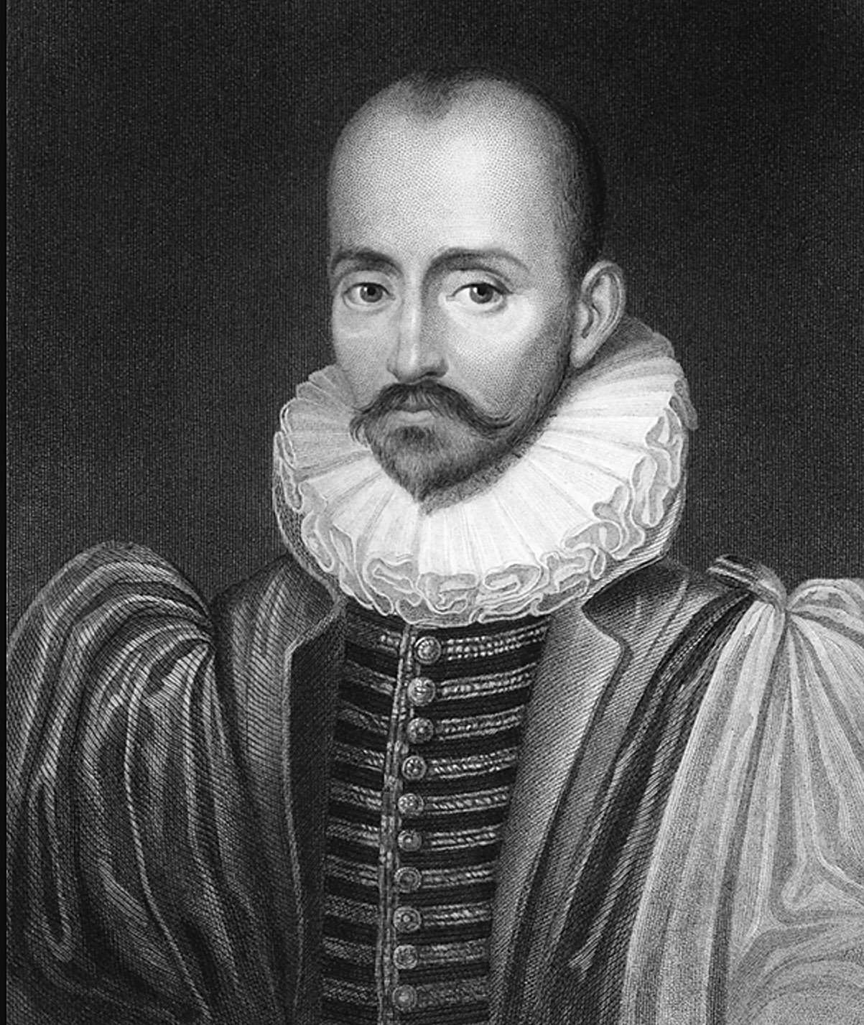
Experience
The personal essay may be anything from Montaigne’s timeless observations from the past, to the weekly National Public Radio feature entitled “This I believe.”
The idea of a personal essay is to connect an experience you have had in your own life, and to find a larger truth in it that you can communicate to readers.

Slide 4
Life experiences
By the time we have walked the earth for two decades or more, we have plenty of life experiences.
Certainly we all can consider some that have clearly changed or enlightened our view about life and our place in it.
A personal essay gives us the opportunity to talk about that life experience, what it means to us, and what it may mean to a reader.

Slide 5
This I believe
NPR was not the first broadcast company to introduce “This I believe.”
The format was developed at the dawn of television.
Edward R. Murrow introduced the idea in the early 1950s. People from a variety of backgrounds, famous and not, would offer their own personal essays on broadcast.

Slide 6
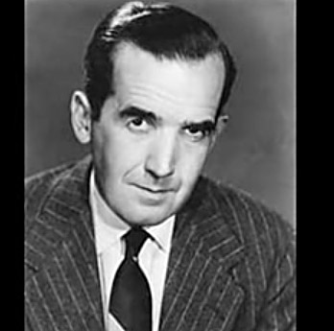
Murrow, “This I Believe”
Of course, few of us have the depth and observation of Murrow, but here is how he explained the series. https://www.youtube.com/watch?v=FMNw7M-eUdU

Slide 7

NPR’s version
NPR resurrected the series to offer similar opportunities to everyday people. You may have heard them at one time or another if you listen to its news broadcasts.
They may be inquisitive, uplifting, sad, gritty, inspiring, terrifying, or just informative. But they are always insightful. Here is an example. https://www.youtube.com/watch?v=9JUhH-Pp43w&index=1&list=PLRUrHr5BJ6uWgRTw3VuV6vCsFPNToewyO

Slide 8

Exercise: This I believe
Writing opportunity: Compose your own “This I believe” personal essay.
Begin by considering an event in your life that has led you to consider yourself or the world around you in a different way.
It may be one specific thing, or just a growing awareness that changed or helped to forge your beliefs or your opinion about life.

Slide 9

This I believe
Try to avoid clichés, platitudes or dogma, as Murrow advised.
Avoid relying on what someone else has told you, unless you have forged that advice through the fire of actual experience.
Avoid reliance on authorities. You are the authority.

