Slide 1
Humor writing
Your secret weapon

Slide 2
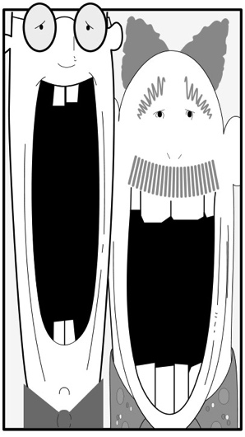
Humor in nonfiction
Often we don’t realize that the best way we have to make a point is by writing humorously.

Slide 3
The paradox
The odd thing about this idea, that humor may be the best way to get your point across, is that it is a serious idea to be funny.

Slide 4

The lightweights
Because it seems odd to take humor seriously, a lot of us don’t.
We dismiss humor writers as lightweights who don’t need to be taken seriously.
The Pulitzer prizes don’t often go to the funny people, but to the serious ones.

Slide 5

Not funny to be funny
But good humorists are not necessarily fooling around.
They are trying to make serious points.
They help us see ourselves or our society in another way, and more clearly.

Slide 6
One cartoon, one book
Humor as cartooning can be more influential than a thousand words of editorials.
One satirical book can be more influential than a dozen sanctimonious ones.
Catch-22 can help us learn more about war for being satire.

Slide 7

The joke is no joke
The joke of a lot of humor is really no joke at all—for example, Catch-22 seriously tells us about the absurdities of war.

Slide 8

The crazy truth
The heart of humor writing is to highlight some crazy truth about society or an issue.
One way of writing a humor article is to begin by noticing an odd trend in society.

Slide 9
Odd trends
What strikes you as peculiar, amusing, unusual, a fad or trend?
It may be people’s obsession for selfies.
It may be hair or clothing styles.
It may be ways of looking at history or our present day.
It may be bizarre ironies.
If we take a humorous approach, we can encourage people to think in a different way.

Slide 10
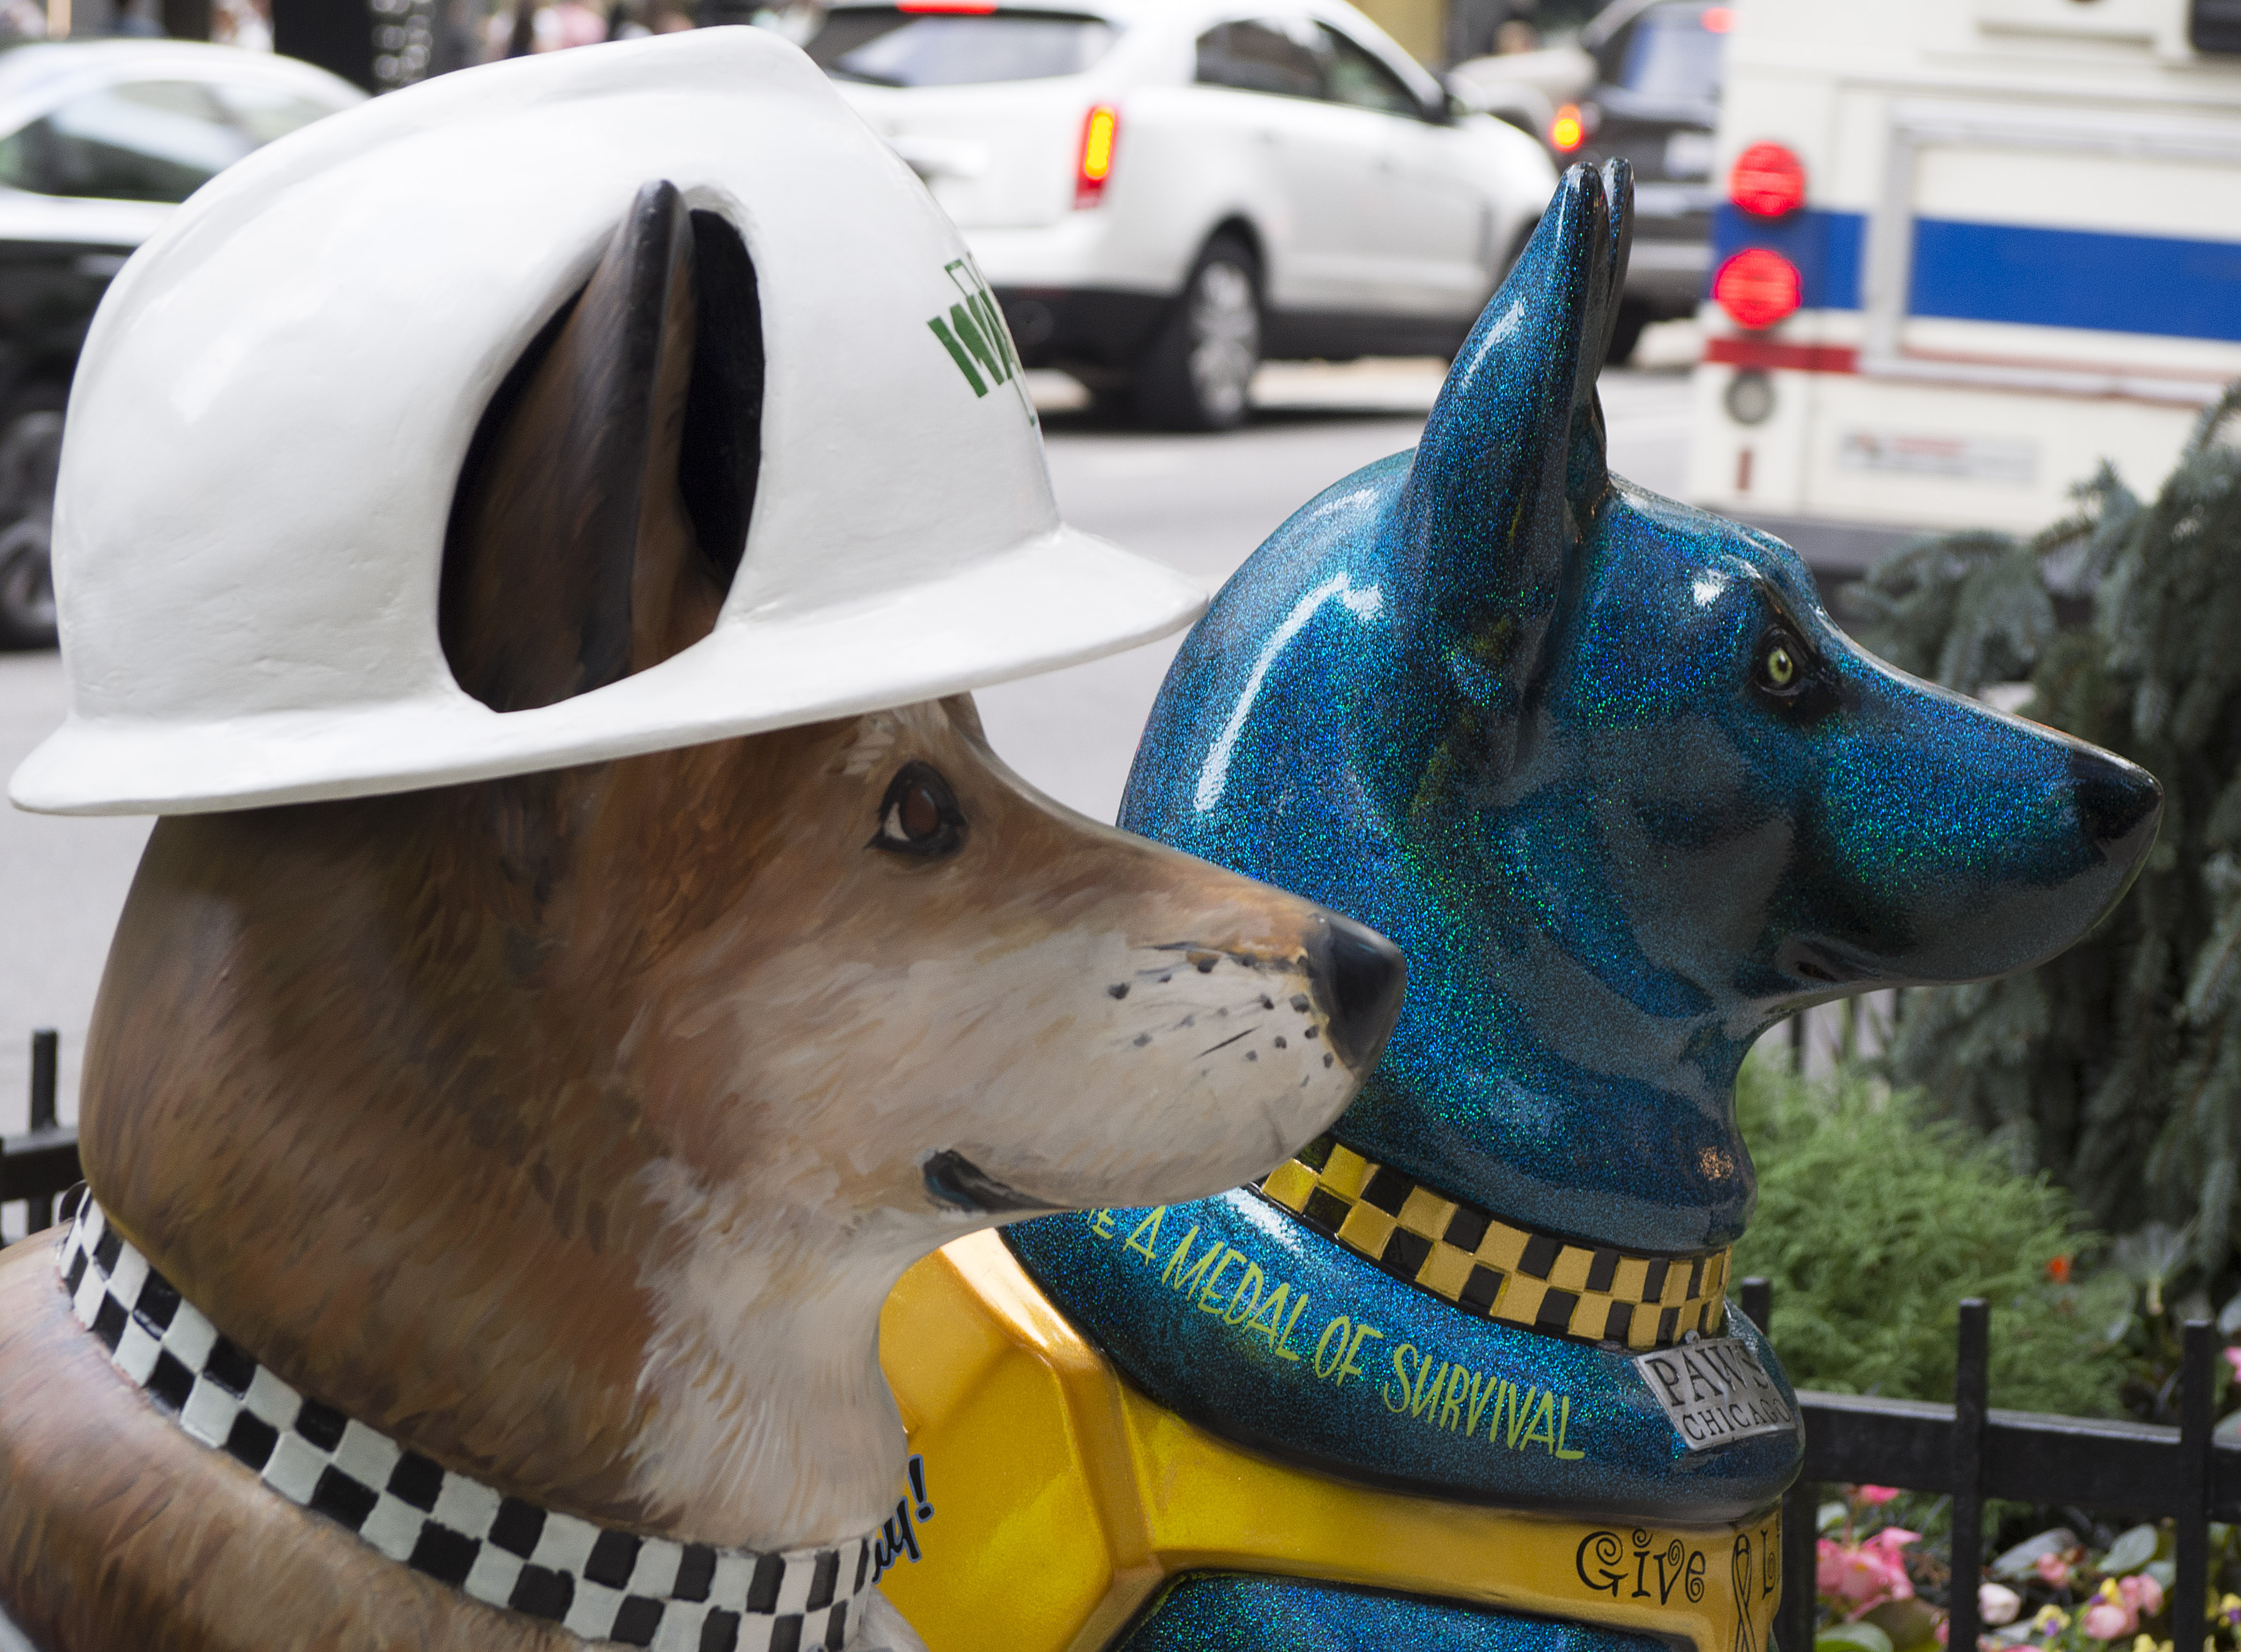
Humorous ideas
What seems odd about our contemporary society that might make a good humor article?
Popularity of tattoos?
Contemporary hair styles?
Obsession with smartphones?
The bizarre habits of social media?
What people are snacking on in class nowadays?
Hammocks on campus?
Fidget spinners?
Funny hats?

Slide 11
Humor and parody
Humor might be parody if it makes fun of a supposedly serious but amusing situation.
We could write a parody of political debates by making the characters in student senate talk like Donald Trump or Hillary Clinton.
We could write a parody of a mass lecture class by counting the instructor’s mannerisms or student yawns.
We can write a story of stupid Baby Boomer advice.
I read one of those lately. The best one was this: “My father told me he started from nothing and look where he is today. I told him I would LOVE to start from nothing. Instead, I’m starting with $40,000 in student loans.”

Slide 12
Control
Good humor is controlled.
Don’t use silly names. Sounds far-fetched.
Don’t say the joke more than once, even if you really like it. It loses its power.
Trust your readers’ sophistication—even if not everyone will get the joke.

Slide 13

Good humor
Good humor writing should make people laugh—but should also have a purpose. The purpose is often this:
“Something really weird is going on here, maybe a threat to our quality of life, or our life itself, and yet everyone thinks it’s normal.”

Slide 14

Relevancy
Humor most often is tied to current events or trends, and those change.
But that also means you’ll always be able to find new material.

Slide 15
Power
Humor has power where serious nonfiction doesn’t move people.
The pompous and the powerful have been dragged down oftentimes by the satirists.
We see this not only in published humor, but the power of satire among television commentators.

Slide 16

Against the grain
But people who write humor need courage—courage to go against prevailing wisdom.
They state what the population or the leadership doesn’t want to hear. And that can be risky.

Slide 17

Lonely
As Zinsser wrote:
“It is a lonely and perilous calling. No other kind of writer risks his neck to visibly on the high wire of public approval.

Slide 18
Problems of the heart
Not all humor addresses problems of the times. Some addresses universal problems related to challenges of life, from childhood traumas to dating to old age.
Humor can be found within the absurdities of many of life’s challenges.

Slide 19
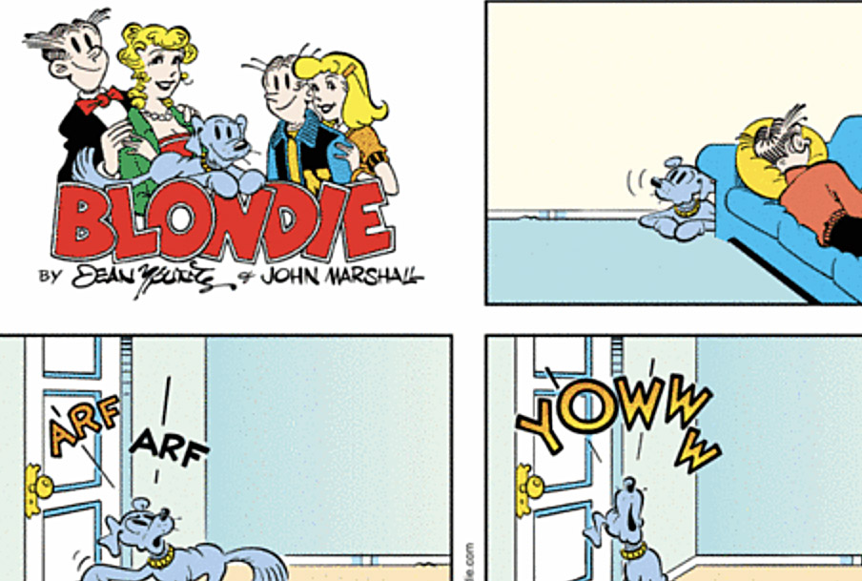
Simple themes
The creator of the comic strip “Blondie,” which has been around for 70 some years, is still popular.
It’s creator said the popularity is based on its simplicity: It’s built on four themes that everyone understands
Eating
Sleeping
Raising a family
Making money

Slide 20
Fundamental truths
Much humor writing is based on fundamental truths.
It’s not usually about life that’s basically ridiculous.
It’s about life that’s basically serious, but contains some irony or strange twist.

Slide 21

Principles
Humor writers are good writers first, and can write a great serious story as well.
Humor writers usually don’t reach for the outlandish and crazy. Instead they find something that we can identify with, and find something funny in it.
Humor writers don’t work too hard for a joke. The fun is to surprise your reader.

Slide 22
What is funny?
Humor, as we all know, is in the mind of the reader.
What one person will find funny another person will not.
An editor will reject humor saying, “it’s just not working,” while another will accept, saying, “this is hilarious.”
It is hard to explain in some humor writing exactly what makes it funny.
And as we know, something that’s funny to one generation is not funny to another.

Slide 23
Ideas
Some humor is a parody on a familiar story or daily news. “The Onion” often works in this way.
Some humor is based on the personal experience of the writer, the “has this happened to you?” story.
Some humor is based on a fad or trend in society, such as enthusiasm for tattoos, smartphones or flip-flops, academic advisors or meetings. (It’s really easy to find humor at a university, I think!)
Some humor is based on the silly ironies of society.
Most humor works because it surprises the reader, and is about something he or she can identify with.
We don’t have to try to make every line funny. Hard to do!

Slide 24

Humor without the I
While humor writers often do write heavily in the first person, often as well it’s a good exercise to see if we can write something funny without that “I.”
The challenge in that is to climb out of ourselves and look around for material.
A lot of us are so me-obsessed that we find that hard to do!

Slide 25
Exaggeration
Humor, at least in this class, is nonfiction. But the line is less clear when we are writing something (we hope) will be funny.
How far can we go in exaggeration?
How much to we have to explain a funny point so that readers get it?
Can we write something that is untrue just to get laughs? For example, can we ridicule ourselves for being a terrible athlete when in reality we are not?

Slide 26
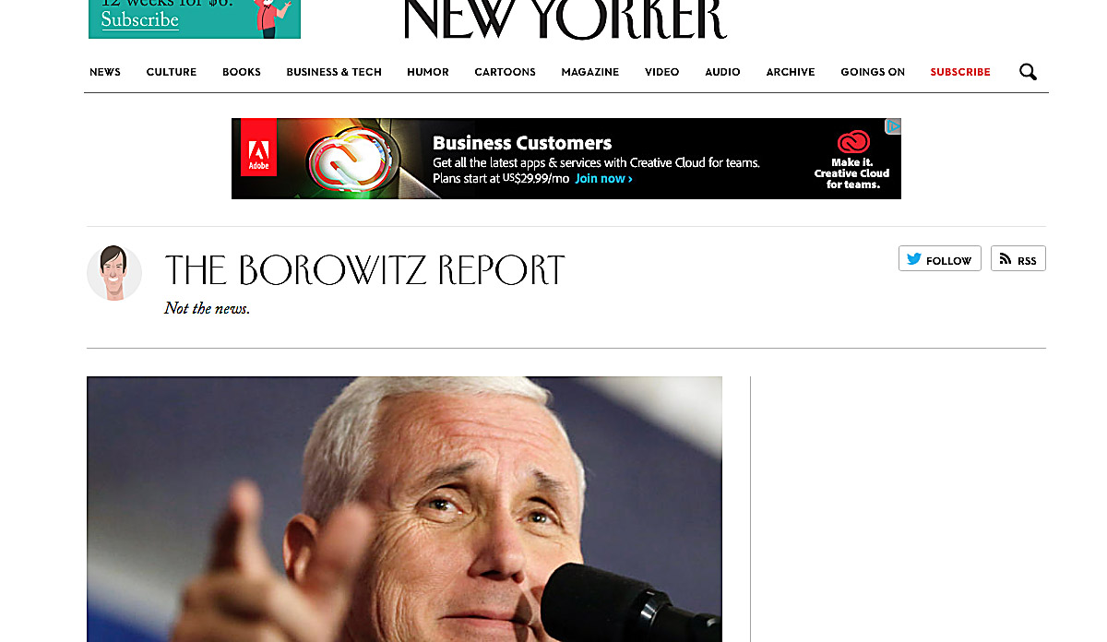
Borowitz
One of my favorite satirists writing today is Andy Borowitz of the New Yorker.

Slide 27
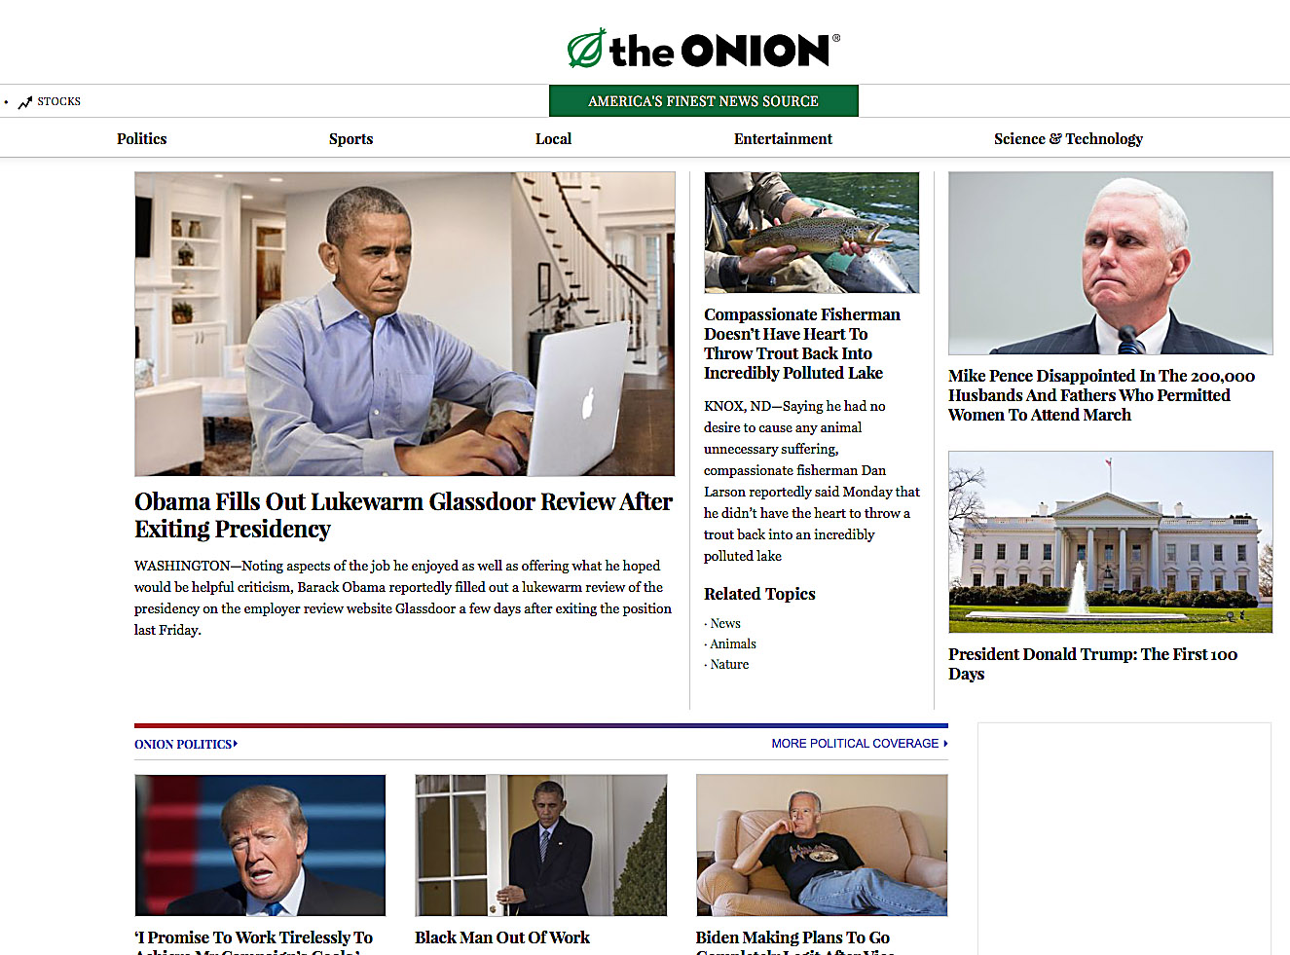
The Onion
More inspiration from The Onion, a spoof news site that has been around for a couple decades, first in print form, and now online.

Slide 28

Possible topics
Assignment: write a humorous article about a common experience or observation in society.
Topics may include:
Smartphones.
Weather.
Clothing and hair styles.
Baby Boomer advice to millennials!
Behavior of students in class.
Behavior of instructors in class.
Coffee shops.
Other possibilities?

