Slide 1
Interviews
How writers in mass media get their information

Slide 2
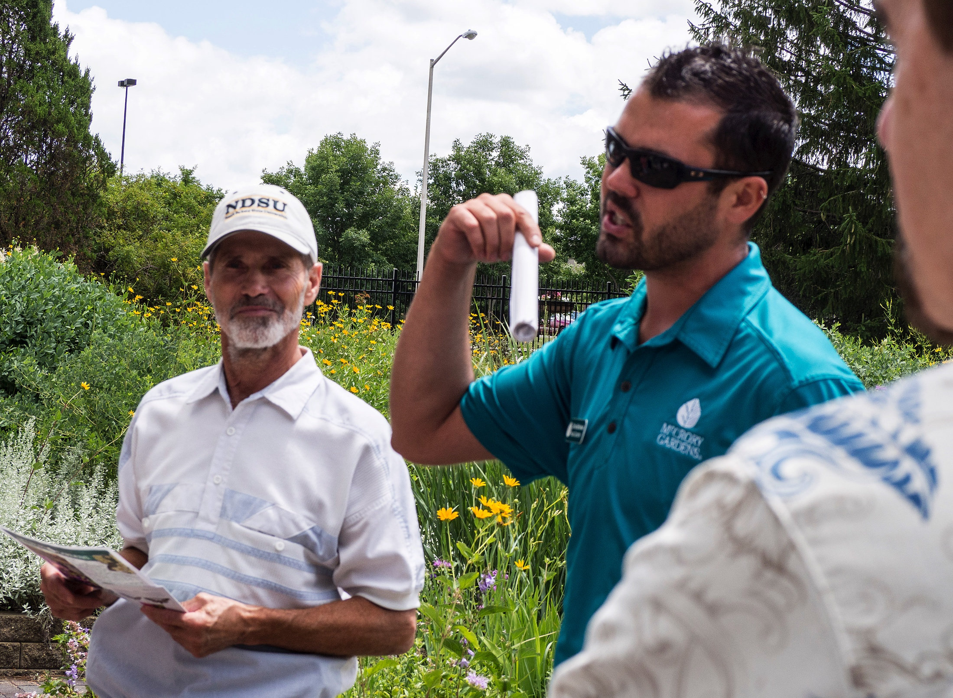
Getting people talking
It’s usually more lively to get people to say things in their own words, instead of writing it for them.
The sources will include their own quirks, regionalisms or trade words that make her or him distinctive.
They convey enthusiasm.
They speak directly to a reader, instead of going through the filter of the writer.

Slide 3
Gathering words
To gather these words, you need to interview people.
“Quotes,” as we call them in the media, can bring to life a story that otherwise is so dull we fall asleep even as we’re writing it.
You have your institutional histories, your nonprofit annual meetings, your city commission public utility committees….
How to make them interesting? How about looking for the human element?
“Journalism is about people doing things.” And also saying things.

Slide 4
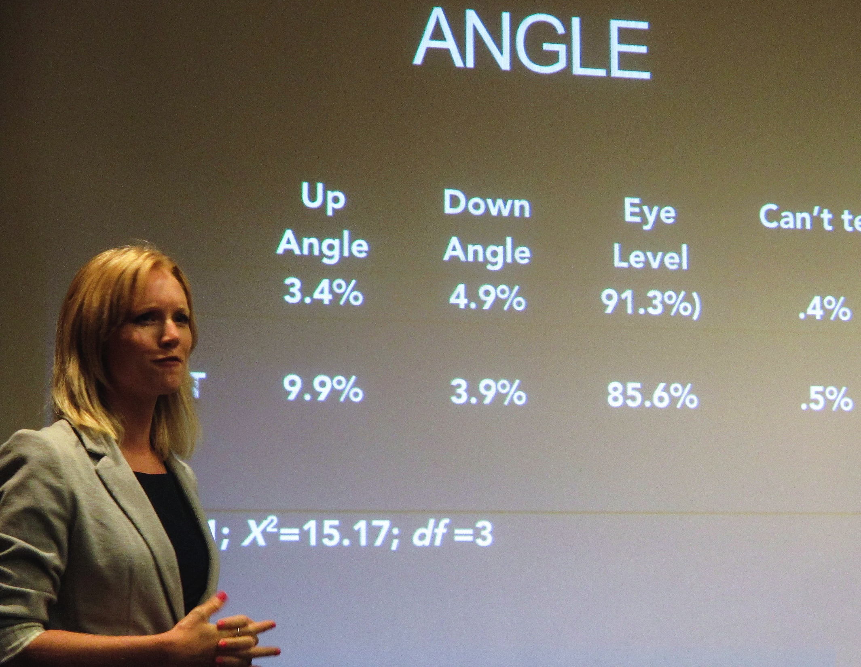
Who’s behind the issue
People are passionate about their interests, even if we may not be:
The chair of the public utility committee has a future in politics hanging on the power line she wants to install.
At the same time, the homeowner is just as passionately opposed to new power lines invading her neighborhood.
Find these people, and your story will not be boring.

Slide 5
What’s behind the bland
Some years ago I was assigned to write a story about neighborhood grocery stores. Many were closing as city customs changed.
I thought this was going to be a boring story. But I was wrong.
I talked to owners, patrons, former owners and families, and found passion and sorrow behind the changes. I found out how one little store owner kept his own meat market for the neighborhood. How another kept a whole wall with treats for the kids. How a third served generation after generation of college students—and what she thought about them.

Slide 6

Talking to people
Instead of boring, I found out this was a story about changing life in the city.
But you have to talk to people!
The information you need is stuffed into most people of age and experience. Your job is to squeeze it out.

Slide 7
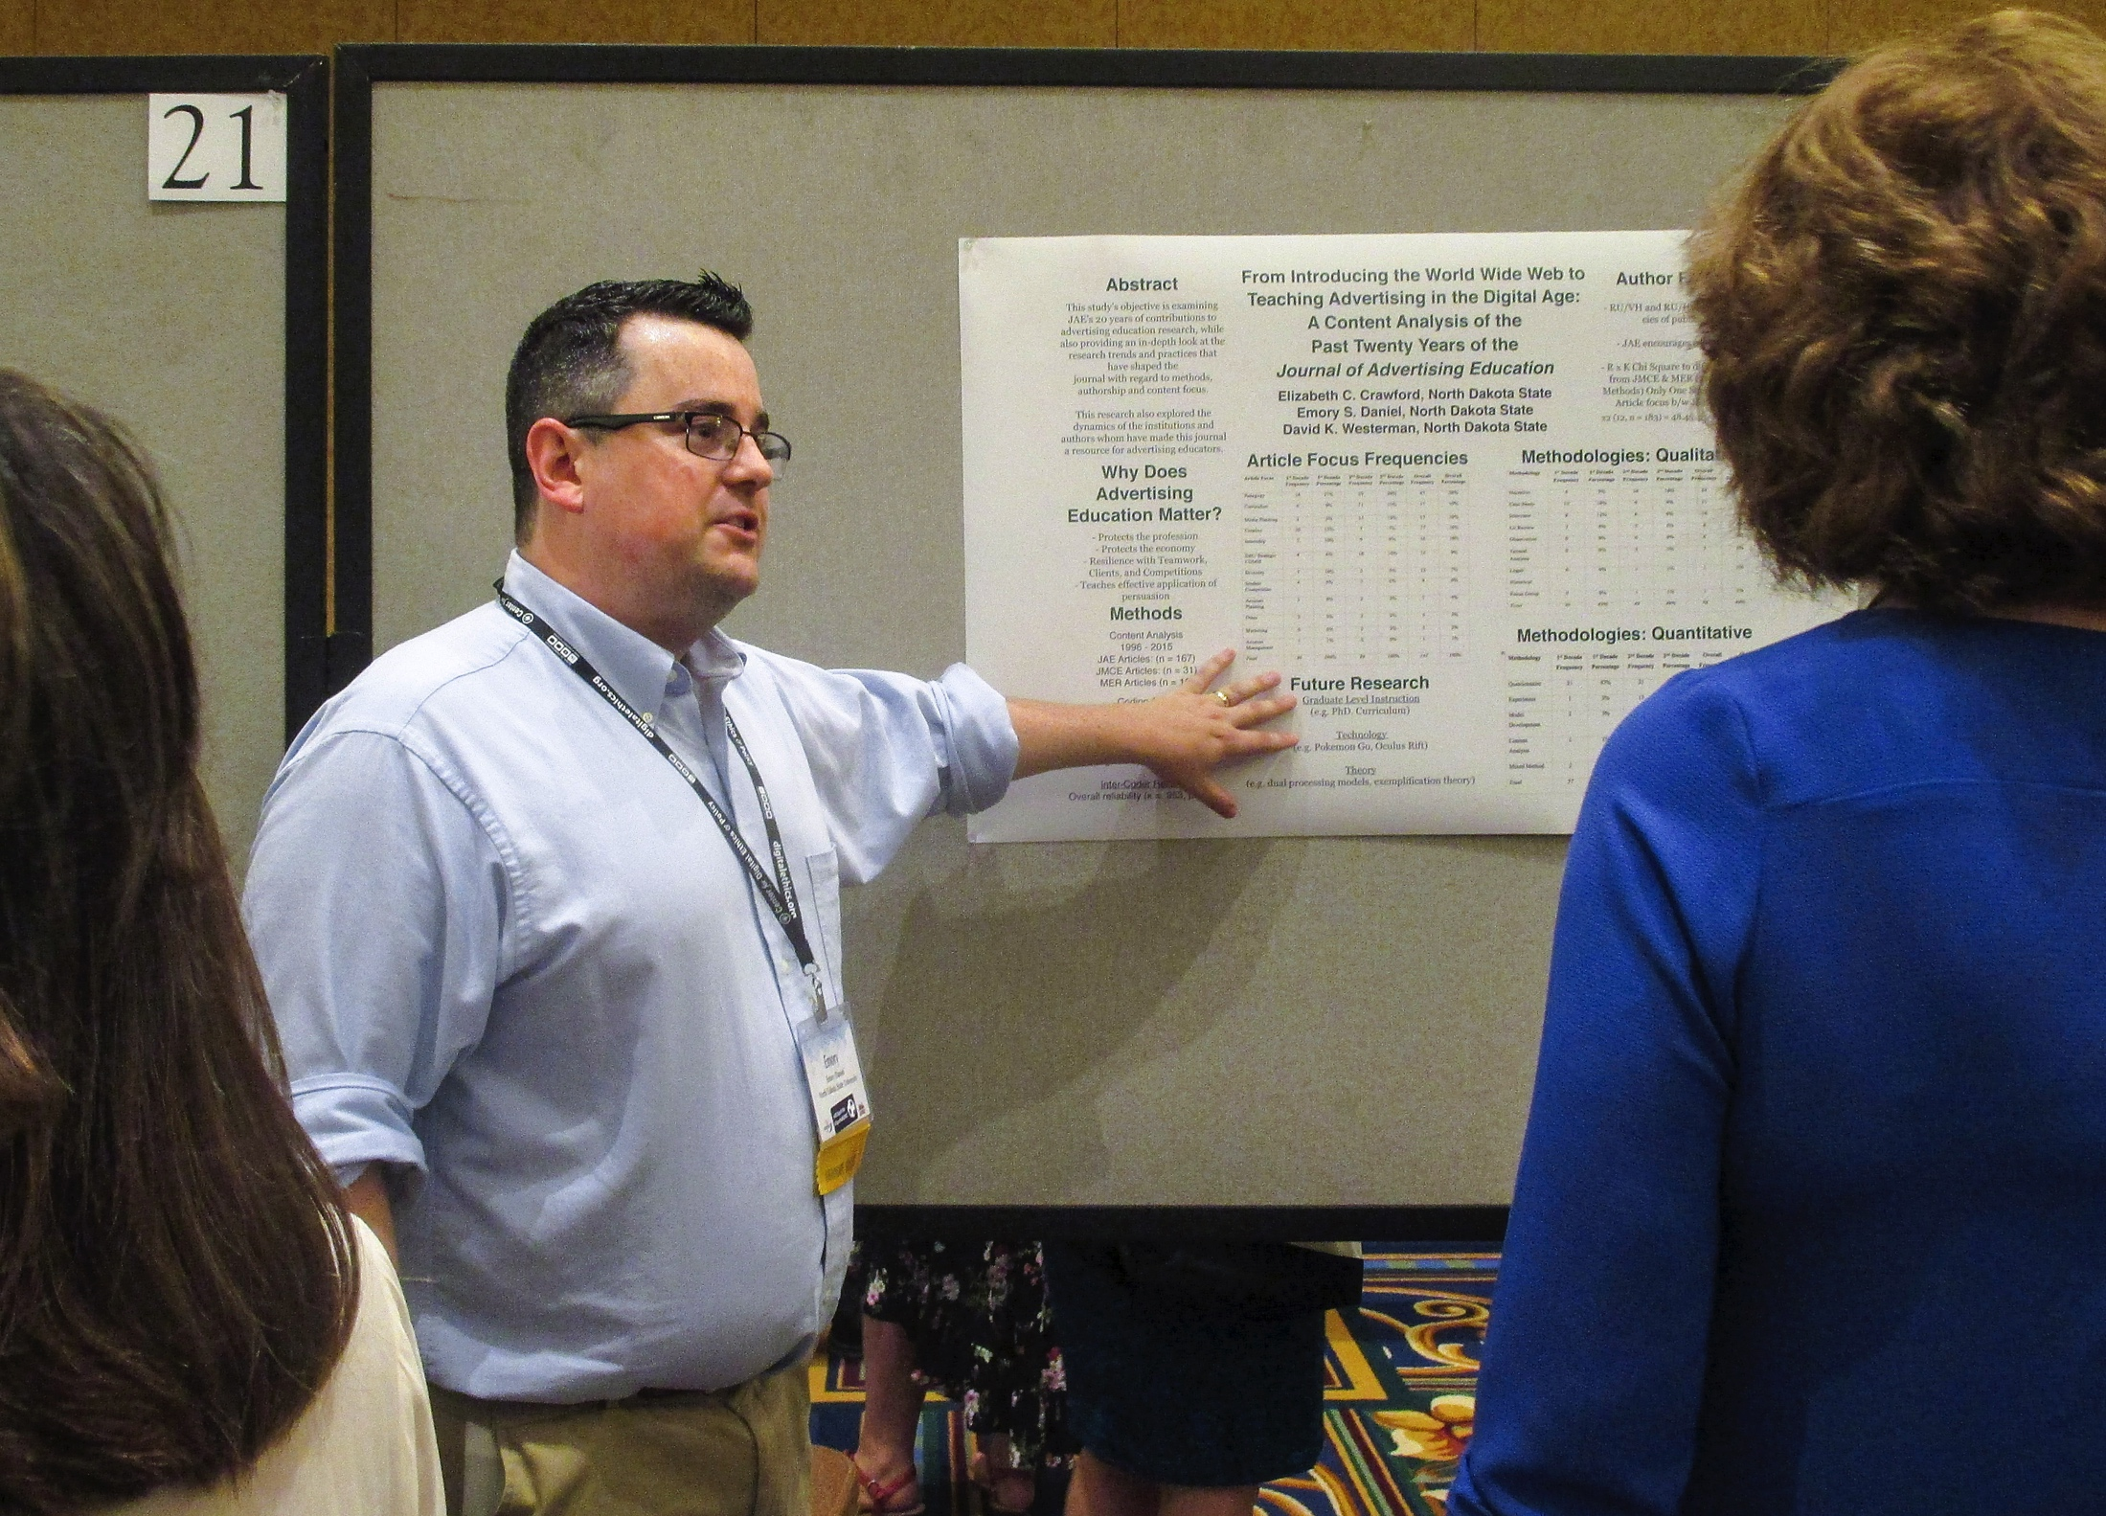
Getting the information
In journalism people get most of their information from interviews. This is in contrast to academic research, when, unless it’s a panel or oral history, usually the writer doesn’t interview people in an open, wide-ranging manner.

Slide 8

Choosing a subject
We can’t predict sometimes who will make a good interview.
We can’t always assume it will be the most important person, like the president of the university.
It might be the coffee counter lady—and depending on the story, that person might be the best interview.
We try to chose someone who is likely to know something and wants to talk about it.

Slide 9

Interviewing skills
Most people don’t start out with highly developed interview skills.
Most of us are nervous when we’re just getting into the interview experience.
But it’s also possible to get too comfortable, and avoid prodding or asking difficult questions that need to be asked.

Slide 10
Taking notes
The best tool for interviews is still a notebook and a couple pens.
You may wish to record an interview. It’s not a bad thing.
But most people find it less time consuming to take notes, and back up with the recording.
You’d be surprised at how many writers “interview” people with no method beyond their own memory to record the interview.
This pretty much guarantees you’ll have no actual quotes, unless your memory is superhuman. (Which sometimes is true. But I wouldn’t count on it.)

Slide 11
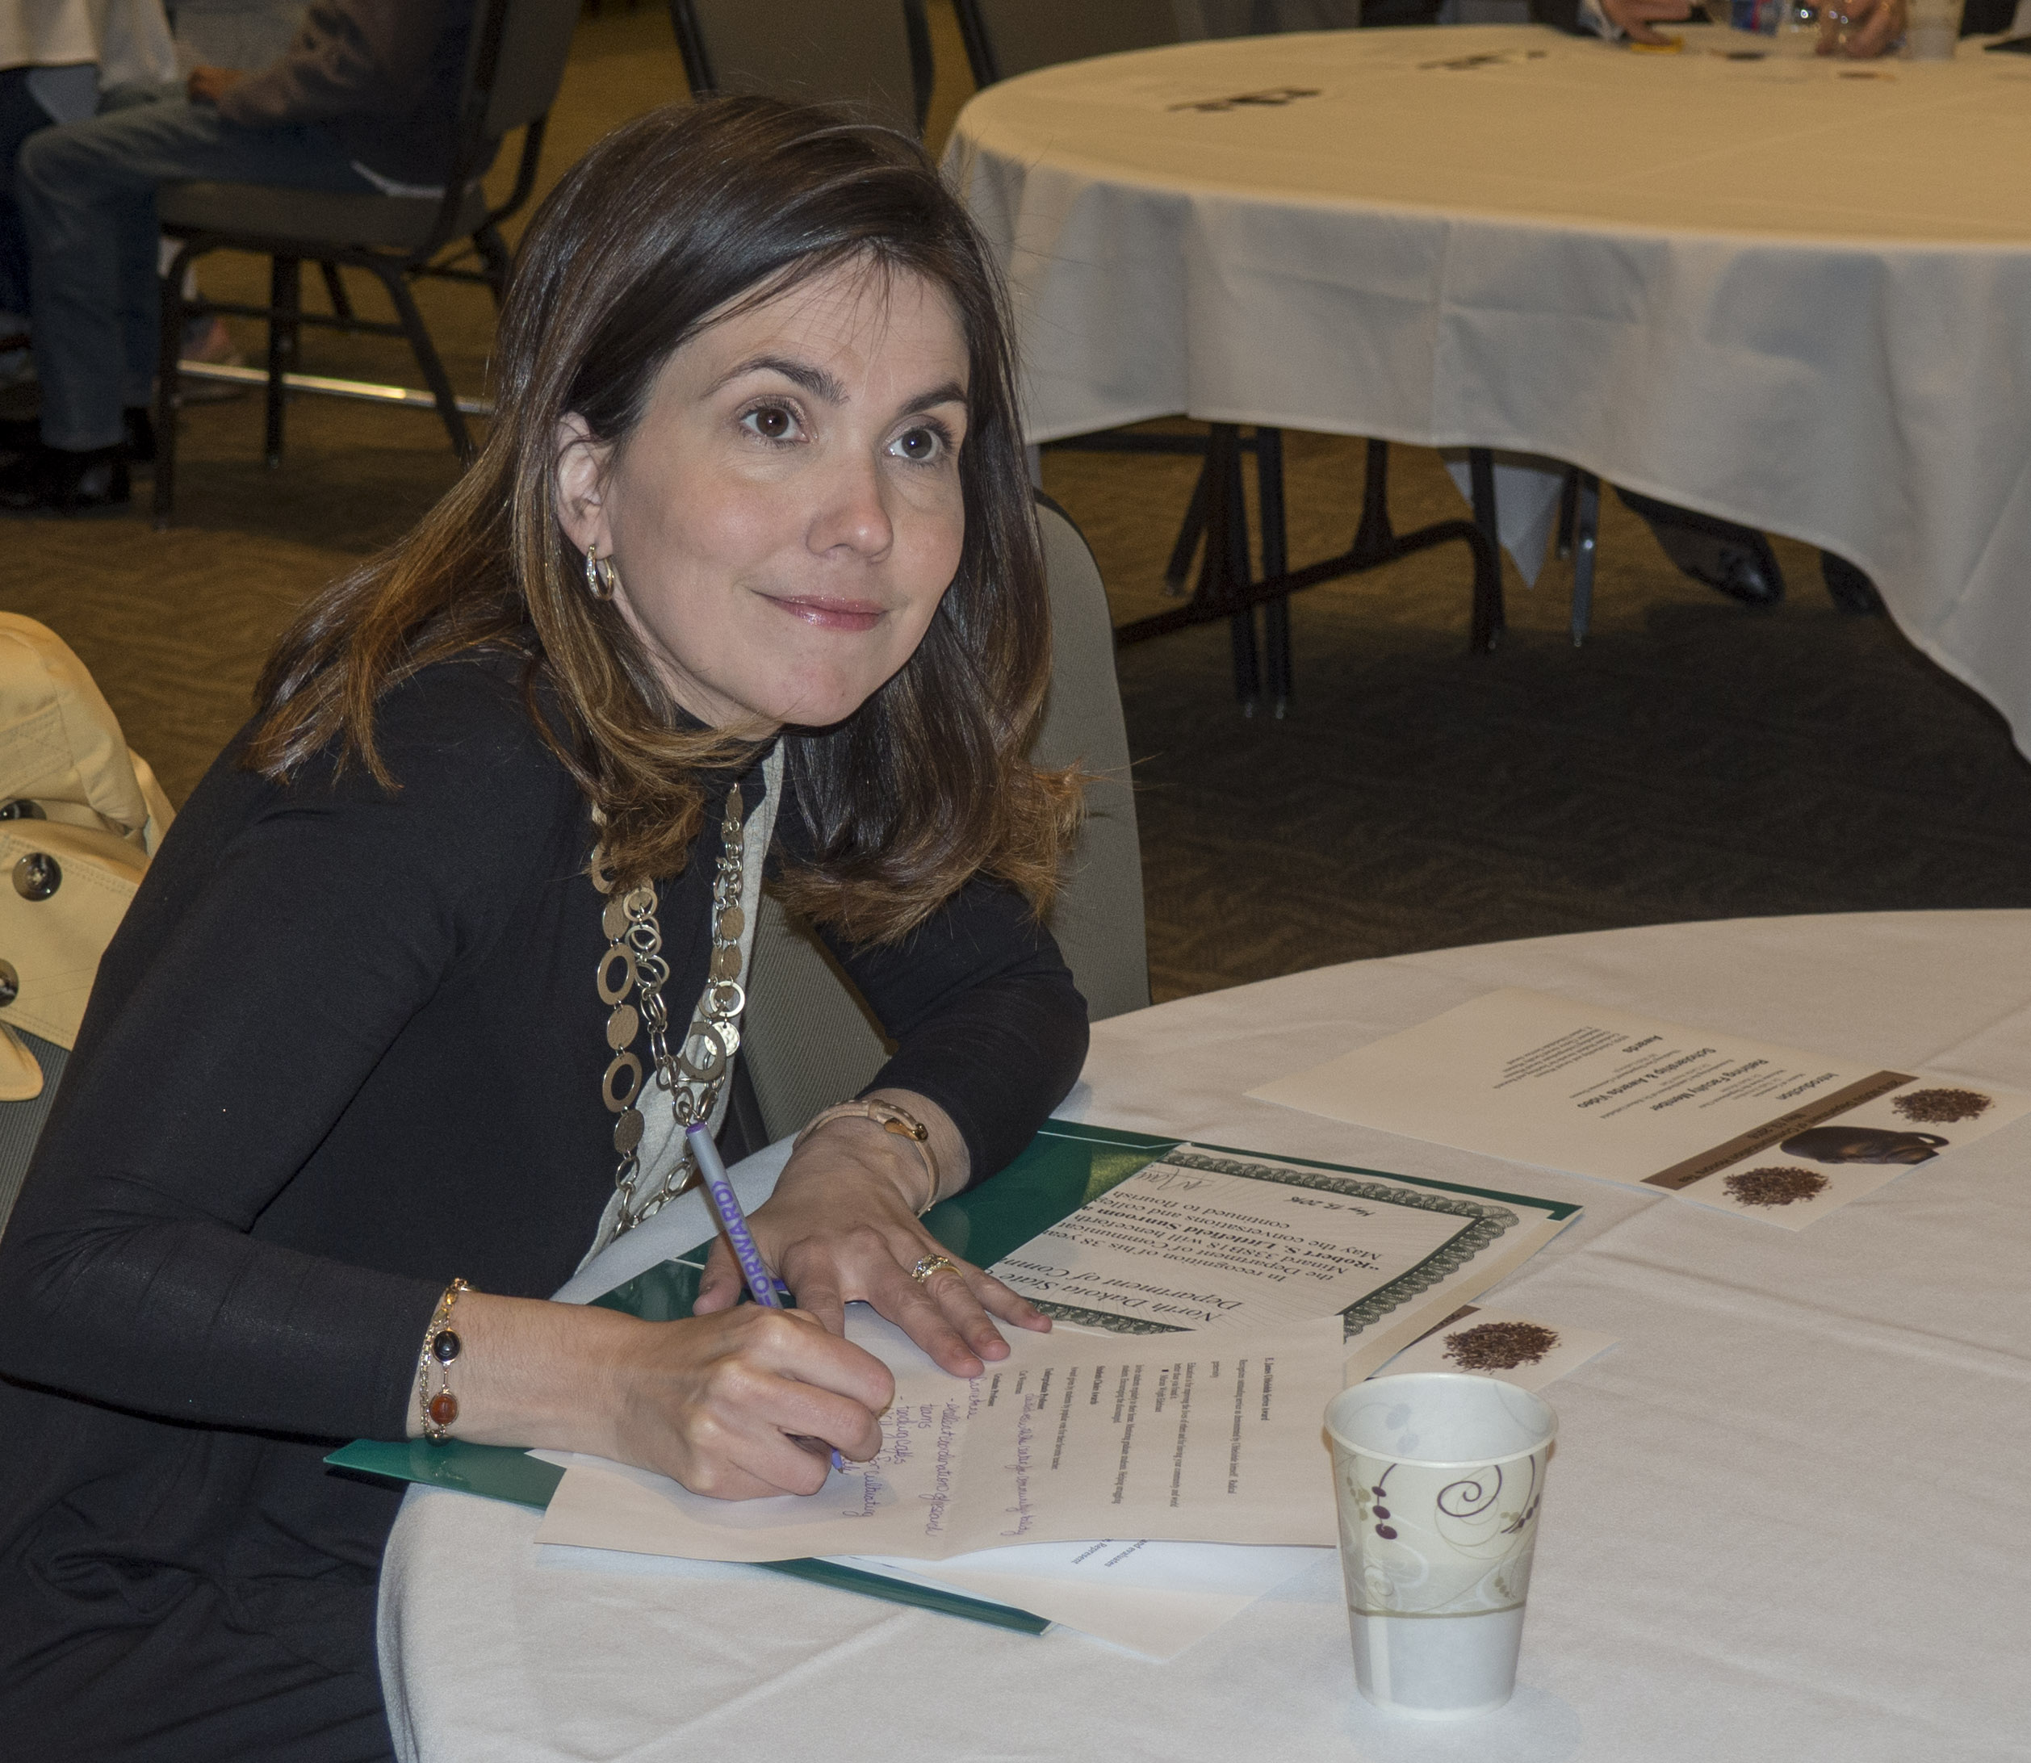
Notes
For me, taking notes makes writing easier, because it is an act of writing.
The words go through you and onto the paper. Even if subconscious, to me they seem to leave a trace that helps you to reflect and compose a story.
Of course, you have to learn to write fast to take notes. Most experienced reporters have their own sort of shorthand.
If the person is talking to fast, it’s okay to ask for a repeat or slow down.
If often write partial sentences, then complete them as soon as the interview is over, when I still remember.

Slide 12
Transcribing
Whether notes or tape, the next step is to transcribe what the person said.
You’ll be able through this process to review and choose those comments that best help you to write your article.
A lot of it isn’t going to work, will be repeated or boring. But it’s your job to distill for the reader the best of what the person said.

Slide 13
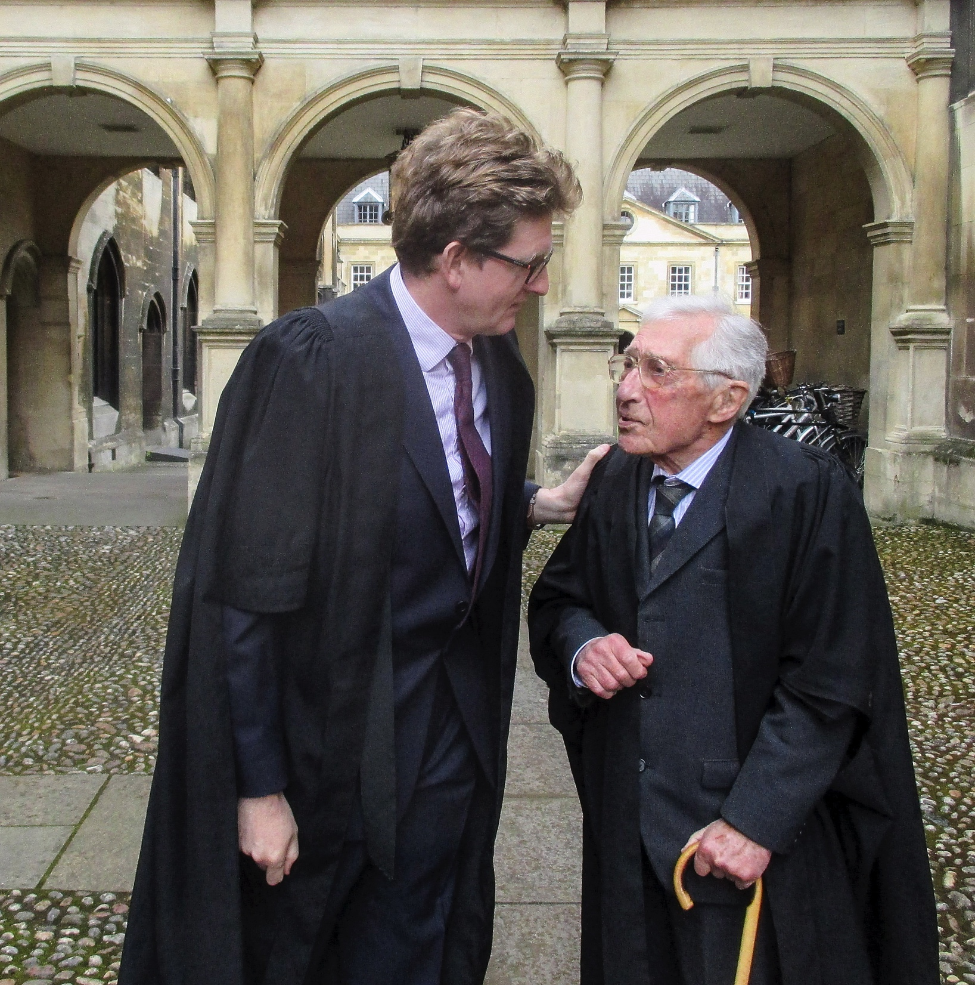
Be prepared
Always have a couple of pens or pencils and a notepad.
You may think you’ll record everything, but technology has a habit of failing when you most need it.
Most reporters keep the notebook out of site until they’ve chatted a bit with the source to help gain trust and encourage both you and the source to relax.

Slide 14
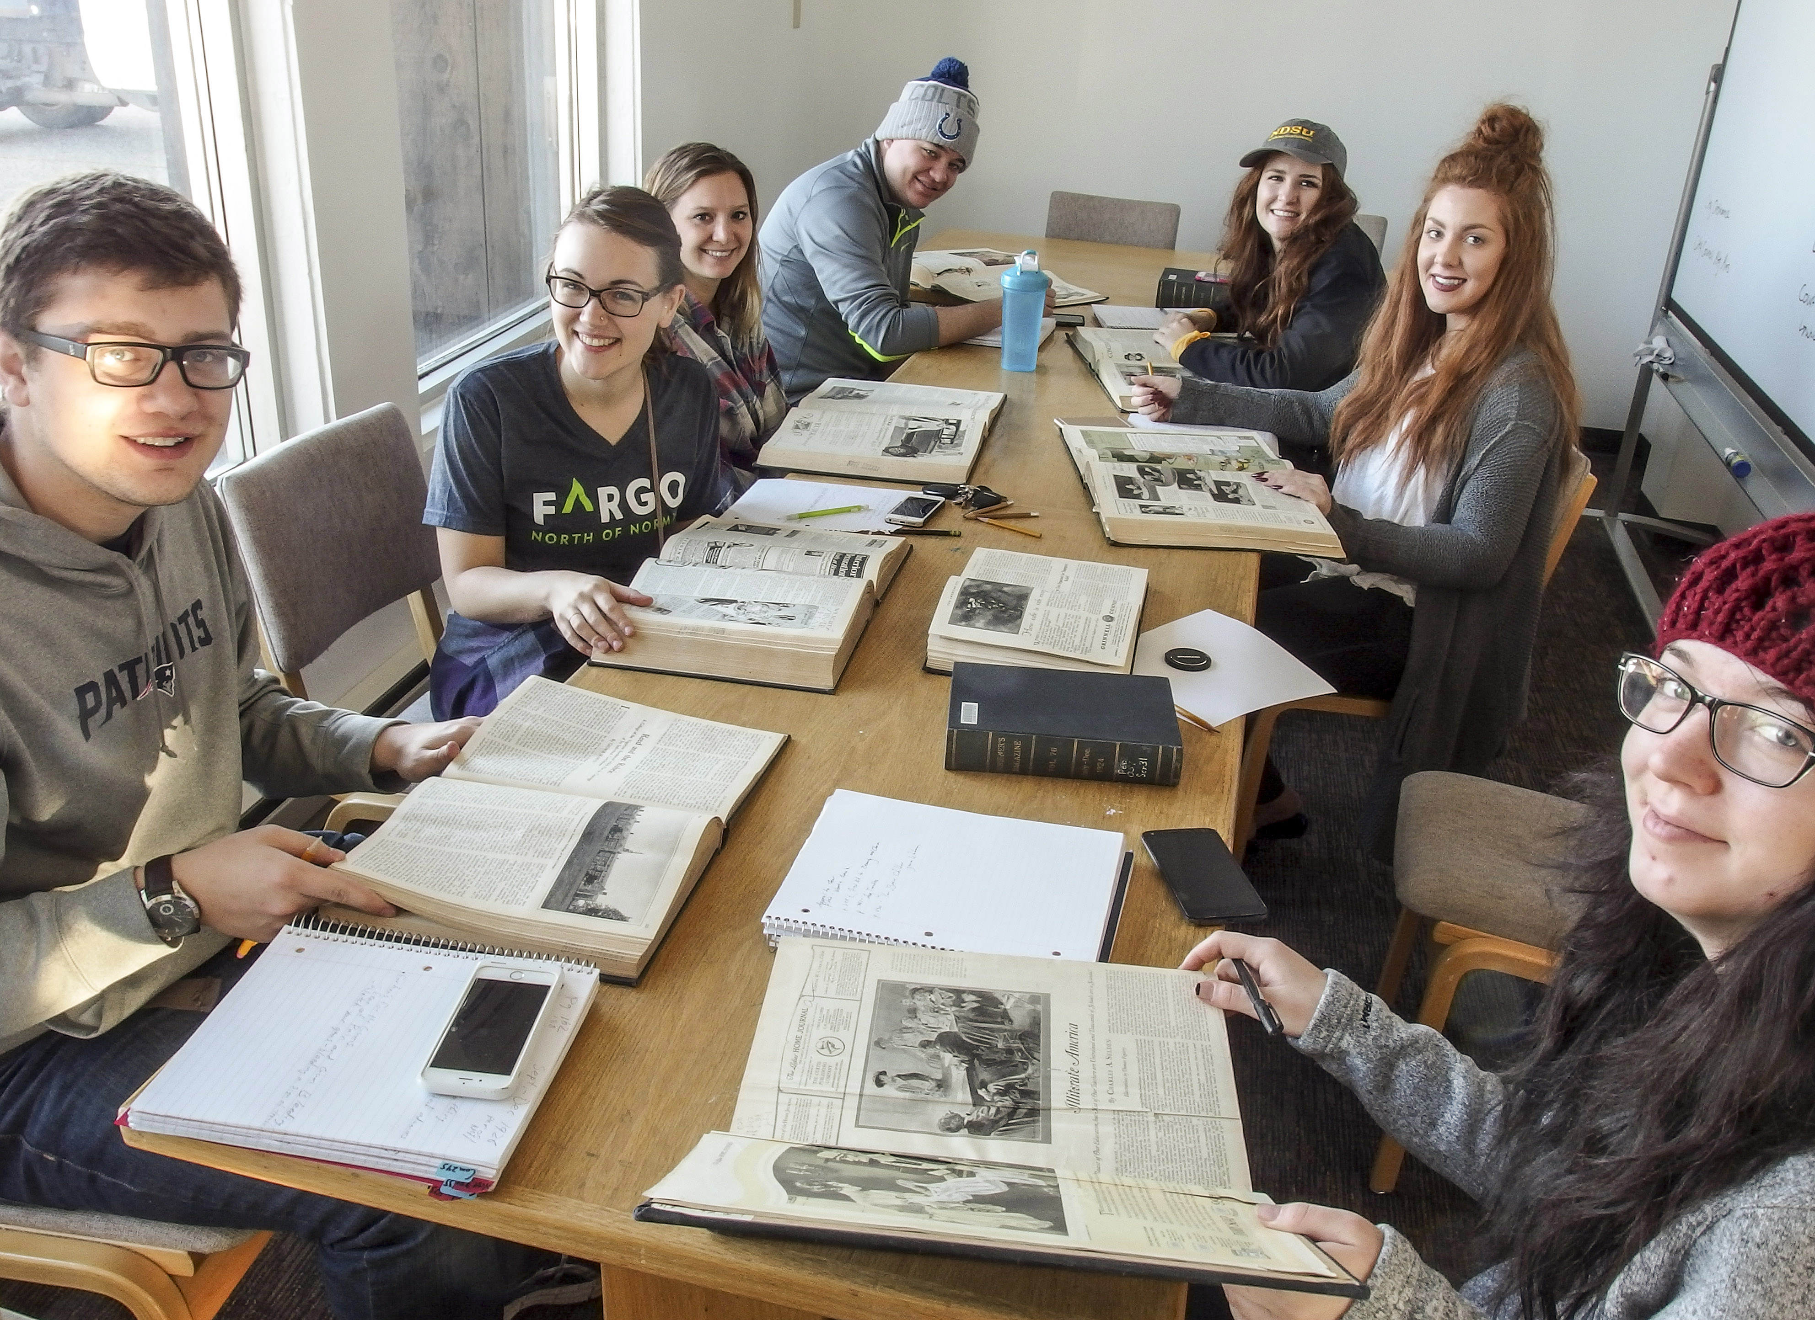
Homework
Never go to an interview without doing as much preparation as you can.
Know what plays the actor has been in, how the politician votes, what the writer has published.
It’s super embarrassing to admit you don’t know anything about the source’s accomplishments, and does nothing to establish your credibility.

Slide 15
Questions
Always write out a series of likely questions.
You don’t have to use them all, but if the conversation falls to silence, you can rely on them.
Questions will also help you to track back a source who has strayed off topic.

Slide 16
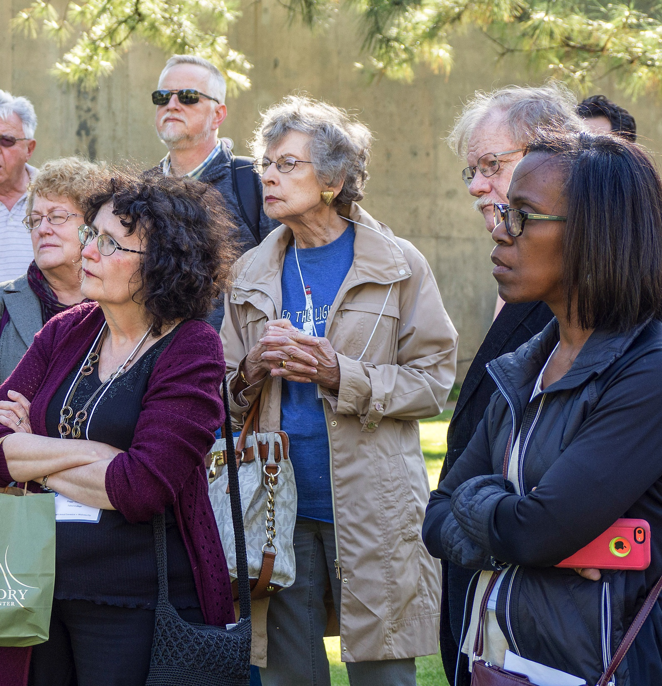
Fear of imposing
People not used to interviewing people sometimes are intimidated.
They fear they are imposing on the source’s time.
That is likely not true. People like to be interviewed.
“Most men and women lead lives, if not of quiet desperation, at least of desperate quietness, and they jump at a chance to talk about their work to an outsider who seems eager to listen.”—William Zinsser

Slide 17
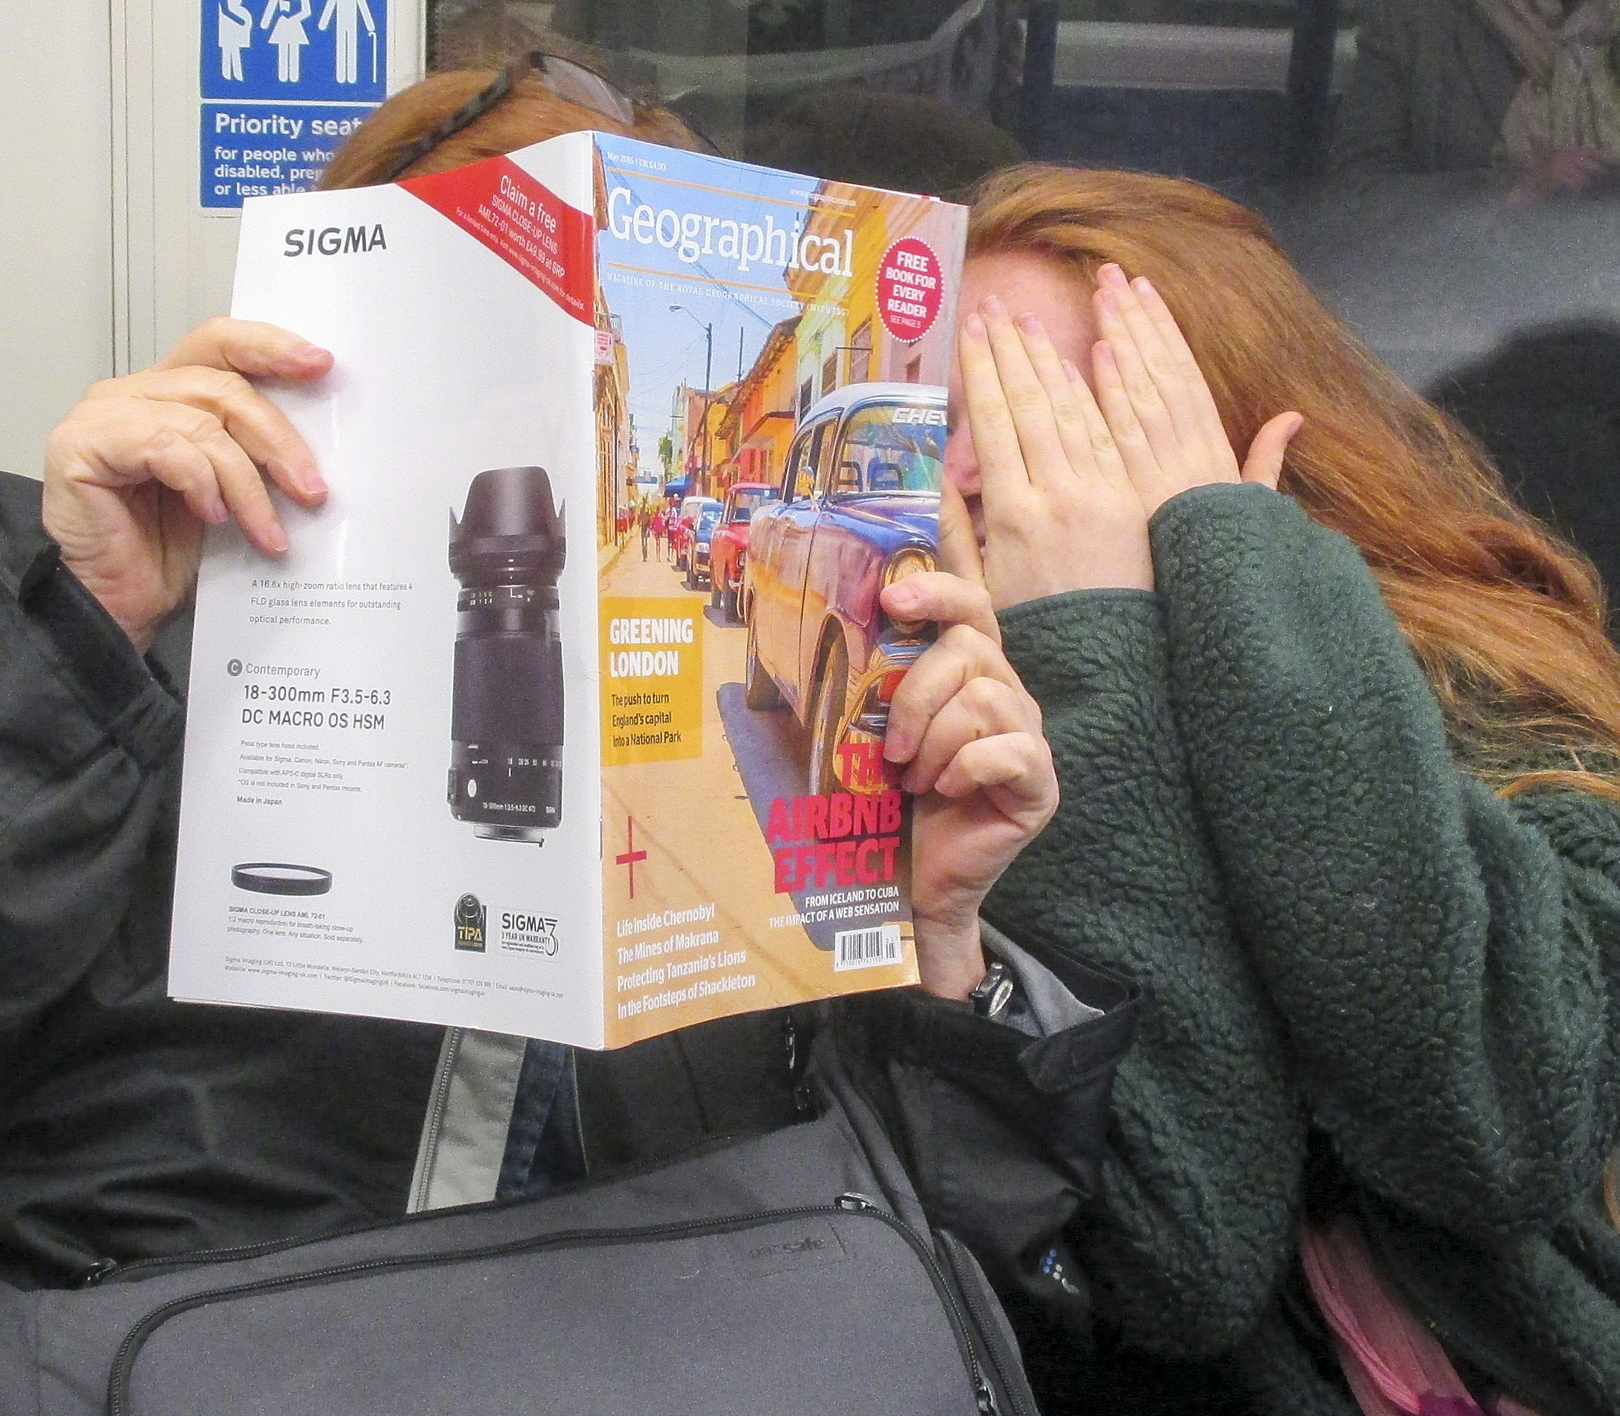
Awkward response
Most people don’t get interviewed.
That means they too will be uncomfortable, and may be awkward or self-conscious.
It is possible they just won’t be able to give you anything you can use.
If that’s so, sometimes it’s better to try again another day.

Slide 18
Awkward interviews
I heard a lecture about interviewing some years ago by Lori Sturdevant from the Minneapolis Star-Tribune.
She was doing a story on the life of Catholic nuns.
She interviewed several nuns, but they were reticent and uncomfortable.
She said she had to return several times to gain their trust, to gain their honesty. Finally, she said, she asked a question she had been waiting for:
“What do you do when you find yourself wishing you had a man in your life?”
“Well,” said the woman, “yes, that sometimes happens. And then I know I have to get to the chapel really quick.”
It had taken Sturdevant weeks to reach a level of trust to the point that those interviewed could reveal themselves.

Slide 19
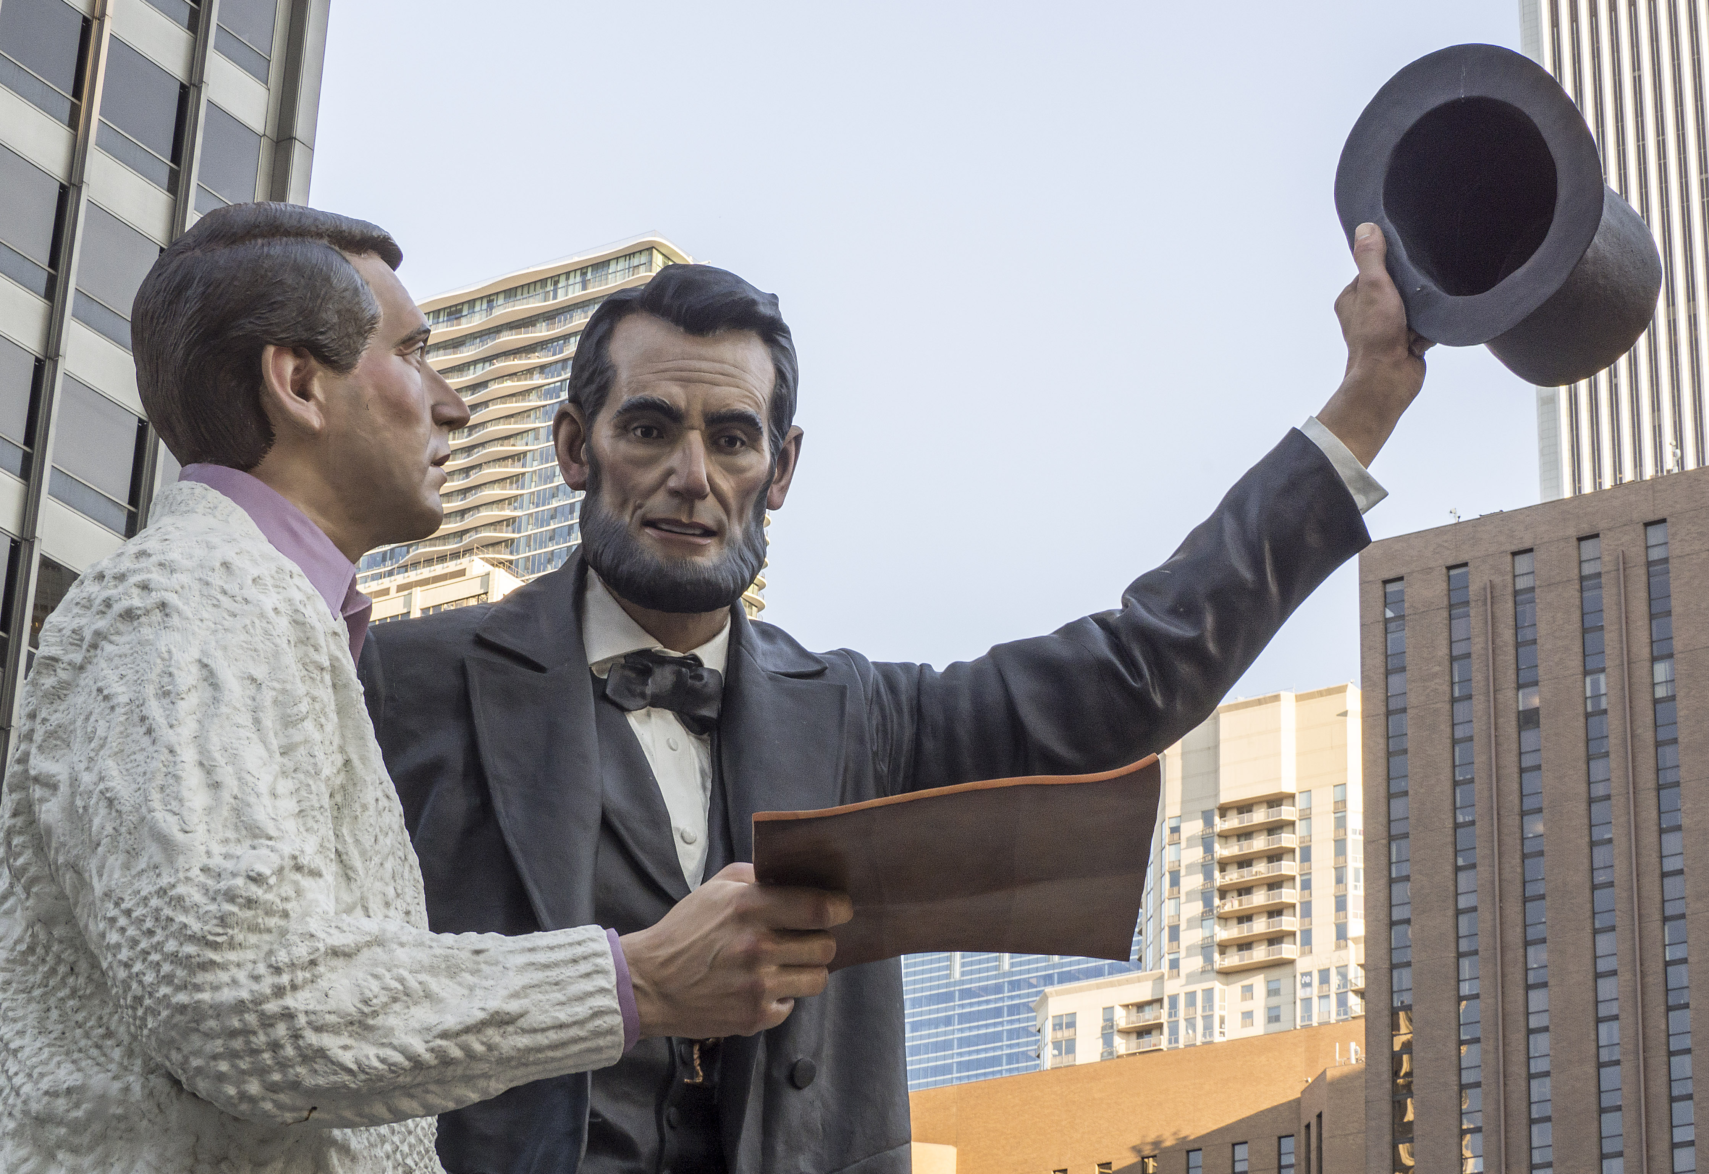
Juggling ethics
Can you chop and change a source’s words? It’s not an easy question.
Begin with your ethical duty: You must reflect accurately the source’s viewpoint.
You don’t quote him or her out of context.
You don’t choose just one side if she has carefully weighed both sides.
You don’t just choose some bright remark without including the serious comments after it.
This is a matter of not only another person’s integrity, but your own.

Slide 20
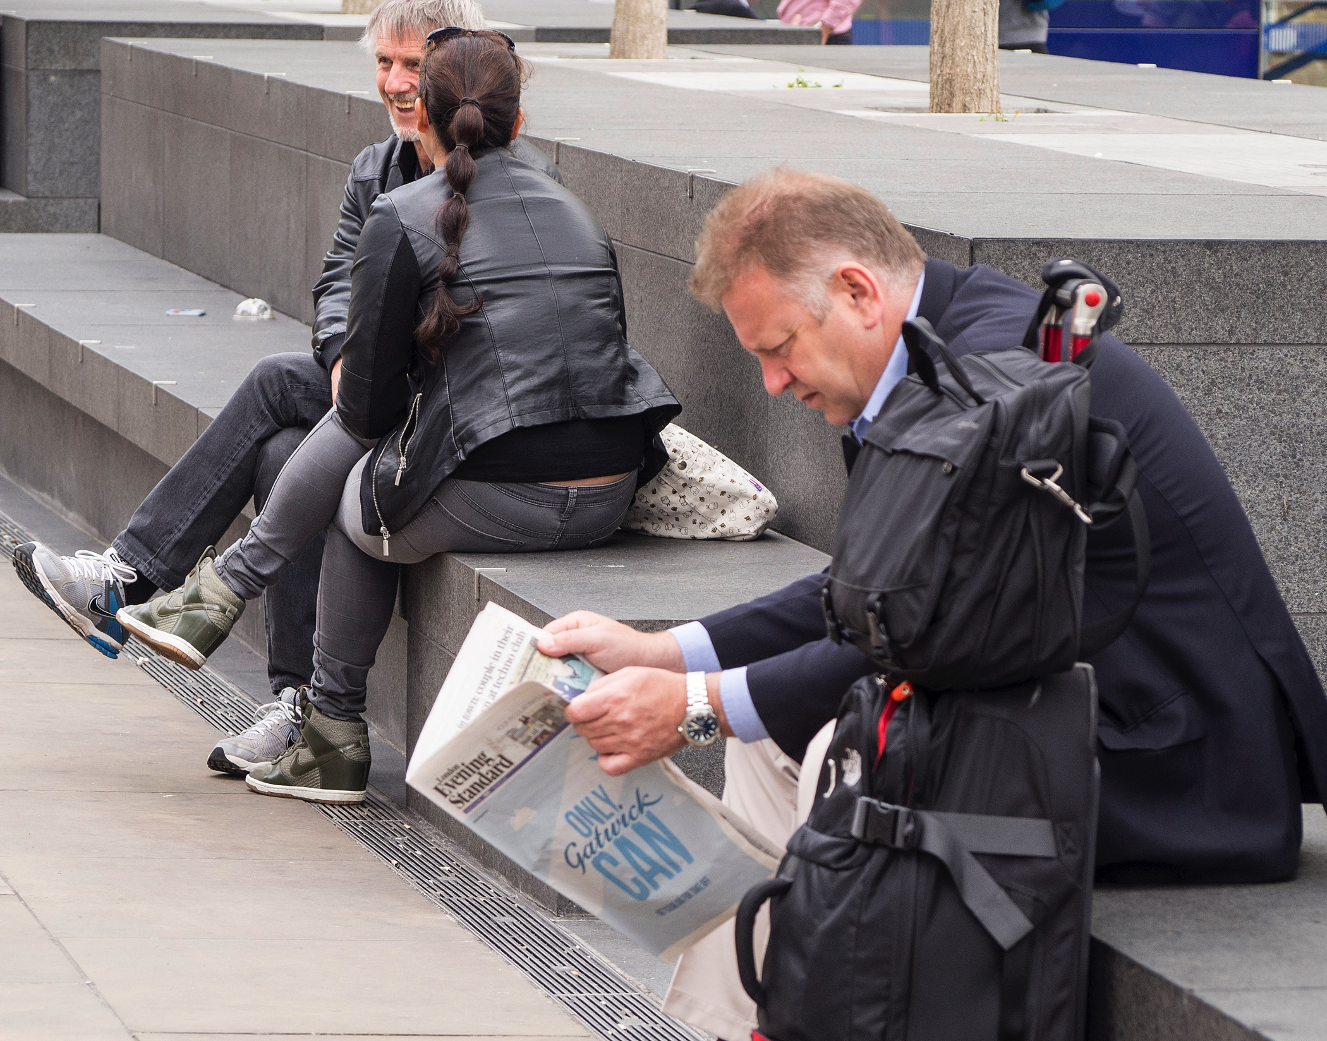
Reader expectations
But readers also have needs. They deserve concise writing.
People wander when they’re talking. Writers have to distill that to a smaller package, and avoid wasting the reader’s time.
If you find a quote on page three of your notes that works well with page one, can you put them together?
Yes, if you are fair, and reflects the truth of what the person was trying to say.

Slide 21
Handling quotes
We know quotes give freshness and authority to mass media stories.
That doesn’t mean paragraphs of quotes make it better. It gets dull.
You are still the writer, so you’re still in charge of the story, not the source.
We try to start the sentence with the quote, instead of leading up to it, such as:
“I like to go to Herd & Horns a couple times a week,” he said, “and hang out with the theatre guys.”
Instead of:
Josh said he liked to “go to Herd & Horns a couple times a week and hang out with the theatre guys.”

Slide 22
Breaking quotes
Avoid awkwardly breaking quotes, such as:
“I like to go,” he said, “to Herd & Horns a couple times a week and hang out with the theatre guys.”
Attributions should be simple enough not to call attention to themselves. “Said” or “says” (be consistent) is standard. People just tend to skip over it.
You can provide variety if the conversation shifts, such as: “She added, pointed out, explained, replied.”
Avoid using “commented” or “stated.” Sounds clunky.

Slide 23
Using quotes
Here’s how Sally Quinn used quotes from several people in her article about how to get around in Washington, D.C.
The third thing one must have to succeed is an innate understanding of who’s in and who’s out, who to cultivate and who to stay away from. To have a finger in every pie. To make a point of knowing and meeting people in different circles. Being totally au courant. Reading the paper.
“He’s got taste and nothing but guts,” says a well-known newspaperman. “How he contrives to get Martha Graham there I don’t know, but I don’t get that many whacks at meeting Martha Graham so I go.”
Another well-known columnist says, “You go, maybe with misgivings, but you go because maybe there’ll be someone you will meet that you need to know for your work. That’s the technique.”
“Steve understands that this is the most democratic town there is,” says Liz Carpenter. “He knows somebody can pick his teeth but if he’s a Supreme Court justice people will want to see him.”
“When I gave the birthday party for Joanie,” says Martindale, “The first thing I had to figure out was who liked her and who would come. And of course, for Joanie, they would all come.”

