Slide 1
Leads
The most important sentence of the story.

Slide 2
Attracting readers
Readers enter a sea of text from a boatload of sources.
Books, magazines, newsletters, newspapers and notes.
Websites, social media, texts.
Billboards, flyers, store promotions and junk mail.

Slide 3
Why read your story?
That’s the question we need to ask when we write. Why should a reader take precious moments to read what we write?
The answer, of course, is “no reason at all.” Unless we make it compelling enough, and we do that, as writers, through the lead (“lede” in journalism jargon, perhaps so we don’t think it’s pronounced like the carbon in a pencil?).
I like to call it “snagging them and dragging them.”

Slide 4
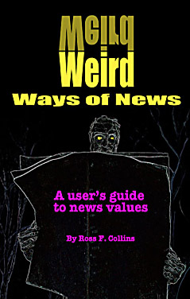
Snagging and dragging
If you want Ross’s extended discussion of snagging and dragging, check out the free online textbook, Chapter 5. (www.weirdwaysofnews.com)

Slide 5
Length
How long should a lead be? Short, probably. It should compel readers to the second sentence, and the second sentence, to the third.
But the lead in some narrative stories may take more than just one sentence to weave. It may be a paragraph, called the “nut graf” sometimes in journalism jargon.

Slide 6
Length
Some leads need to snag quickly, and that’s what we usually are trying to do in mass media style.
But in narrative, story-telling style, sometimes they smolder for a few lines, piquing curiosity and enticing readers instead of hitting them right off the top.

Slide 7
Snagging
In any case, you can’t expect a reader to be very patient.
Writers may try several familiar techniques to snare readers:
Humor
Surprise
Irony
Novelty
Curiosity

Slide 8
Building the lead
In a story of some length, writers try to build a lead so that the reader is drawn further and further into the story.
Each sentence, particularly at the beginning, needs to build toward that goal.
Particularly consider the last sentence of the paragraph—make it a springboard to the next.
Try humor—if you’re good at that sort of thing.

Slide 9
Leads that snag and drag
William Zinsser wrote a classic book, On Writing Well, that takes seriously the idea of leads. Here are a few of his own:
I’ve often wondered what goes into a hot dog. Now I know and I wish I didn’t.
Presumably few of us would not be compelled to go on to the second graf (paragraph) after a lead like that.

Slide 10
Sample leads
Here’s the second graf:
My trouble began when the Department of Agriculture published the hot dog’s ingredients—everything that may legally qualify—because it was asked by the poultry industry to relax the conditions under which the ingredients might also include chicken. In other words, can a chicken-furter find happiness in the land of the frank?

Slide 11
Sample leads
Zinsser notes that his longer sentence explains the incident, but then he adds what he calls a “snapper” to “restore the easy-going tone.
We also note he uses a supposedly forbidden passive voice:
…because it was asked by the poultry industry to relax the conditions…
Question: Why did he not write in the active voice, “because the poultry industry asked it to relax the conditions….”

Slide 12
Sample leads
Here’s the next graf:
Judging by the 1,066 mainly hostile answers that the department got when it sent out a questionnaire on this point, the very thought is unthinkable. The public mood was most felicitously caught by the woman who replied: “I don’t eat feather meat of no kind.”
Funny quote at the end. Say something funny and a reader will probably at least continue a little longer. As Zinsser noted, when you find a funny quote, find a way to use it.

Slide 13

Sample leads
Whatever you think about hot dogs, I’m pretty sure you’re going to want to read more of that story.

Slide 14
Surprise and novelty
Here’s a lead from the Star-Tribune (Minneapolis-St. Paul):
As a Minnesota fisherman, Daniel VanVickle is on the verge of sudden fame and notoriety.
He is also 31/2 years old.
(Ron Schara)

Slide 15
Surprise and irony
Most of us would probably read on. The story is about a kid who caught a state record fish.
Irony is also surprising, melding two seemingly dissimilar concepts:
It seems bizarre and remote, John Sexton’s story of death and pain, as his Thunderbird races in brilliant sunlight down the concrete highways that seem both soul and sinew of Detroit.
(Myra MacPherson)

Slide 16
Surprise and irony
Would you want to read on? I’ll bet you would. It’s a story about a former POW and his challenges of dealing with life in the States.

Slide 17
Snagged
Once a writer can be fairly confident that the lead has done its work, the rest is not quite as difficult.
If you’re casting about for leads, often the answer is in some odd fact or interesting detail likely to attract attention.
In researching and interviewing for a story, observe details. Look for the unusual that may set the tone of the story.
As you sift through your notes a detail sometimes steps out and begs for promotion to the beginning.

Slide 18
Details as leads
Here’s a lead that suggests the writer observed details:
Fresh young faces, flushed with cold and excitement. Flaring miniskirts, flashing, slender legs, splayed in the air in symmetrical formation. Shouts and yells, screeched to the crowd in forceful unisons, answered by thunderous roars. It’s the cheerleaders, doing their stuff for the big game, the culmination of the season, the ultimate prize.”
(Alan M. Kriegsman)

Slide 19
Details
A story about high school cheerleaders would seem to be fairly mundane, but most people who read that lead would go onto the second graf, at the least. Or how about this:
Parris Island, N.C.—He is seething, he is rabid, he is wound up tight as a golf ball, with more adrenalin surging through his hypothalamus than a cornered slum rat, he is everything these marine recruits with their heads shaved to dirty nubs have ever feared or even hoped a drill instructor might be.
(Henry Allen)
Are you going to be reading the next graf? I’m betting you are.

Slide 20
Rules for standard leads
Try Ross’s SAVE formula. Leads for mass media should be
Specific
Accurate
Mostly in active Voice
Relying on Energetic verbs

Slide 21
SAVE in action
Let’s revisit the recent hurricane. We have a story about the aftermath of the hurricane in the Bahamas. We interview a guy who lost his home. Here’s a possible lead:
Homes were lost by many people in this week’s hurricane that hit many towns in the Bahamas.

Slide 22
SAVE
Homes were lost by many people in this week’s hurricane that hit many towns in the Bahamas.
It is accurate. But is is specific? Not really. Which towns? Is it in active voice? No. Does it use active verbs? Not really.
Here’s the actual lead:
Since Hurricane Dorian plowed through Stafford Symonette’s house and with it much of the community of Treasure Cay, he has stopped by from time to time to visit the ruins of his home.
(Kirk Semple, NY Times)

Slide 23
SAVE
The story doesn’t have to be compelling for the lead to be. How about a press conference? You could write:
The mayor held a press conference Tuesday. First he talked about the cool weather we’ve had this summer. Then he talked about his topic for the meeting, students. He said the police are going to tighten the party patrol to arrest students who are too noisy after 8 p.m. on weekends.

Slide 24
SAVE
While the lead is accurate, and in active voice, it’s neither specific nor energetic. Mass Media is about people doing things. What action did he take? Here’s a rewrite:
Student who party after 8 p.m. on weekends will be arrested, Fargo Mayor Tim Mahoney announced Tuesday.

Slide 25
Narrative
Some stories lend themselves to a narrative, or story-telling lead, beginning with details. Here’s one from Hurricane Dorian’s destruction in the Bahamas:
The roof had blown clean off. Outside, the ocean surged, swallowing the land. Brent Lowe knew he had to escape—and take his 2-year-old son, who has cerebral palsy and can’t walk, with him.
But Mr. Lowe had another problem. He’s blind.
(Rachel Knowles, NY Times)

Slide 26
Quirks
Zinsser suggests writers can find ideas for leads from the interviews and obvious sources. But he says to go farther:
Look at signs and billboards and at all the junk written along the American roadside. Read the labels on our packages and the instructions on our toys, the claims on our medicines and the graffiti on our walls.
Read the fillers, so rich in self-esteem, that come spilling out of your monthly statement form the electric company and the telephone company and the bank. Read menus and catalogues and second-class mail….Our daily landscape is thick with absurd messages and portents. Notice them. They not only have a certain social significance; they are often just quirky enough to make a lead that is different form everybody else’s.”

Slide 27
Leads to avoid
You probably know some of the clichés in lead-land, but just as a reminder:
Avoid question leads. Don’t ask; tell.
Avoid the future cliché: “When a future archeologist comes across…”
Avoid the spaceship cliché: “If a space being landed what would he think….”
Avoid quote leads, unless the quote is short and compelling. Begin with your own words.

Slide 28
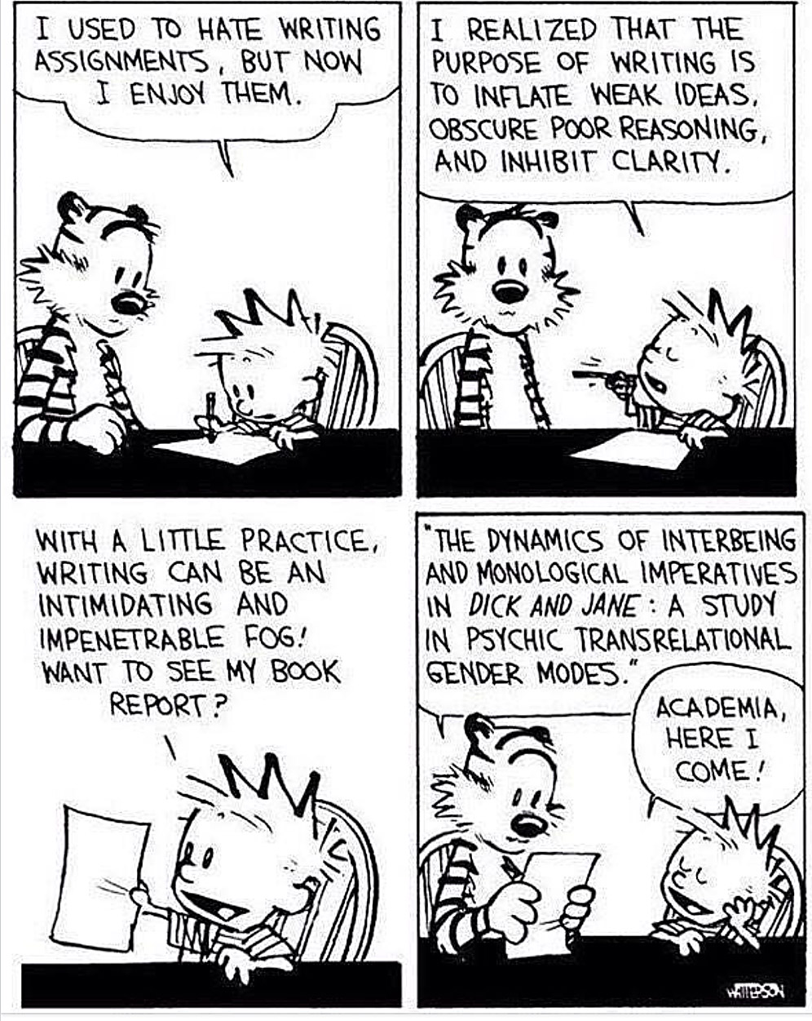
Mass media writing
And remember: mass media writing is not the same as academic writing. (But maybe academic writing needs work too.)

