Slide 1

Clustering
A new way to overcome writer’s block and generate themes and ideas

Slide 2
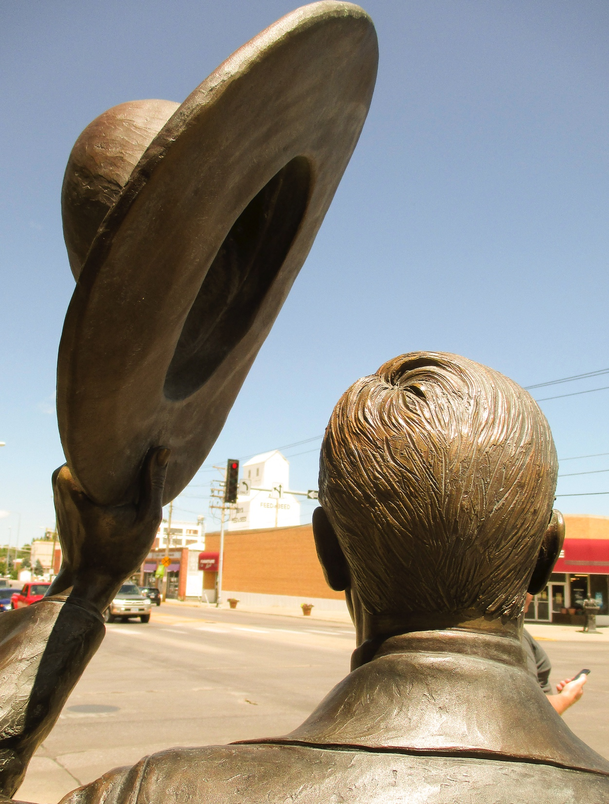
Right-brain thinking
The idea behind this technique is to reach directly into our right brain, the intuitive, creative side.

Slide 3

The struggle
Because we usually learn to write based on mechanics, structure, grammar and vocabulary, writing becomes tedious.
Most people do not find writing fun, because they learned to write as discipline, not creativity.

Slide 4
Discipline
Of course, discipline is necessary in writing. Particularly as we are professional writers.
But that doesn’t mean the mechanics and the grammar has to come at the beginning.
In the beginning should come the creativity.

Slide 5
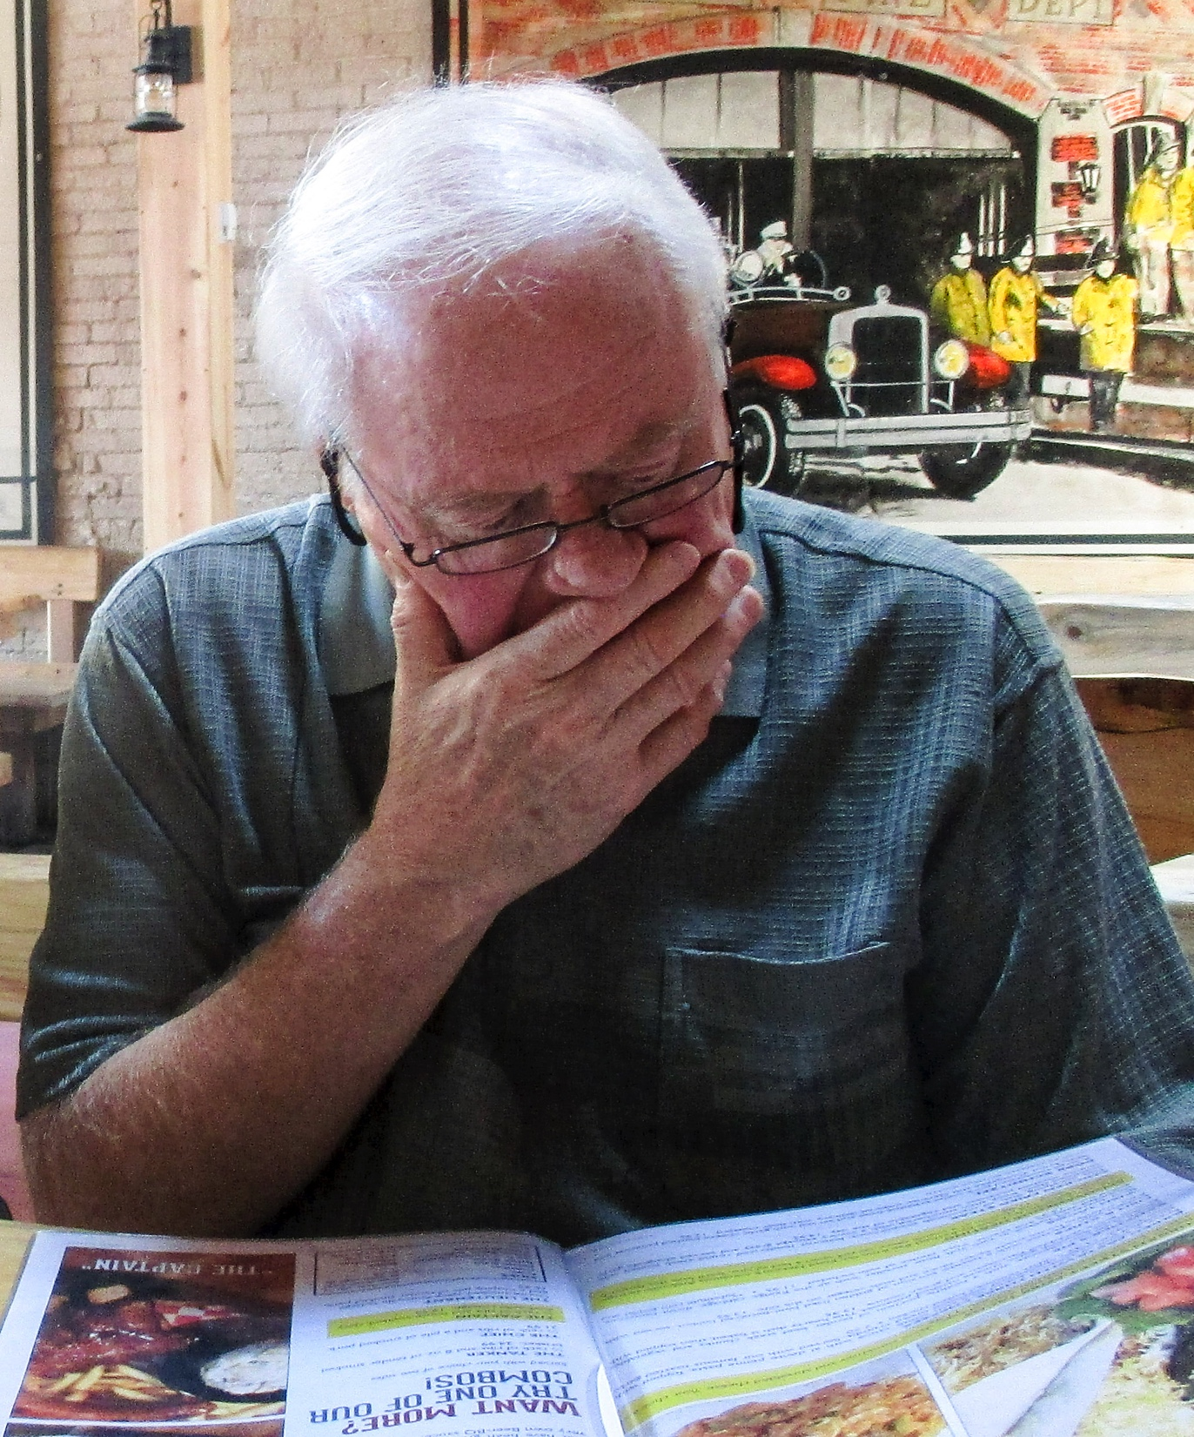
Natural writing
Writing is creative, and creativity comes naturally to all of us—research shows that.
But as we become older it seems harder and harder to tap our natural creativity, in art, music, or writing.

Slide 6
The two-step process
Most writing activity comprises two phases:
The productive, or “unconscious” phase or artist phase;
The conscious, critical phase that edits and revises, or critic phase.

Slide 7
Left and right
These phases seem to reflect left- and right-brain thinking:
Left brain is the rational, logical, ordering side, the critic. Denotations: definition of a tree.
Right brain is the image side, thinks in patterns or designs. Connotations: how a tree feels.

Slide 8
Participation
Both sides of the brain should participate in writing. But we tend to jump right to the critic side, and forget about the artist side.
The nuance and meaning of the language evokes emotion through sensory, evocative, unconventional images. That seems to come from right brain.
Sometimes it’s compared to music: notes vs. melodies.

Slide 9
Voice
“People often lack any voice at all in their writing because they stop so often in the act of writing a sentence and worry and change their minds about which words to use. They have none of the natural breath in their writing that they have in speaking….We have so little practice in writing, but so much more time to stop and fiddle as we write each sentence.”
—Peter Elbow, Writing With Power

Slide 10

Ways to reach right
Writers have proposed many ways to reach beyond our critical mind, sometimes as ways to overcome writer’s block, sometimes as ways to find a voice, a style, sometimes as ways to just begin.
We’ll look at it just a little bit, as an introduction.

Slide 11
Creativity
To begin with, we try to write quickly without self-censoring our work.
Don’t worry about grammar or structure. Liberate yourself to just write.
Note that you can always go back later and fix the grammar. The left brain side can come back later.

Slide 12
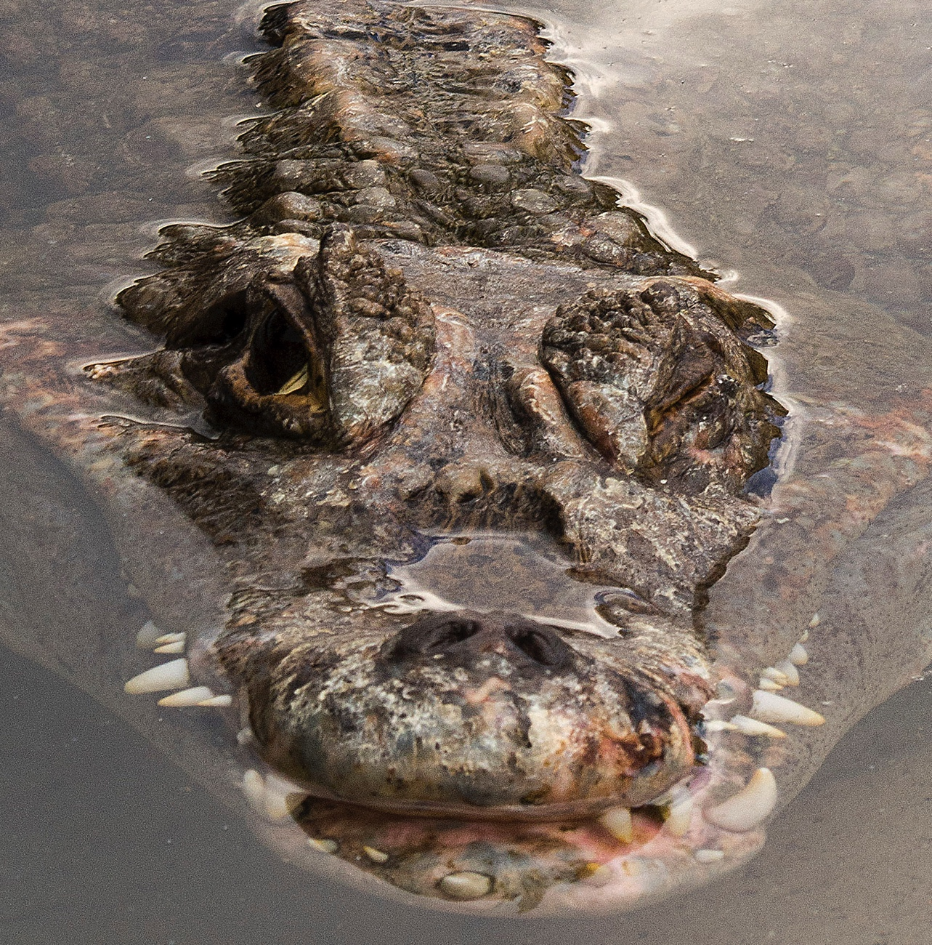
How to begin
For many people, the hardest part of writing is the beginning.
It’s too easy, and often painful, to stare at the blank screen, cursor blinking, and come up with nothing.
As the deadline looms and the anxiety grows, writer’s block may get worse.

Slide 13

Hatching the idea
Can we just force an idea to come? Not really, if you’ve ever tried it.
But perhaps we can invite the idea into our writing brain. We can just let it happen.

Slide 14
An idea cluster
Writing teachers have a number of ways to encourage ideas.
The one we’ll try is called clustering.

Slide 15
Clustering
To begin, a short phrase or word becomes a nucleus.
This acts as a springboard for a burst of ideas related to that.
A cluster emerges quickly. Just a few minutes.

Slide 16

Generating a focus
The cluster flows out like ripples in a pond.
It’s a self-organizing process, as words move out from a center.
At some point, the apparent randomness seems to take on a pattern.
Suddenly you sense a focus for writing, the “aha!” moment.

Slide 17
Order
You do not worry about order of ideas.
You just let the words go as they surface.
There is no right or wrong way.
You do not apply logic or censorship to the cluster.

Slide 18
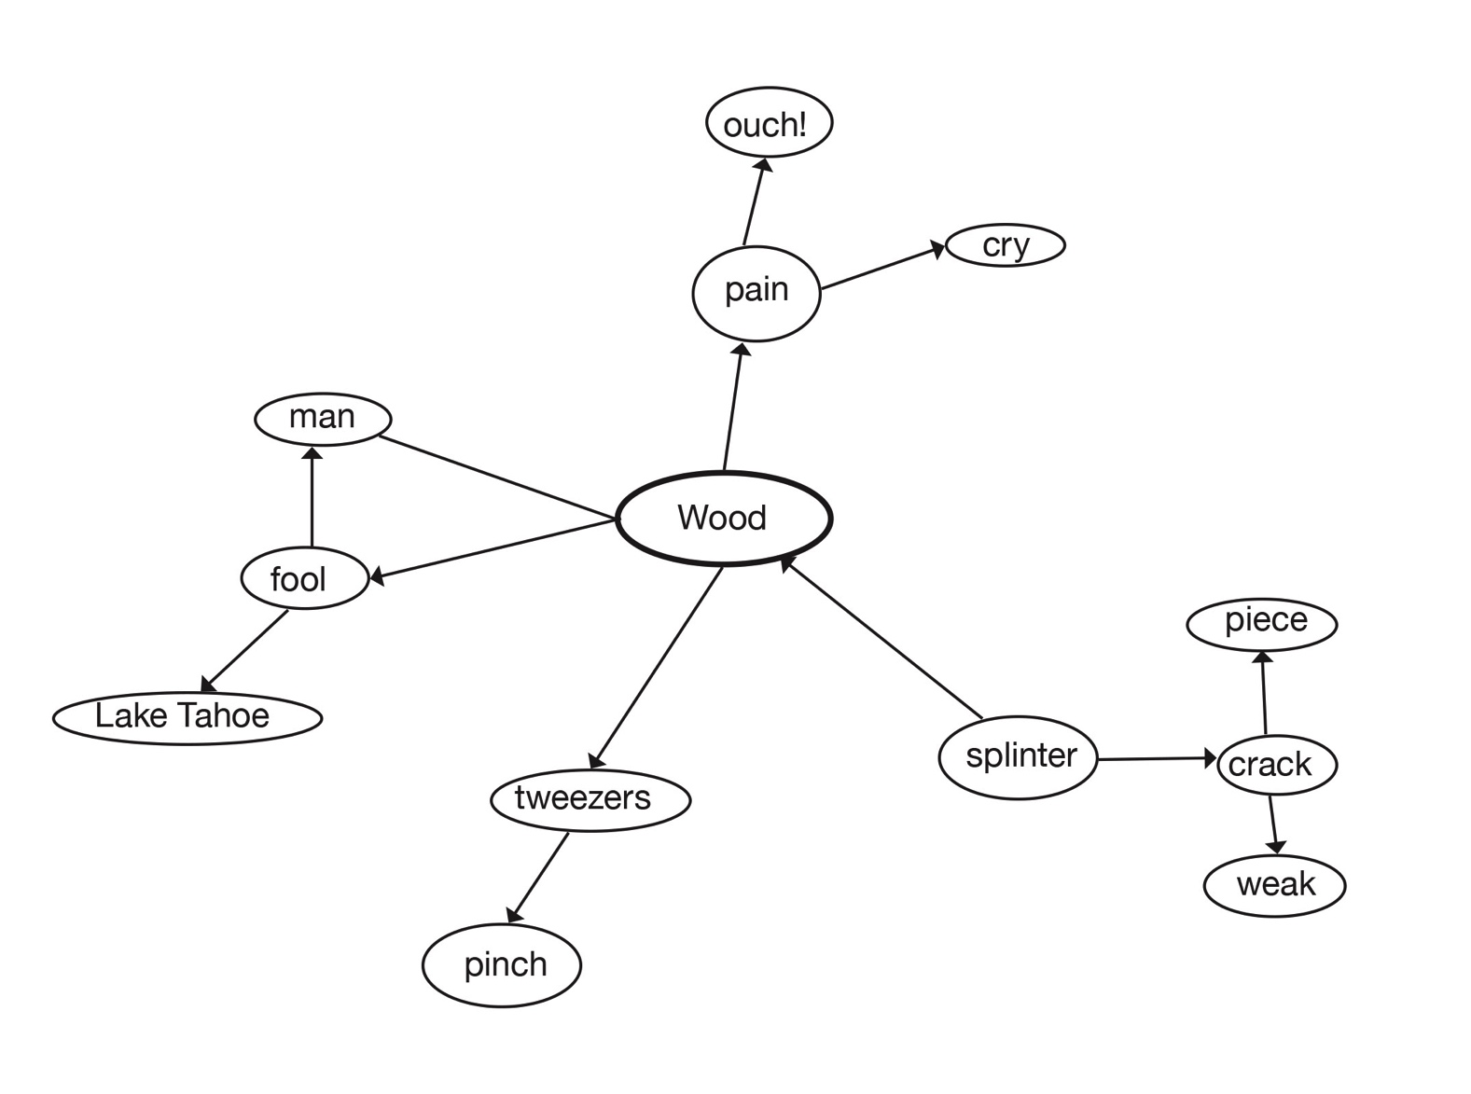
Trying a cluster
Here’s a cluster I redrew from a student’s work:

Slide 19
Trying a cluster
Here’s what the student wrote:
Splinter is a terrible word. Its sound is synonymous with the sensation: jagged, sharp, piercing, like the nagging voice of a dissatisfied spouse. I remember vacationing in Tahoe. The pier was old, worn, and wooden; the boards as rough as a face full of scabs. Running along it, my foot caught the attention of an angry spike of wood, injecting itself cleaning and deeply into the ball of my foot. If I screamed it was not from the pain initially felt, but from anticipated sensations. It’s not the hole the shot makes but the length of the slim sword that brings pain.

Slide 20

Editing
Of course, we always know at some point we need to return to our first draft and employ some left-brain skills: editing.
But let the first draft flow. Try to write a complete thought, a vignette.
Reach back to the free flowing ideas of childhood.

Slide 21

Try it!
Build your cluster from the word below. When you feel ready, begin to write.

