Slide 1
Covering a speech
Show your skill as a writer

Slide 2
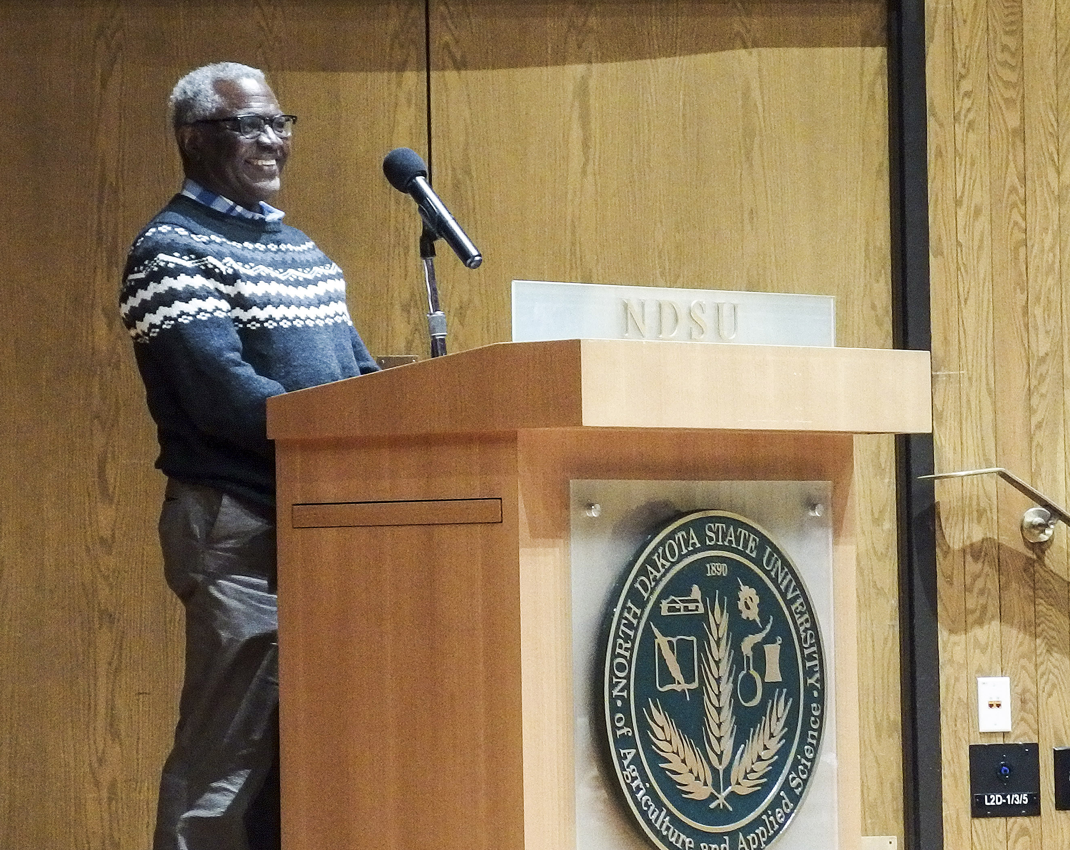
Typical speeches
Information;
The speaker provides facts that can make news.
Idea;
Opinions of the speaker, based on credibility as expert. Can be controversial.
Inspirational;
No facts or opinions, but designed to arouse emotions. Hard to write a story on this kind of speech.

Slide 3
Significance
Speech stories seem boring to cover, but are important. Usually.
May affect a reader directly.
May cover a controversial issue.
May affect the course of history! Depends on who’s speaking.

Slide 4
Advance
Some speakers provide an advance copy of the speech.
This makes it a lot easier to cover the speech, as we don’t have to furiously take notes or go back to a recording.
Of course, speakers do tend to stray from prepared copies.
And it’s risky to “cover” the speech by just reading the advance copy!

Slide 5
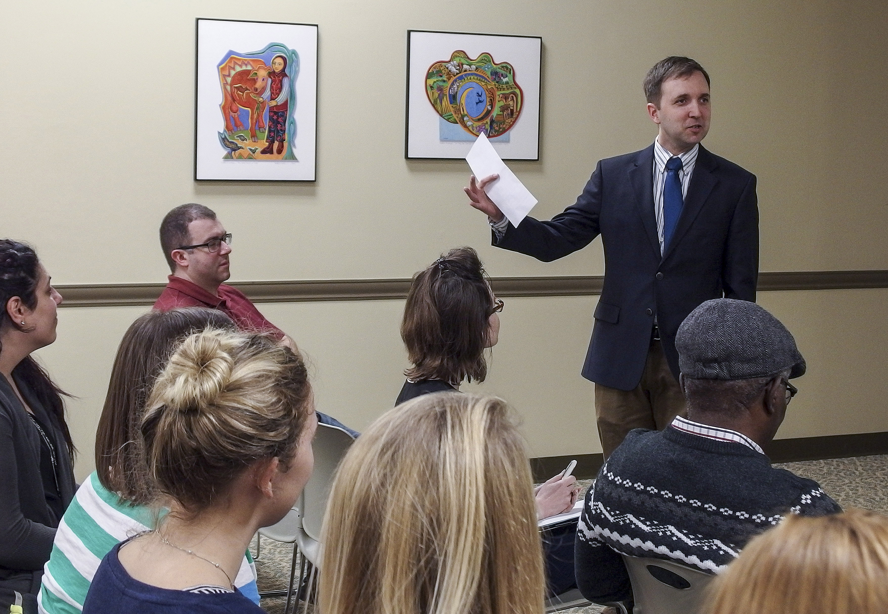
Advance copy
Of course, it is possible to report based on the advance copy if you word the story correctly.
You can say, “the speaker planned to…” or “prepared to deliver....”

Slide 6
Boring speeches
So what if the speech is boring?
Listen carefully. Discipline yourself to be professional. Fight distractions.
Consider Chesterton’s (familiar) quote:
“There is no such thing as an uninteresting subject; there are only uninterested people.”

Slide 7
Themes
Try to identify a central theme.
Try to find good quotes, and right them down as best as you can. It’s tedious trying to find them later in a long recording.
After a while you get used to listening and writing notes at the same time.
Try to take as many notes as you can. Relying on a recorder, and just sitting there, is a giveaway of an amateur. In a way it’s lazy, but the time you save by not taking notes will be made up by trying to find quotes on an hour’s recording.

Slide 8
Listening challenges
We all have “deaf spots.” That is, when a speaker touches on our own cherished convictions, biases, or emotional triggers, we don’t listen anymore.
Instead, we retreat to our emotions and sensitivities.
For example, trigger words for many include:
Liberal, conservative, redneck, pro-life, pro-choice, refugee, terrorist, gun control, income tax, dumb farmer, evolution, climate change, gay rights, oil barons….
Well, you can add your own to the list.

Slide 9
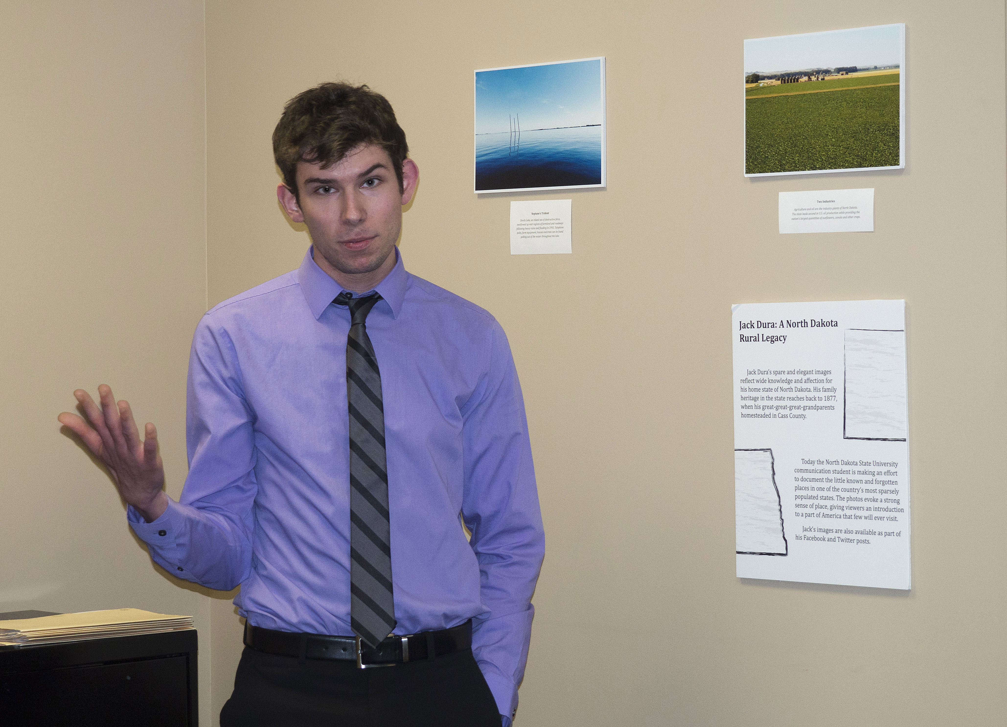
Listening challenges
Try to identify the most upsetting words for you, and to understand the emotions associated with them.
In other words, know your biases.

Slide 10
Mannerisms
In addition to looking for colorful quotes, observe a speakers mannerisms.
Note gestures, and how they relate to points the speaker makes. Note word choices and how they relate.
It helps writers to understand the context of a speech, as the actions of the speaker are as important as the words. Perhaps more.

Slide 11
Between the lines
Listen between the lines. That is, look for voice and gestures as significant.
We know that most political leaders (especially nowadays!) make speeches that appeal to emotions, probably more than intellect. Consider this subtext of a speech purportedly aimed to be factual.

Slide 12
Check it out
It seems even more important today for mass media writers to carefully check and re-check facts.
If you’re not sure about what someone said, or what it means, ask the person after the speech to clarify.
Few speakers would not welcome your effort to get things right.

Slide 13
Writing
You’re ready to write the story. Here’s what you don’t write:
“Irving Nern, CEO of XYZ Digital, spoke today.”
“Irving Nern, CEO of XYZ Digital, discussed web technology last night in front of NDSU communication students.”
The first has no news. We have no idea what he talked about.
The second is too general. It raises questions instead of answering them.

Slide 14
The lead
Here’s a better lead:
“A faster wireless connection will soon give students the ability to stream videos from any smartphone, XYZ
Digital CEO Irving Nern told an NDSU communication class yesterday.”
Note this lead gives specific news for the reader, and also makes it easier to write a headline.
It avoids simply giving the speaker publicity, emphasizing the real news of the speech.

Slide 15
The news
So this suggests that the first rule of speech stories is this: tell the reader something the speaker said.
Two ways to do this:
The writer can summarize the theme of the speech.
The writer can present a feature of the speech.

Slide 16
The flow of a speech
Speech writing is different from writing a news article.
Speeches usually run point by point, each point elaborated, a (perhaps) dramatic climax at the end, and than a conclusion.
The dramatic climax is usually what the writer wants to emphasize in a lead.

Slide 17
Avoid chronology
We hate to make rules, but here is one fairly good one: never report a speech by writing chronologically.
That is, don’t write:
“The speaker began by saying… then he said this...the next point he made was this...then he pointed out...and he concluded by....”
Generally, effective speech stories start out with a lead emphasizing the news value, followed immediately by the speaker’s credentials.

Slide 18
Other principles
Include attributions often enough so that the reader is reminded of who is providing the facts or ideas.
Try to find synonyms to avoid just repeating the name over and over.
“The CEO added…”
“The former governor suggested....”
Or just “he” and “she.”

Slide 19
Objectivity
In today’s world of purportedly “fake news” and enormous divergence of opinion, it’s critical for professional journalists to try to stay objective.
You may be a Bernie Sanders supporter listening to a supporter of Mr. Trump.
You may be an anti-abortion rights supporter listening to a pro-abortion rights supporter.
Don’t make your relationship to the subject apparent in your story!

Slide 20
Objectivity
Avoid small words that suggestion your bias:
“The well-known speaker….”
“The prominent advocate....”
“The topic was well-presented....”
“The accomplished speaker....”
Okay, it’s likely impossible to be completely objective, but do your best to maintain your credibility by staying neutral, but reporting factually.

Slide 21
Accurate quotes
There is absolutely no excuse for a professional journalist to quote inaccurately.
It hurts your credibility.
It may end your career.
Taking a quote out of context also is unethical, whether or not you agree with that context.
Cleaning up bad grammar is sometimes considered all right. You need to judge the context.

Slide 22
Quotes
Quotes are essential in speech stories.
But like in any story, too many will drag it down. Often it’s better to paraphrase.

Slide 23
Concise writing
One challenge of new writers is trying to boil down a 5,000-word, hour-long speech to a 500-word article. Two tips:
Hit only the main points. You’ll have to omit some things.
Try to write more concisely than the speaker spoke.
Observe that both of those things requires judgment, and that means ethical challenges. Ask yourself: does this change misrepresent the speaker?

Slide 24
Context
One of the most significant ethical challenges for a journalist is to consider context.
Speakers offer context within the body of a speech. But some unethical writers pull quotes from the context and report them as facts.
When they are challenged, they reply “But that’s what she said!” As if that were an absolute defense.
We see this all the time in social media, I’m afraid.

Slide 25
Accuracy
Something that’s literally accurate may not be fair. Professional journalists lay groundwork for a quote so that it can be understood in context.

Slide 26
Style
Writing a story about a speech is a skill that goes beyond just a few general rules, of course.
The same speech can be presented as a really interesting topic—or a really boring topic. Below are two examples.

Slide 27
First reporter
The Nevada desert may seem like a desolate area, and the idea of its producing more than cattle, sheep, rattlesnakes and jackrabbits may strike some people as a pipe dream. But Dr. John M. Ward, new president of the Desert Research Institute, looks at Nevada as more than just a dream.
Speaking to the Reno Rotary Club yesterday in the Hilton Hotel, Dr. Ward examined the accomplishments of the DRI....

Slide 28
Second reporter
Twelve years ago, “a small group of idea people” set out to discover “unknown, perhaps undreamed-of resources” of Nevada’s desert. And the 506 projects of the Desert Research Institute since then have paid off “beyond the dreams of its originators.”
That was the way Dr. John M. Ward, new DRI president, summed up the accomplishments of his statewide agency yesterday for the Reno Rotary Club in the Hilton Hotel.

Slide 29
Third reporter
“Important and outstanding contributions” will come from the University of Nevada’s Desert Research Institute, its new president predicted yesterday in a speech to the Reno Rotary Club in the Hilton Hotel.
Dr. John M. Ward said the ecological discoveries of his “unique establishment” have already helped to prevent humanity “from becoming a truly endangered species….”

Slide 30

Final advice
Explain context beyond the speech, if necessary. In a speech about refugee status in Fargo, explain the background concerns some city commissioners have raised regarding cost and security.
Disregard any “off-the-record” requests. It’s a public speech.
Take two pens or pencils to the speech.

