Slide 1
Headlines
And headings

Slide 2
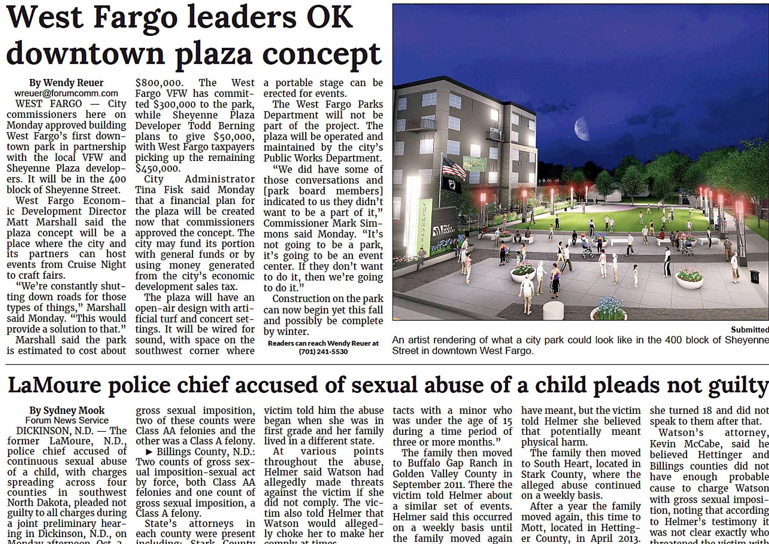
The title
In journalism/mass media terminology, the title above a story is called a headline. In journalese this is sometimes shortened to head, or hed.

Slide 3
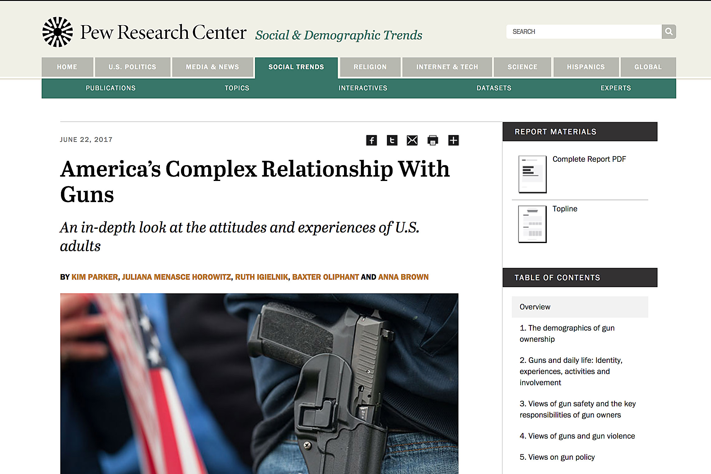
Online
In online material, it’s called a heading.

Slide 4
Attracting readers
The headline is the second of four ways to draw readers into a story:
photo or illustration, to catch the reader's attention;
headline;
deck, pull quote, or other descriptive block;
lead.

Slide 5
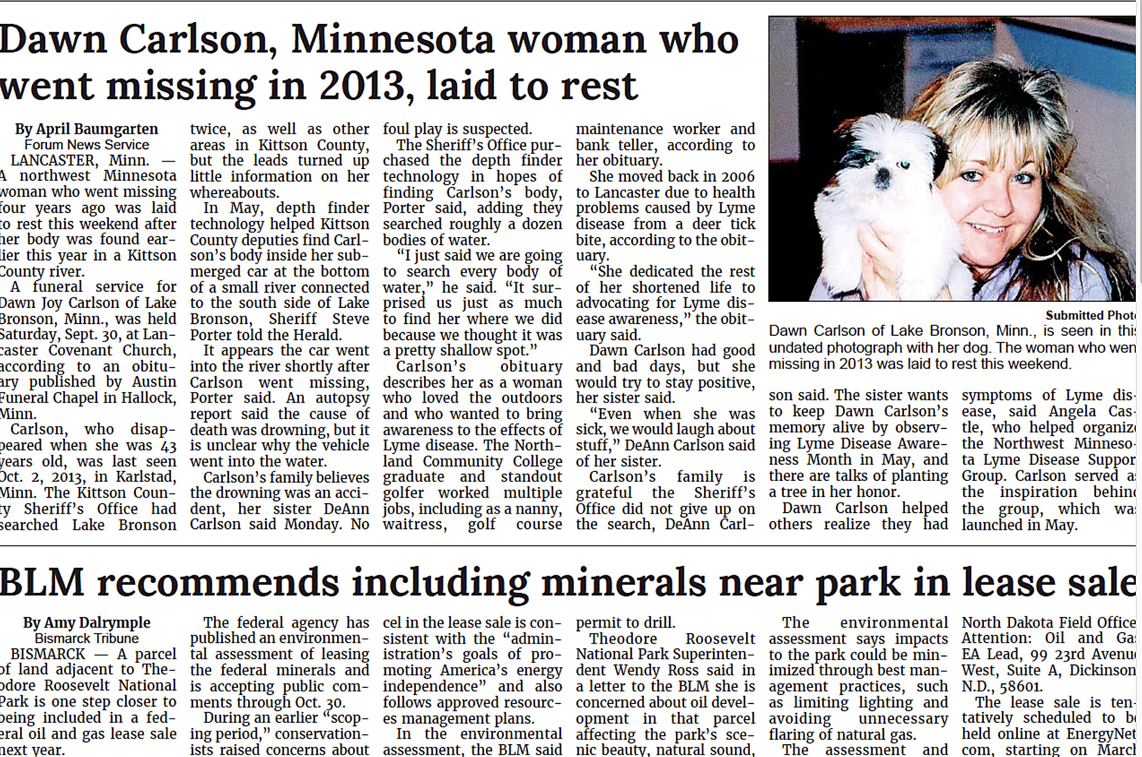
Priorities for headlines
Headlines must be two things:
Accurate.
The right size to fit the space.

Slide 6
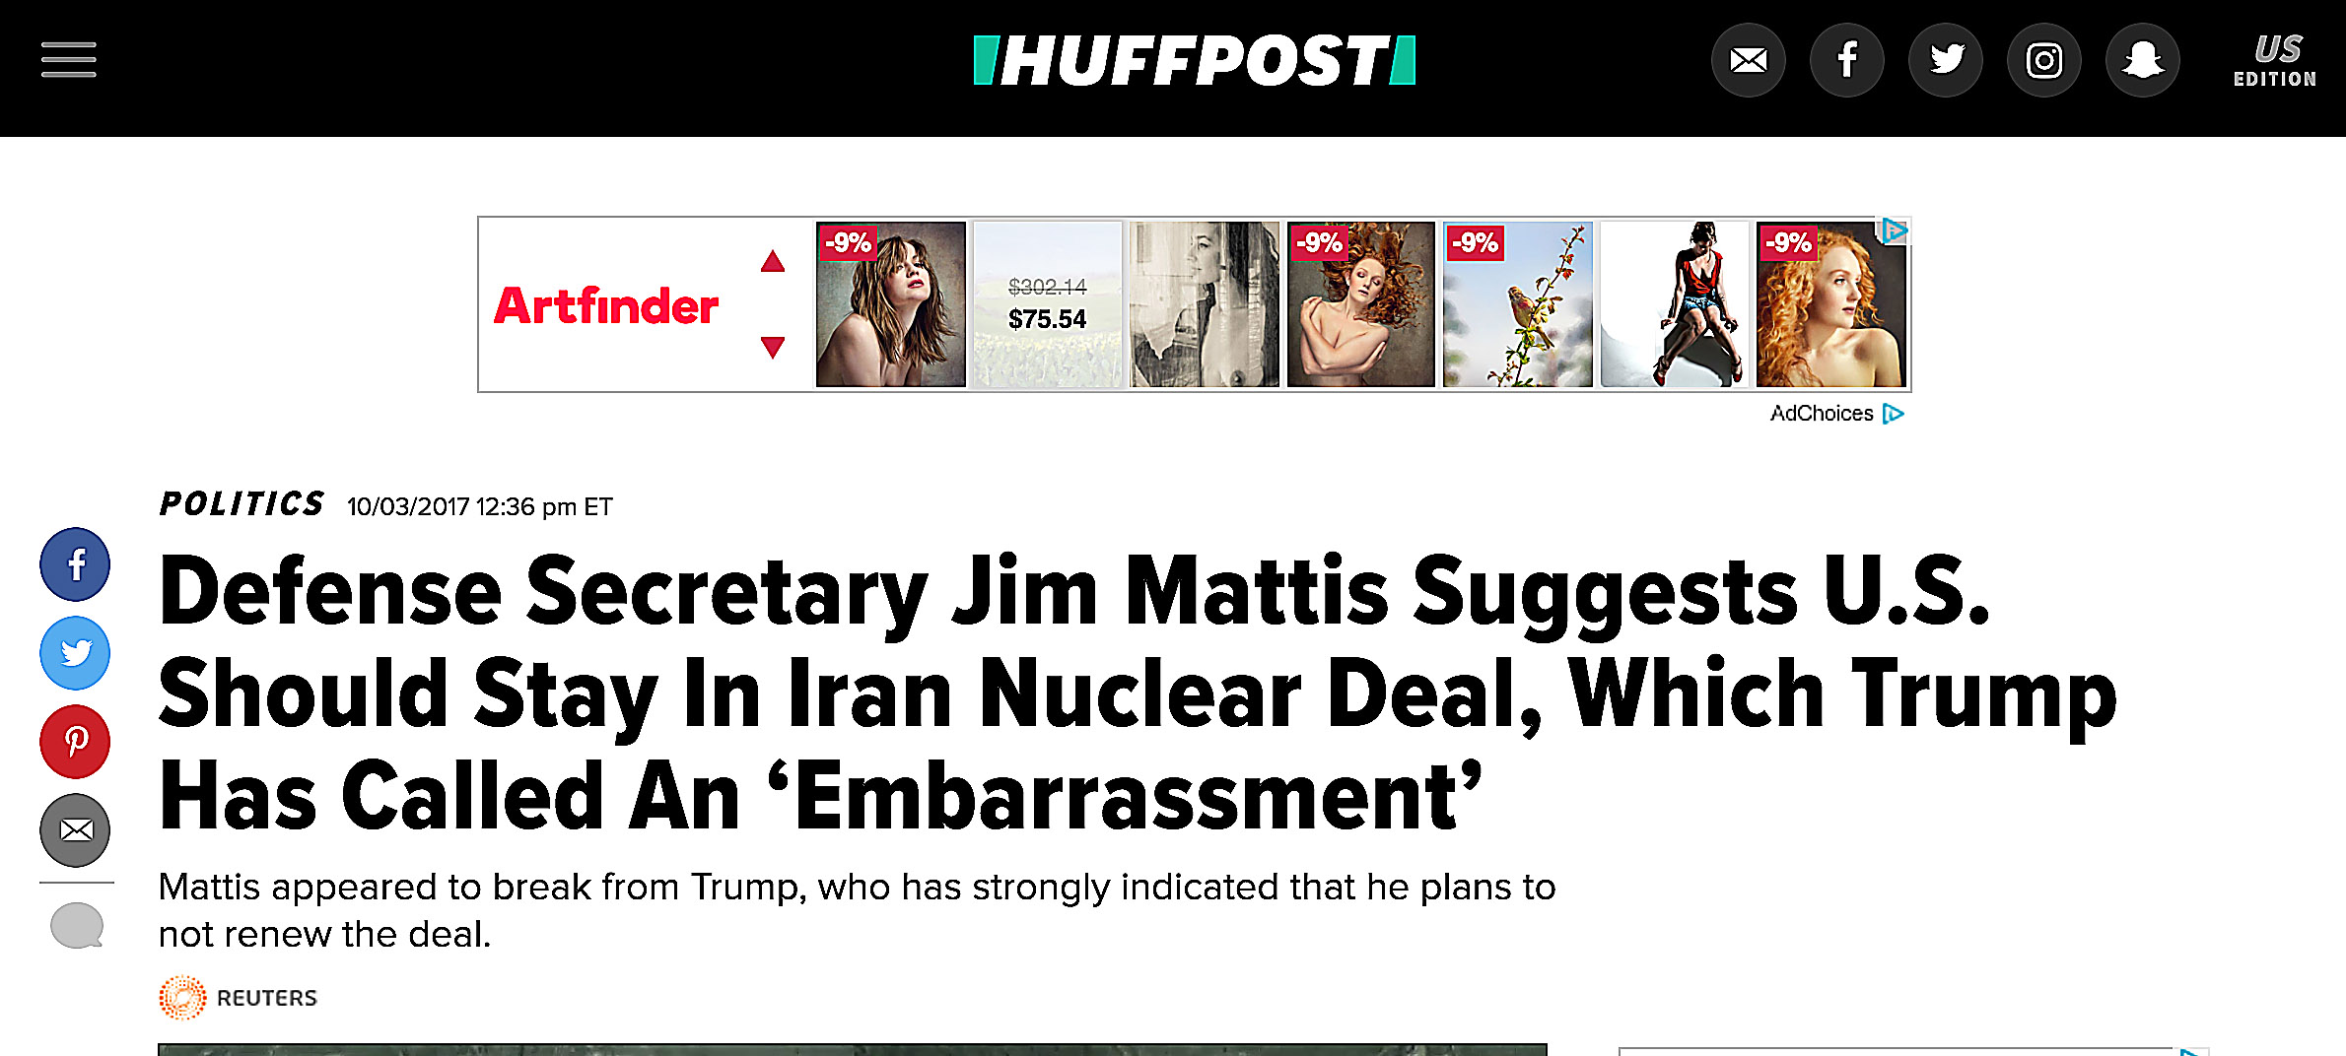
Headings
Online headings allow more flexibility for space, but need to meet SEO (Search Engine Optimization) requirements, and so are usually quite long.

Slide 7
Headline categories
Traditional mass media headlines generally fall into two categories:
Standard
Label

Slide 8
Standard headlines
Standard headlines are most familiar to us. Though they are written oddly—not at all the way people speak—we think they seem normal because they are so common.
For example, if we are telling a friend about something we saw earlier, we would not say:
“Two students injured in bike crash.”
But we would not be surprised at all to read this as a standard headline.

Slide 9
Standard headlines
A standard headline:
uses subject-verb-direct object format, or occasionally passive voice. Think action verb.
eliminates articles (a, an, the).
includes verbs in the present tense (or sometimes future tense).

Slide 10
Present tense
Standard headlines use the present tense even if the event happened in the past:
Student Senate hammers out athletics budget
(Not “hammered out.”)
Probably mass media does that to emphasize that something just happened—and we’re on top of it for you readers!

Slide 11
No articles
Articles are special types of adjectives, comprising three: a, an and the.
We do not use them in standard headlines, probably because they take up space. (They are more often used in online headings.)

Slide 12
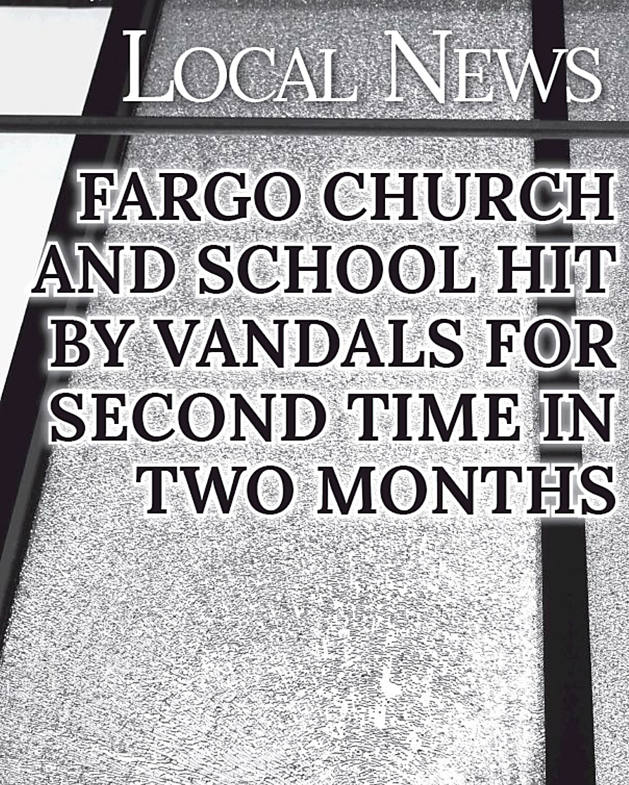
No articles
Note this headline contains no articles. It could say “A Fargo church and school…”
It is true that more often we see standard headlines containing the article “the,” but, strictly speaking, these are not standard heads.
Note the word “is” is understood here (“is hit”). Also note it is in the passive voice.
Standard heads often drop forms of the verb “to be.” Passive voice helps fill space.

Slide 13
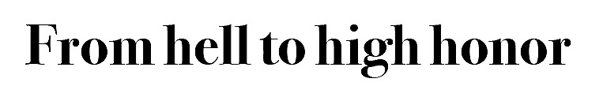
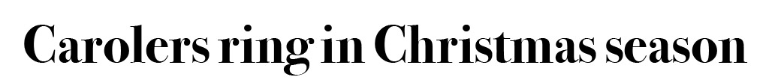
Clever headlines
We usually stick to serious headlines for hard news or serious stories.
We can try to find clever headlines for feature or humorous stories.
Headline writers often use alliteration or plays on words and clichés.

Slide 14
Label heads
A second common headline is the label head.
It has no verb. This includes dropped forms of the verb “to be.”
It may have articles.

Slide 15
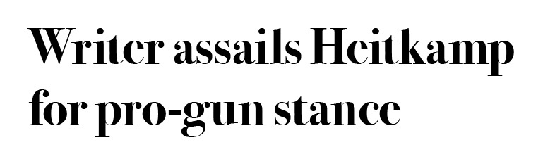
Label heads and titles
Label heads are used when editors want to indicate the topic of a story, but don’t want to suggest the story’s point of view.
This is particularly significant for opinion columns and letters.
For example, let’s say we have a letter from a reader regarding gun legislation controversy. We write a standard headline.

Slide 16
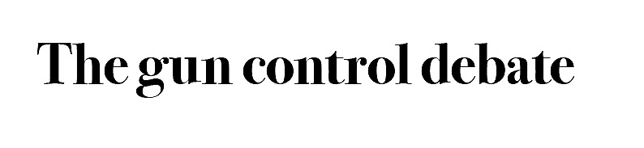
Label heads are neutral
Perhaps, however, the writer will disagree with the editor’s interpretation of her comments. What if we write a label head instead?
This headline is more neutral, not suggesting an interpretation of the writer’s perspective. It also sounds more literary, less journalistic.

Slide 17

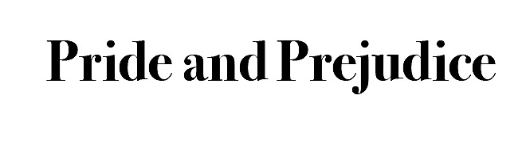

Writing label heads
Many people used to standard mass media style heads have a hard time coming up with label heads.
But label heads are all around us. They are similar to book titles.

Slide 18
How to write standard heads
Read the whole story. It’s harder to write a head if you just read the first couple paragraphs.
Begin with an active verb that suggests the idea of the story. Build a headline around that.
Try to use the subject-verb-direct object format as much as you can.
You may use passive voice if you need to fill space, as passive voice takes up more space.

Slide 19
A standard head
Example: the Cass County Commission Tuesday raised property taxes 10 percent.
Begin by thinking of a verb: raises. Okay. But kind of boring. Gooses? A bit lurid. Pumps? Jacks? Pushes? Cranks? Boosts?
Mmmaybe…. How about this?
County commission boosts property taxes

Slide 20
A standard head
But we have another problem: the headline must fit the space in printed mass media products (or, often, pdf format). Let’s say we need a three-line head. It’s often easier to write it first, then divide it.
County commission
boosts
Property taxes

Slide 21
A standard head
“Boosts” is a little short. Can we do this?
County com-
mission boosts
property taxes
No! We can’t hyphenate multiline heads in standard headline writing.

Slide 22
Shortcuts
While we can’t hyphenate multiline heads, we are not bound by other constraints of writers.
We don’ t have to use AP abbreviations. For example, in a head “percent” can become %. It takes up less space. “One” can become 1.
We don’t use periods after a headline (but we do use commas or semicolons, if necessary.
We use single, and not double quotes.
We can use abbreviations.

Slide 23
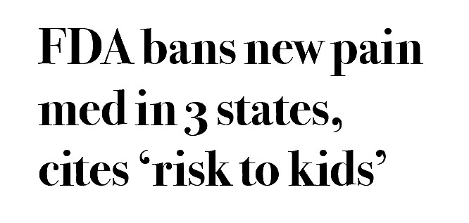
Shortcuts
For example, it’s okay to write the headline below. Note ”3” is not AP style, FDA is an abbreviation, and single quotes replace double quotes. No period, but the comma is still necessary.

Slide 24
Obscure abbreviations
We can use abbreviations if most readers are likely to understand them.
Most people know FDA means Food and Drug Administration.
But if the abbreviation is uncommon, avoid it.
How many of us know what AEJMC stands for? Didn’t think so.

Slide 25
Capitalization
We normally write headlines in sentence style. That is, we capitalize the first word and proper names, but the rest is “down” (lower case).
We also normally do not write in all caps. Research has shown that this technique and the title style (capitalizing every word) are harder to read.
Note that some publications do not follow these conventions.

Slide 26
Options to attract readers
Headline writers have other options to attract readers.
A deck is a smaller headline below a standard head.
A kicker (or eyebrow) is a smaller headline above a head.
A pull quote is a line from the story that grows into a headline. It may be placed anywhere within the story, with the copy flowing around it.
A subhead is placed within a story to announce a new topic.

Slide 27

A kicker
Normally we drop the noun in a kicker.

Slide 28
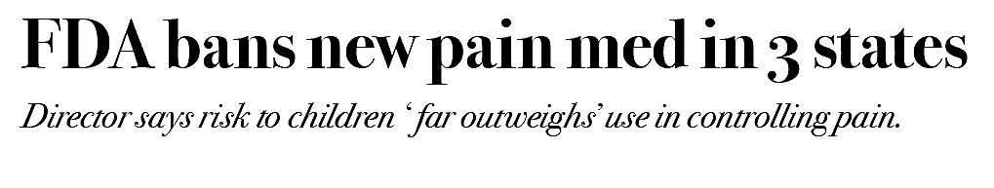
A deck
Decks are normally written in complete sentences, although they may be written in standard head style, present tense, no articles.

Slide 29
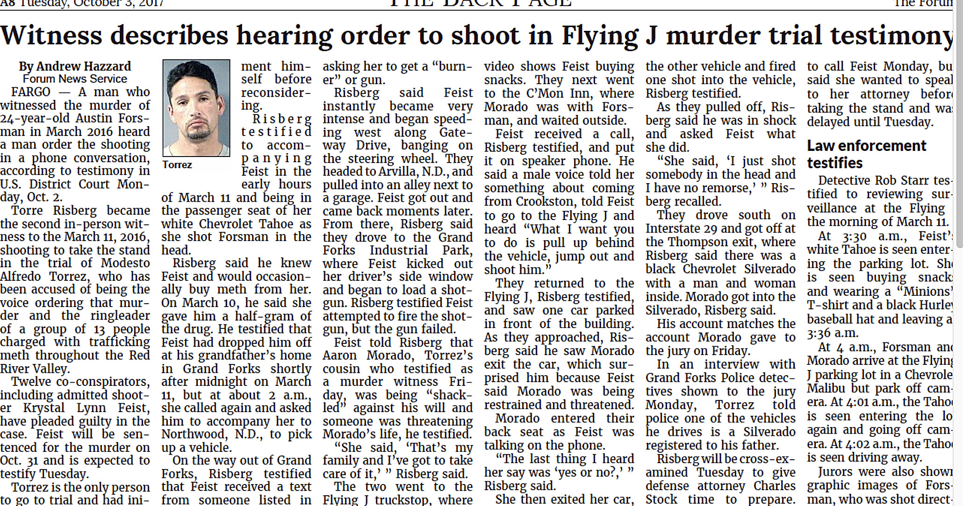
A subhead
This article includes a subhead.

Slide 30
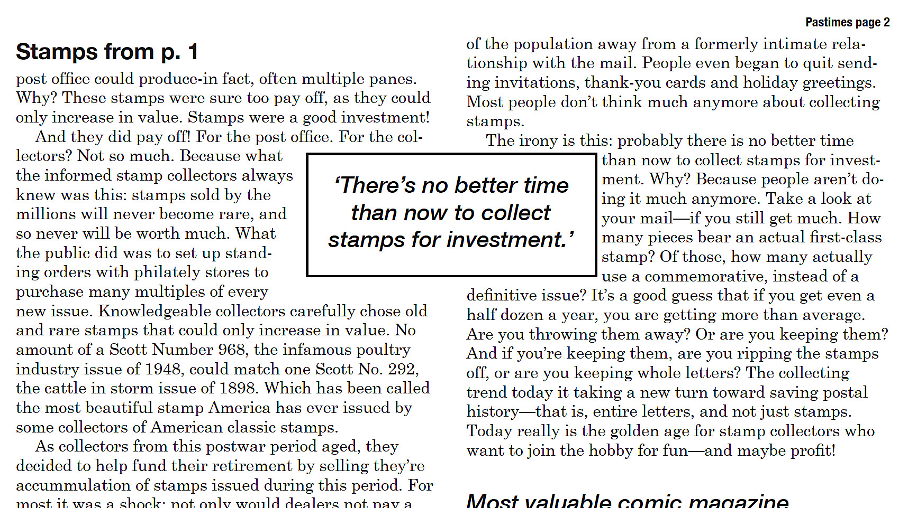
A pull quote
This newsletter includes a typical pull quote.

Slide 31

SEO and headings
Note that online headings do not have to be short, as headlines often do. In fact, they are often written longer for Search Engine Optimization. The writer tries to think possible words a reader may use to search for the story topic, and hopes that a search engine will produce the story. Decks also are popular.

Slide 32
Making headlines fit
While headings have quite a bit of flexibility, headlines need to fit the space left for them.
They can’t be too long, obviously. But they also should not be too short.
The rule is this: A headline should go at least half way across the last column of text below it.

Slide 33
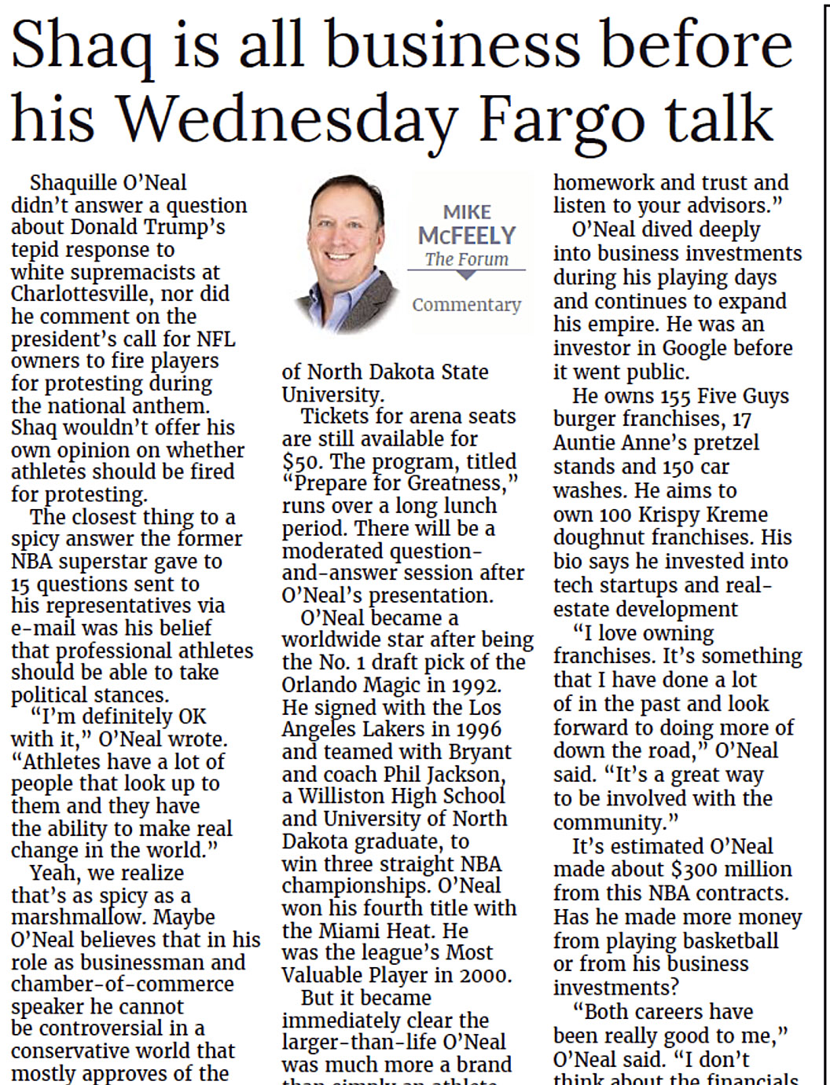
Fitting headlines
This two-line, three-column head fits almost perfectly.

Slide 34
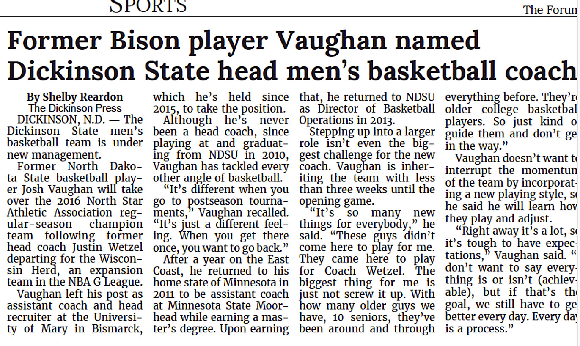
Short head
The first line of this four-column head is a little short, but okay.

Slide 35
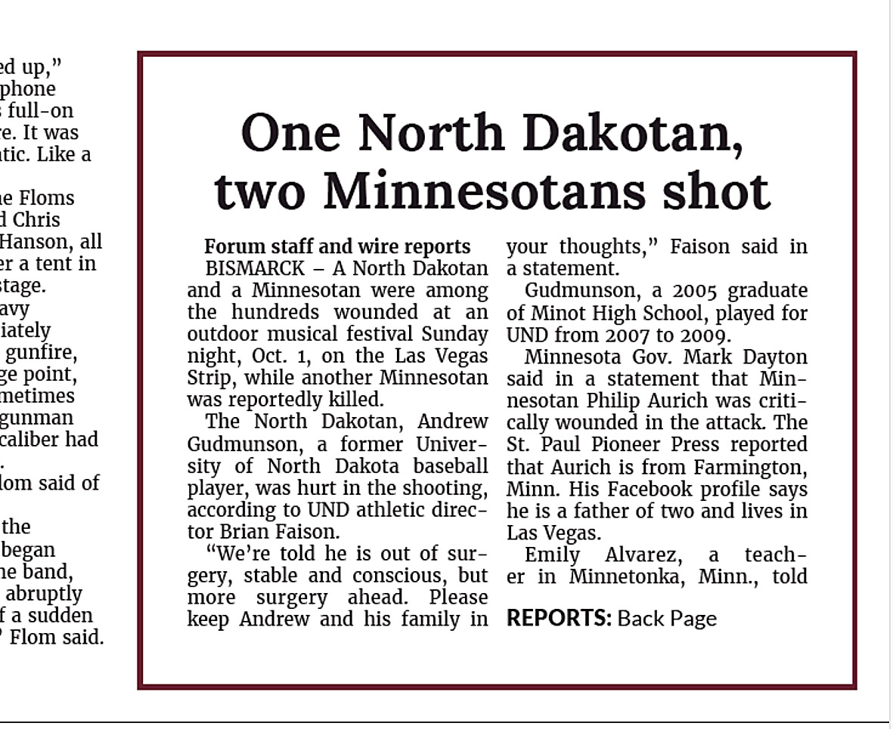
Centering
Modern mass-media headlines are normally flush left. If they are centered, they often have a border around the story.

Slide 36
Headline size
We measure headline height in points and picas, the standard scale used in the graphic arts industry.
1 pica (p)=12 points (pts).
6 p=1 inch (just about).
72 pts=1 inch.
Type from about 8 pts to 12 pts is called “body text (or type)”
Type from about 14 pts up is called “display text.”
Type smaller than 8 pts is sometimes called “agate text.”
It’s used for small print and classified ads.

Slide 37
Standard measurements
Headline sizes are usually indicated in multiples based on 72 pts, or 1 inch:
Body text is usually 9 or 10 pts.
Display text is 14 pts, 18, 24, 30, 36, 48, 60, 72, or rarely, 84 and above.
Headlines bigger than about 72 pt are sometimes called “woodies,” nickname from letterpress days when big letters were made out of wood.
Journalism uses a lot of terminology left over from technology long extinct. We respect our elders.

Slide 38
Headline size convention
We indicate headline sizes with three numbers:
Number of columns, size (in pts) and number of lines.
We use a shorthand with the three numbers separated by hyphens.
For example, a 3-col (column), 36-pt, 2-line head would be:
3-36-2.

Slide 39
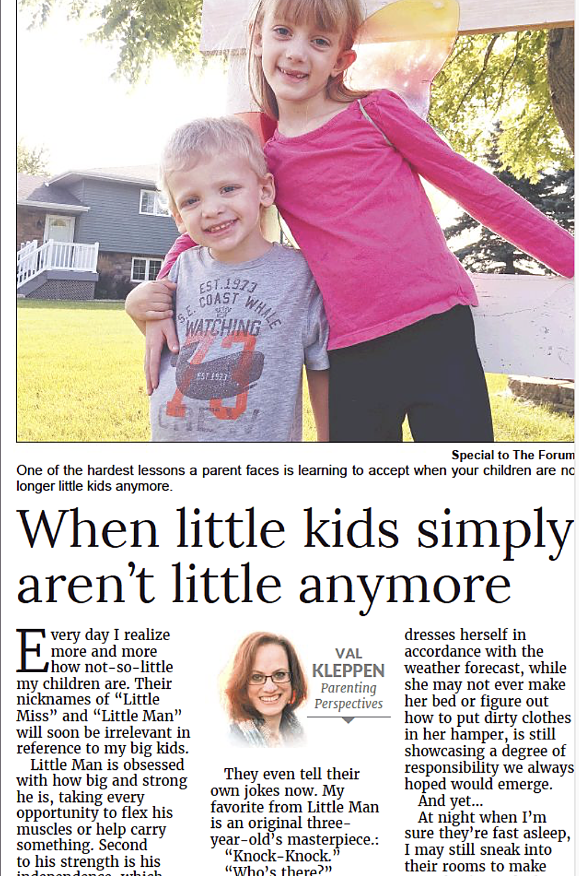
A 3-36-2 in action
Typical 3-36-2.

Slide 40
Calculating head sizes
How do we calculate headline sizes?
Most type is designed to be proportional. That is, different letters take up different amounts of space. (Except monospaced type.)
How much space? Well, we know m and w take up more space than I and t, for example. Capital letters more than small letters.

Slide 41
Unit count
In the old days we used a headline schedule, or hed sked for short, to calculate unit sizes for different sizes and type faces.
Units were calculated like this:
All lower case letters=1 unit.
Except m and w=1 ½ units.
Except f, l, i, t, and j (“flit-jay”), spaces and commas=1/2 unit.
All capital letters=1 ½ units, except M and W=2 units, and I, 1 unit.

Slide 42
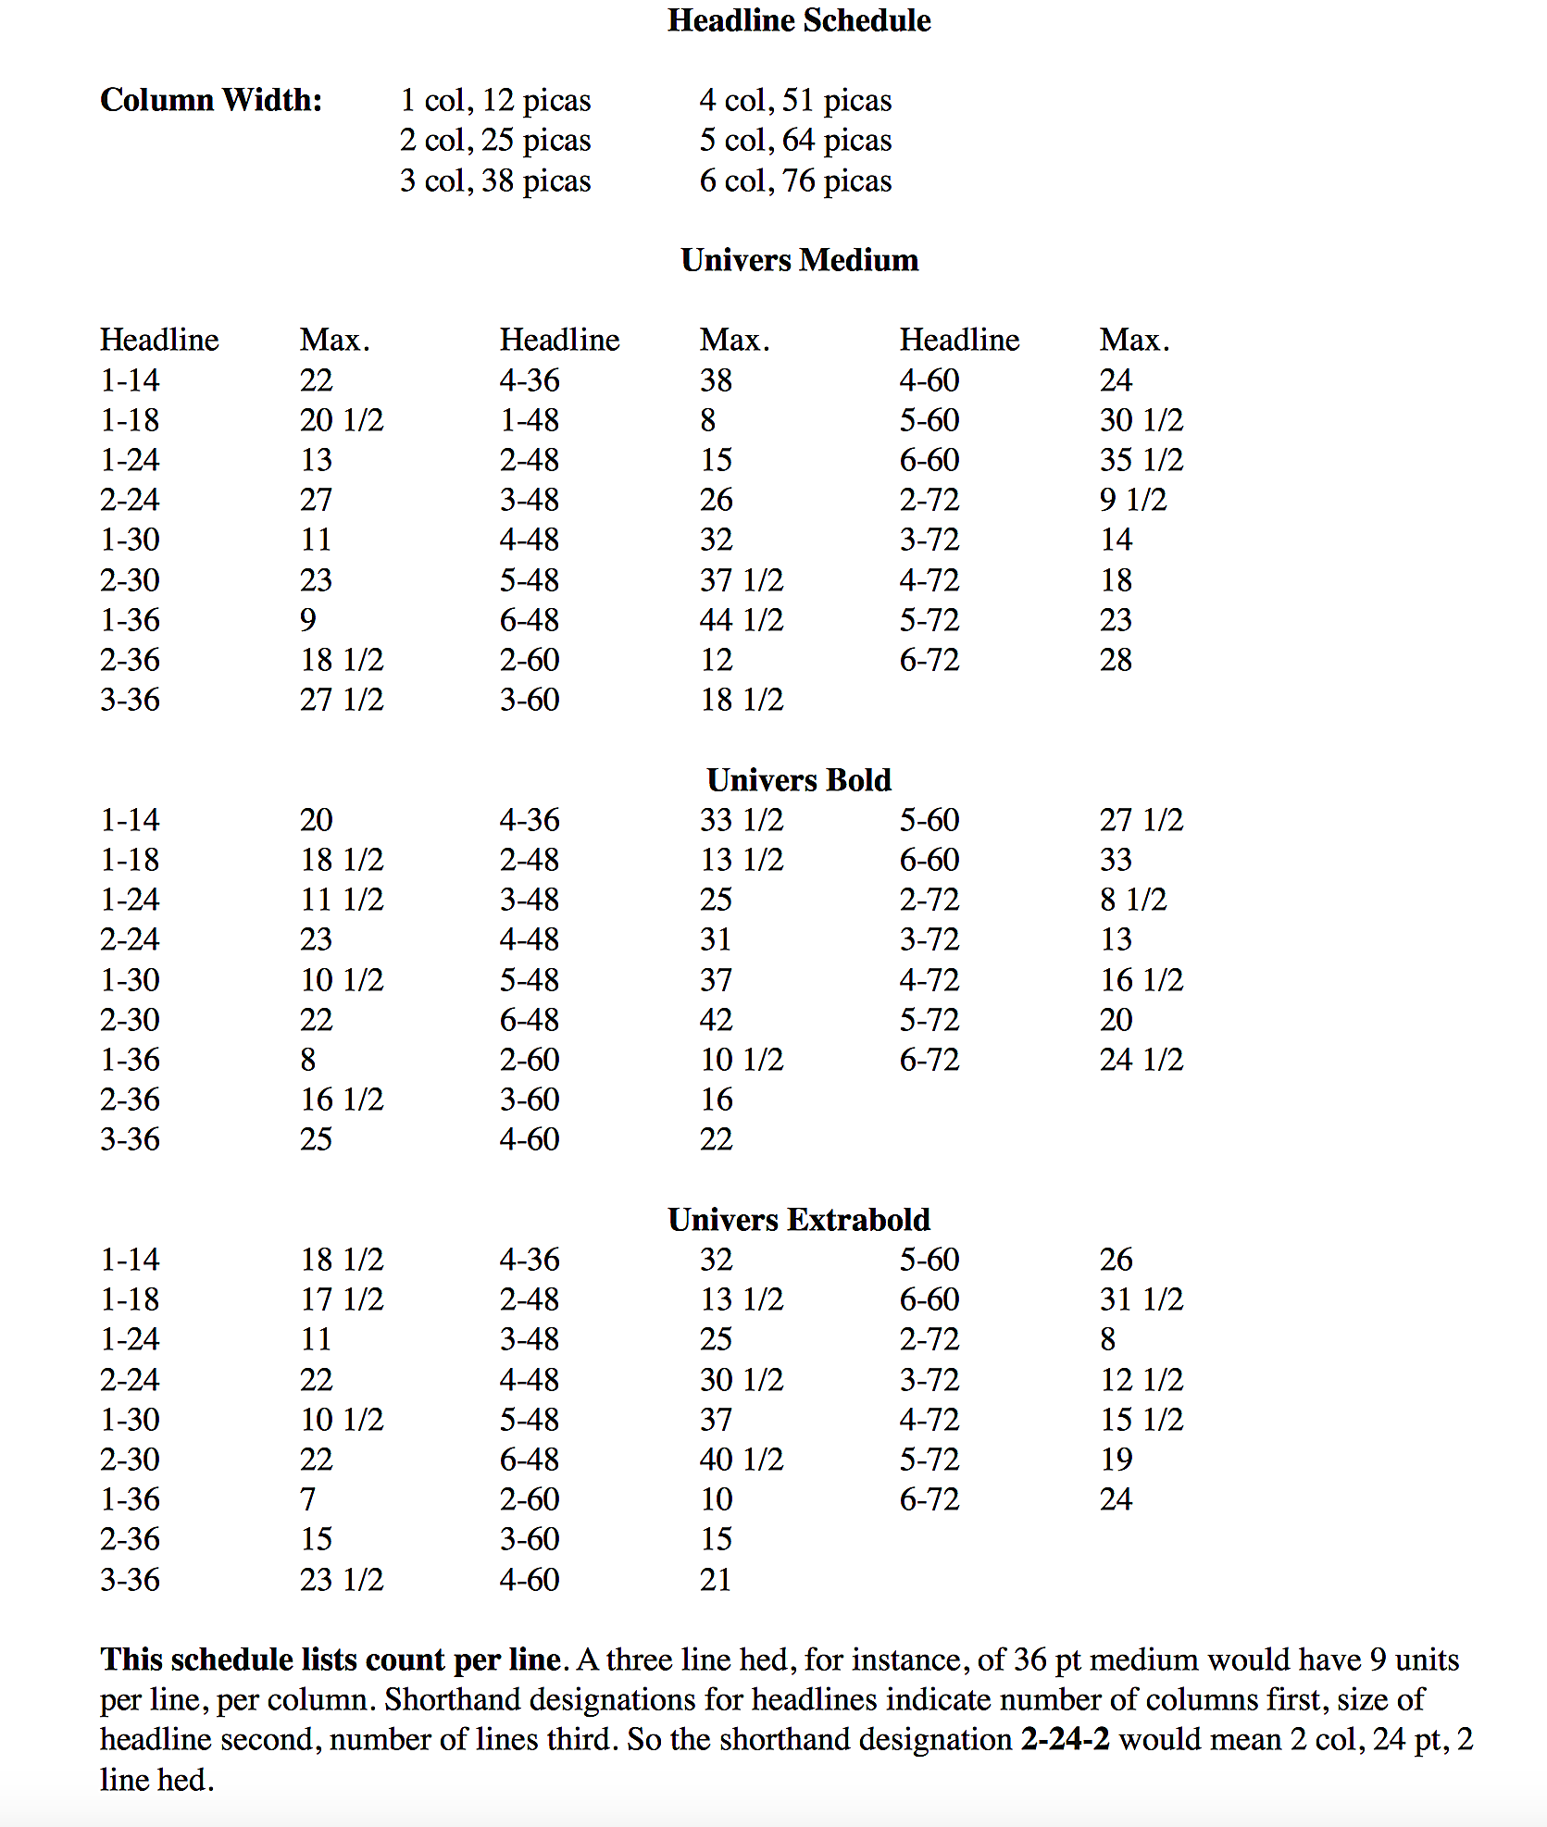
A typical hed sked
The typeface is called Univers.
Headlines take up differing amounts of space depending on the typeface.
The numbers on the left indicate columns and point size.
The number on the right indicates maximum units.

Slide 43
Hed sked uses
Note some headline sizes are not listed on the hed sked. For example, you see no 1-60 (1 col, 60 pt).
Why? Think about it. It would be impossible to write a 1-col 60 pt. Not enough space.
Similarly, you don’t see, for example, a 4-14. Why? Too much space for a headline. Would be okay for a deck, however.

Slide 44
Counting units
Let’s say for a one-line, 36-pt head going across three columns, the number of units according to your hed sked is 25 (Univers bf).
You write this headline:
Student editors detest unit count
And now you count it. I usually begin by counting everything as 1, then adding or subtracting as necessary.
I get a unit count of 28. Will it fit? Nope. Have to rewrite.

Slide 45
Counting units
Unit count method is nearly obsolete, as computers now count headlines for us. But I introduce it for two reasons:
It gives us a feeling for the proportional sizes of different letters.
Some tests for editing jobs and internships, including the famous Dow Jones exam, still require familiarity with unit count.

Slide 46

Computerized pagination
Today we have a variety of software to count headline sizes for us.
We’ll reserve that discussion for another presentation.

