Slide 1
Working with large formats
Principles for tabloids and broadsheets.

Slide 2
Large format grids
Some editors are daunted when facing the seemingly enormous expanse of white space available in a larger format.
A grid is one way to help organize the space.
Most tabloids are 5 columns; most broadsheets are 6 columns.

Slide 3
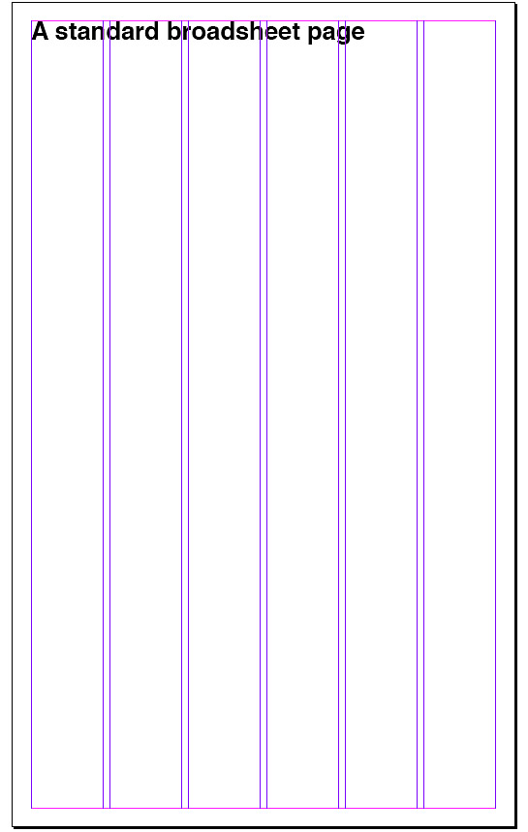
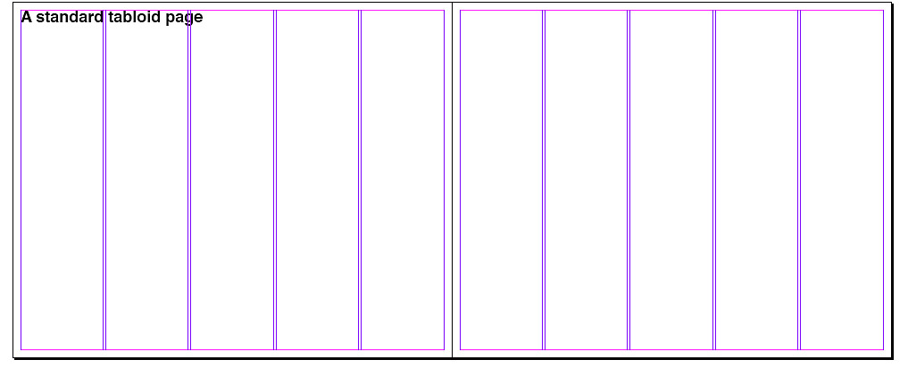
Grids
A tabloid is usually a broadsheet folded in half and printed horizontally.

Slide 4
Empty space
Often editors must deal with space left after advertisements have been placed. But let’s consider first an empty page.
An empty page may be a vertical format or, if the editor has two facing pages to work with, a horizontal.
A horizontal is called a spread or double-truck.

Slide 5
Four points of entry
Editors have four basic ways to attract readers to a story:
The photo or illustration.
The headline.
The deck or pull quote.
The lead.
It’s up to the designer or editor to place these so that the reader’s eye will be pulled into the text.

Slide 6
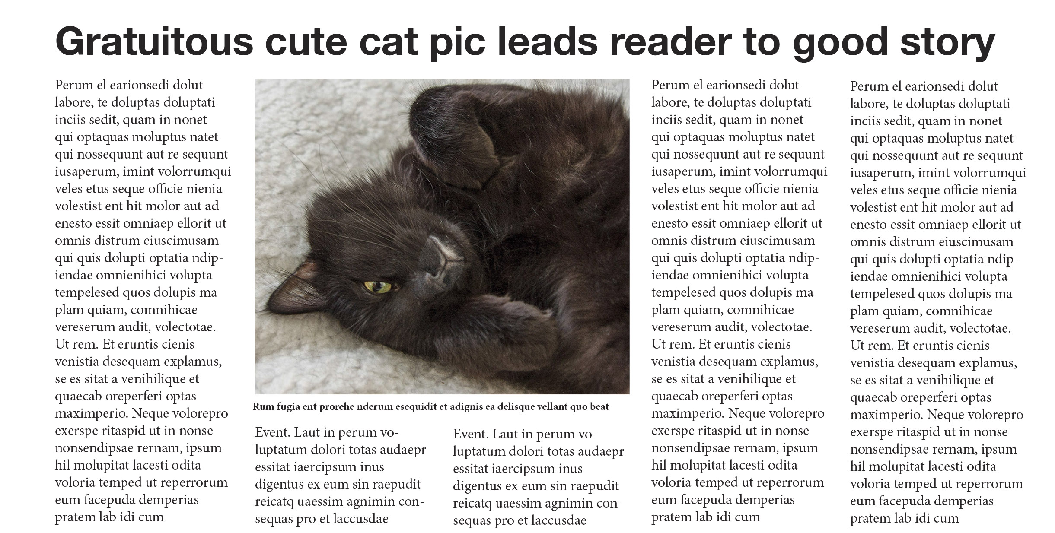
Attractions
Normally readers will first be attracted to a photo or illustration.
From there they will look for a headline to give a sense of the story’s interest.

Slide 7
Attractions
Next they will consider a deck or pull quote to determine whether it’s worth continuing.
Finally, they’ll evaluate content based on the lead or “nut graf” (first paragraph).

Slide 8
Large format spaces
Commonly designers have one page to work with, a vertical format. To begin, consider a dominant, theme-setting photo with a strong center of interest.
The photo should be at least two columns vertically, or three columns horizontally. Small photos are unattractive, unless mugshots.

Slide 9
Large formats
Run the story across at least two columns.
Place headline at top, photo underneath, and story columns surrounding photo.
Add deck or pull quote, if possible.

Slide 10
Large formats
Elements should line up at top and bottom.
It’s okay to leave a little white space if the story comes up slightly short, but no more than a half column inch or so. (A column inch is one column by one inch.)

Slide 11
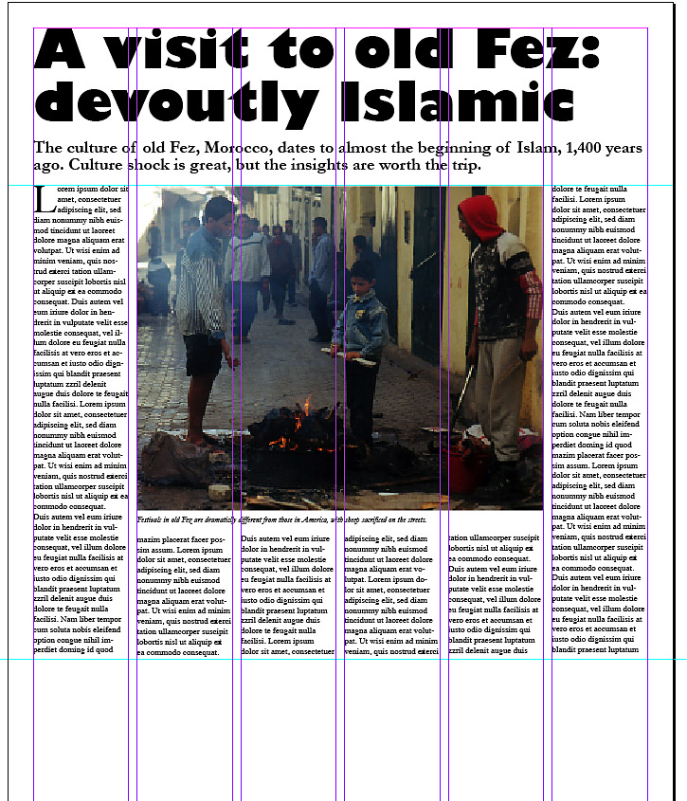
Typical layout
Here is one typical layout.

Slide 12
Think illustrations
As a general rule, one-third of the page should be art: illustrations, photos, graphics, tables.
Add a sidebar, rules, screens, or other elements for contrast.
Add more stories. If headlines butt against each other (“tombstoning,”) consider making them look different by choosing bf, ital, or multi-line.

Slide 13
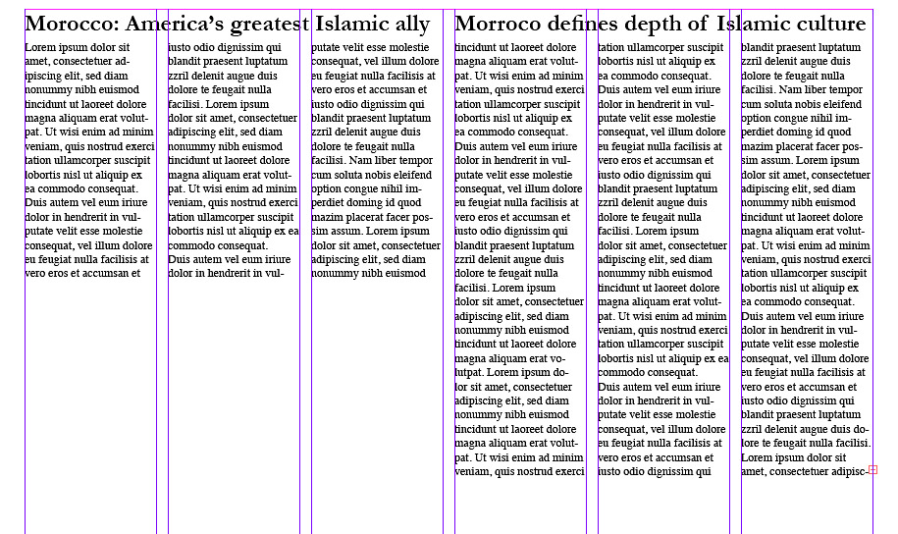
Tombstoning
These headlines are unattractively close and may be confusing to read.

Slide 14
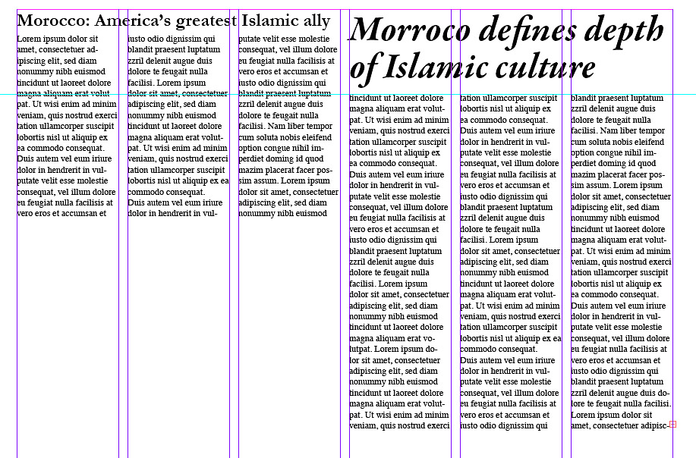
Tombstoning
Avoid tombstoning by making one headline contrast with the other.

Slide 15
Add contrast
Try to avoid large expanses of gray text. Below we’ve tried to add contrast through:
a boxed and screened sidebar;
photo;
drop cap;
deck;
rule between sidebar columns;
pull quote.
It’s still a little gray and text heavy.

Slide 16
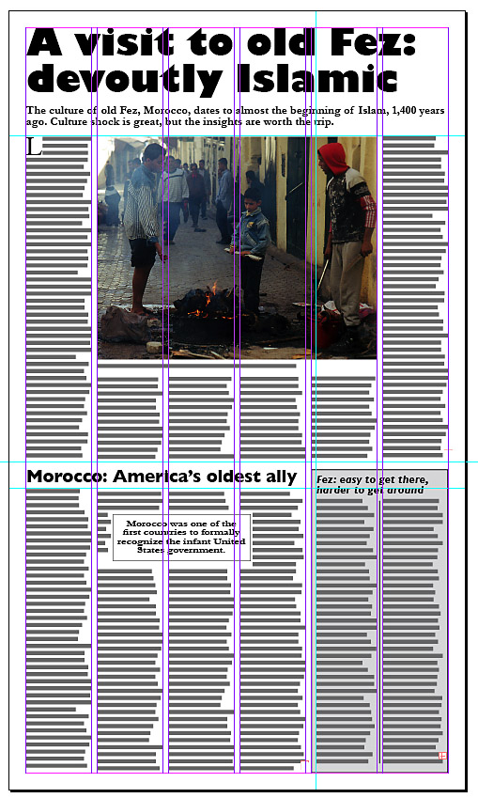
Large formats
A completed page.

Slide 17
General rules
Some general rules:
Don’t change leading to make story fit. Looks unattractive.
Don’t place photos all the same size.
Find a dominant focal point for the page, usually a large photo.
Avoid squeezing elements. When in doubt, it’s better to leave extra white space.

Slide 18
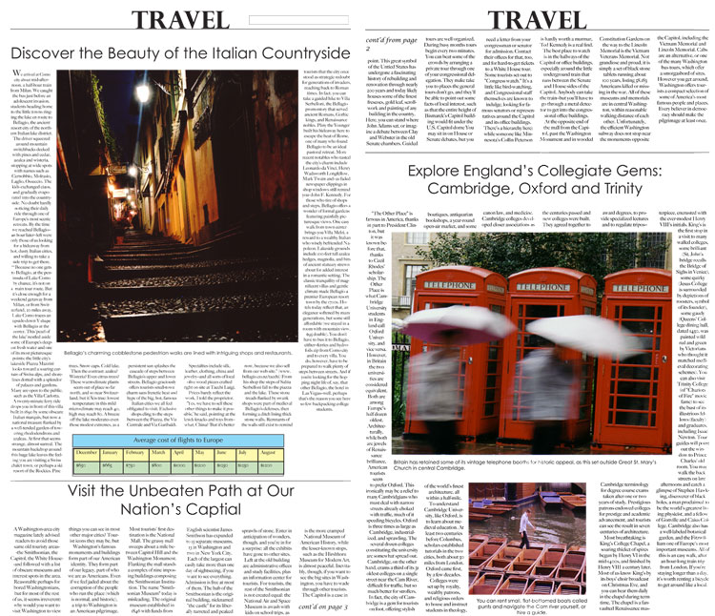
Large formats
Critique this student broad-sheet.

Slide 19
Many stories
Many times graphic designers and editors working in large formats are supplied with many stories, some of them small.
The challenge is to make the elements look attractive and balanced.

Slide 20
Emphasize balance
Try to avoid placing all large stories at top, small ones at bottom. It gives the page an unattractive look, as if the designer ran out of copy.
Try to balance elements on a page.

Slide 21
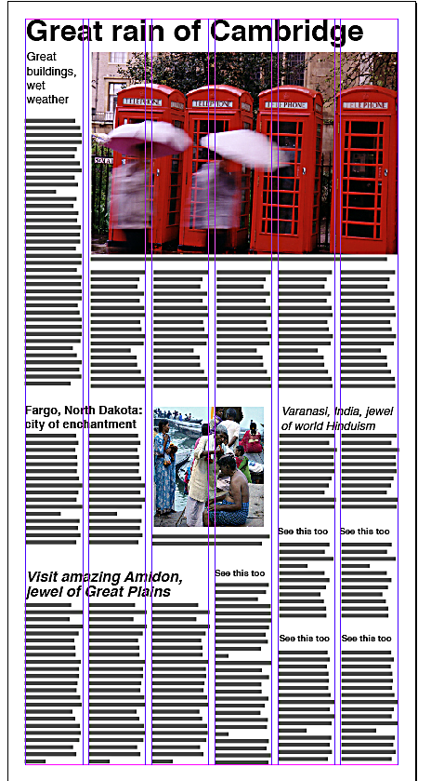
Large formats
How could you improve this layout?

Slide 22
Placing ads
Many times graphic designers won’t be able to work with advertising-free pages.
Display advertisements can be placed in one of three standard arrangements:
pyramid;
well;
modular.

Slide 23
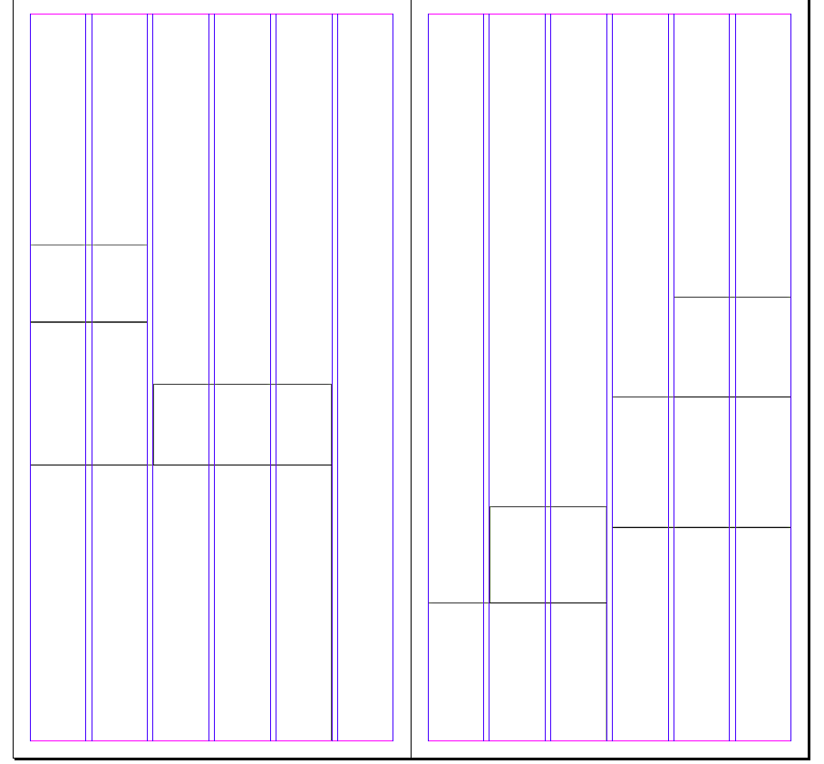
Pyramid
Pyramid style on a spread.
Note ads usually go to the outside and bottom of each page.

Slide 24
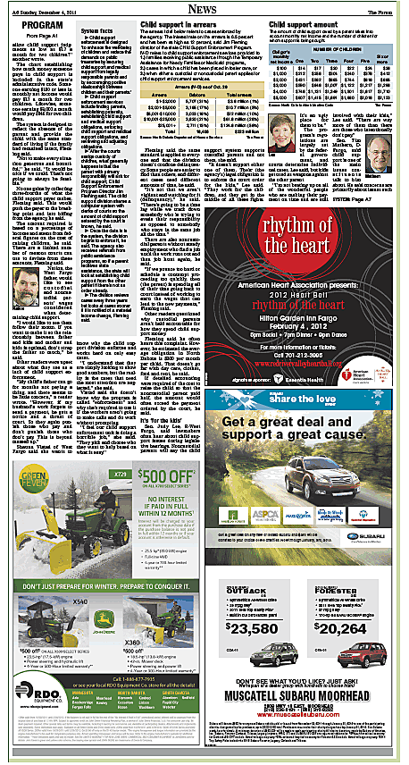
Pyrmaid
A pyramid style.

Slide 25
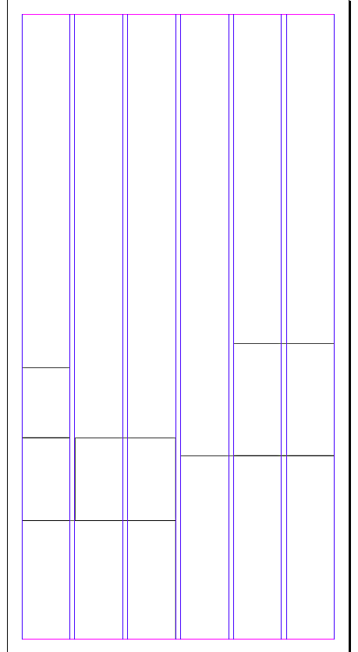
Well
Well style. Adds go to bottom in a sort of U shape.
This is less common than the pyramid style.

Slide 26
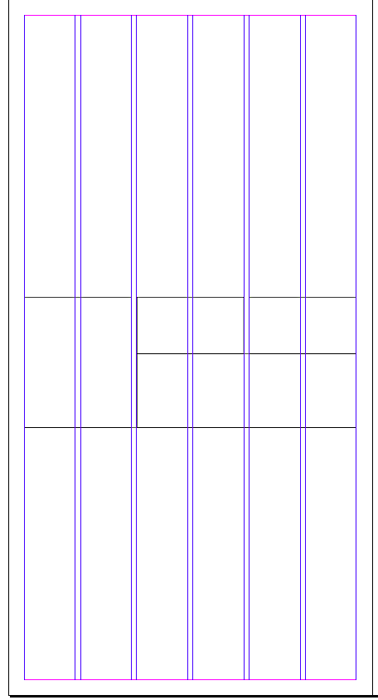
Modular
Modular style.
This style is best for attractive design.
Most graphic designers add a rule between display ads and copy to separate.
Avoid boxed copy or photos next to ads.

Slide 27
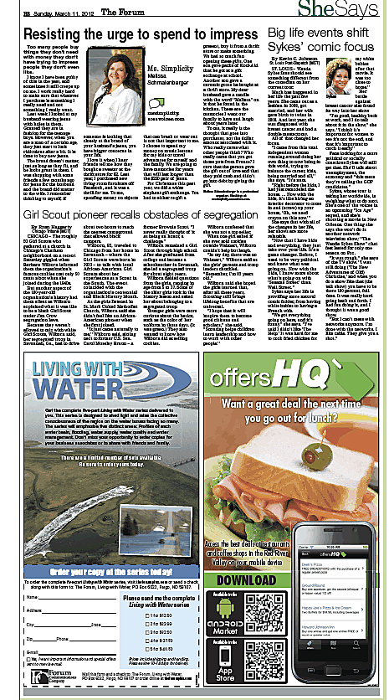
Modular
A modular style page.

Slide 28
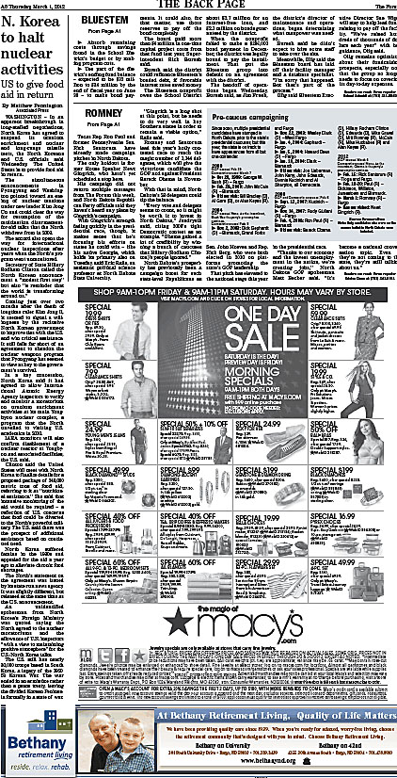
Awkward ads
Advertising placed with deep wells or single columns to one side doom a graphic artist’s or editor’s efforts.

Slide 29
Ad problems
Editors may request that ads be moved, but as advertising comes before copy, the request may not be honored.

