Slide 1
Flow and unity
Evaluating the gestalt

Slide 2
Flow and unity
“Gestalt” means the unified whole.
We’ve approached design by using Gestalt research, planning our work by understanding how people look at visual images.
But while we can analyze images for particular aspects, people look at them as a whole.

Slide 3
Flow and unity
Considering this idea of a whole, we can analyze our designs by determining how people scan them.
This is sometimes called flow.
Flow is important because it determines how designers can control the way viewers look at a design.

Slide 4
Flow and unity
Of course, Western culture is used to beginning reading from the upper left, but that’s not always the case.
Asians traditionally begin at the right.
I suppose most of our designs will be for a Western audience, but we can’t always presume that.
We also can’t presume everyone will look at a design as research says they ought.

Slide 5
Flow and unity
Good flow is based on consistency of type and other elements. This offers visual cues to help a viewer move through a page.
You might recognize this as an implementation of the Gestalt principles, in particular similarity.

Slide 6
Flow and unity
In the next illustration, try to identify ways the graphic designer has worked on flow. Focus on
Typography.
Consistency.
Repetition.

Slide 7
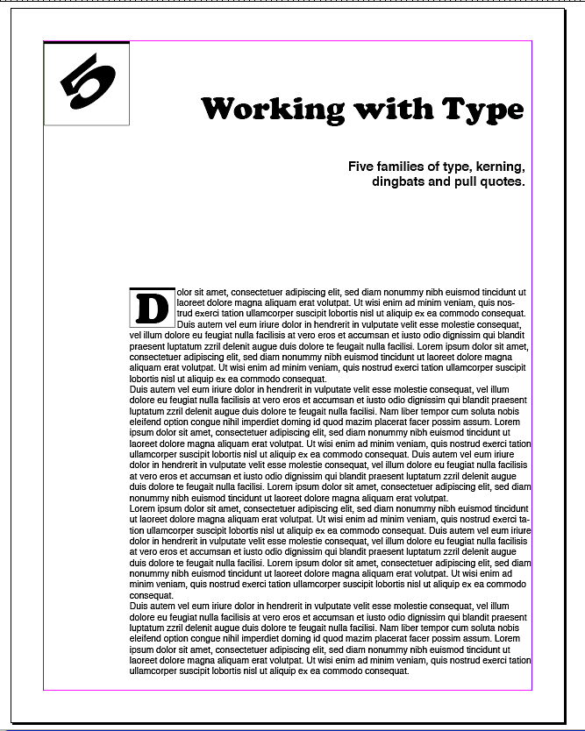
Flow and unity

Slide 8
Flow and unity
Title typeface matches drop cap.
Drop cap style matches chapter number.
Deck typeface matches body text.
Title lines up with chapter number.
Deck lines up on right with title.
Body text lines up on left with chapter number.
Eye moves through page from chapter number, to title, to deck, to cap, to text.

Slide 9
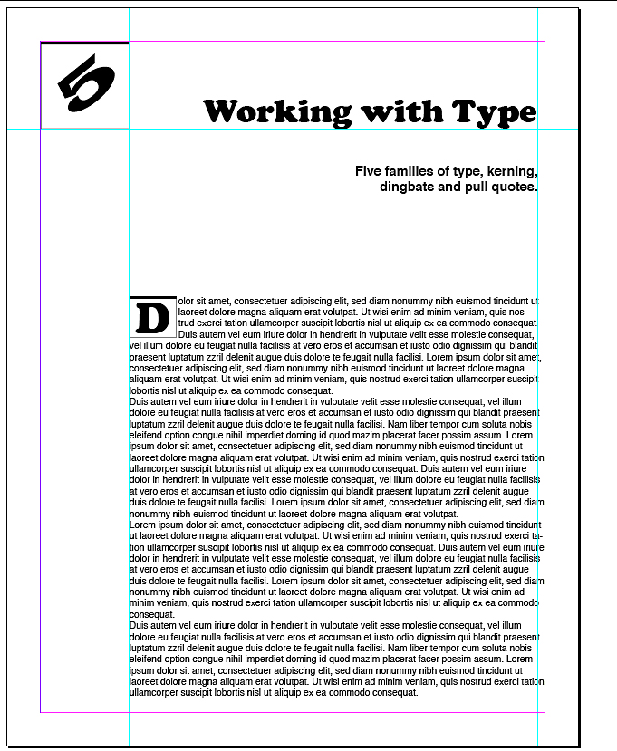
Flow and unity
Here is the design with guidelines to show placement.

Slide 10
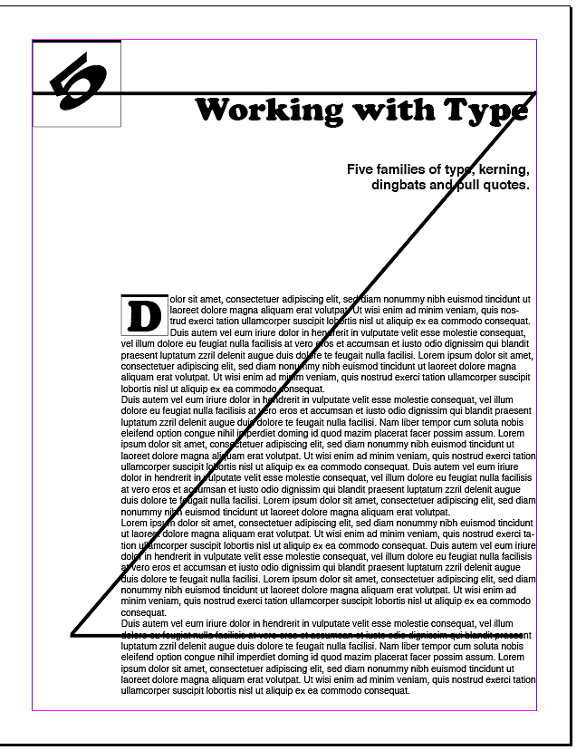
Flow and unity
Research shows people tend to scan a page using the Z-pattern, that is, from upper left to lower right.

Slide 11
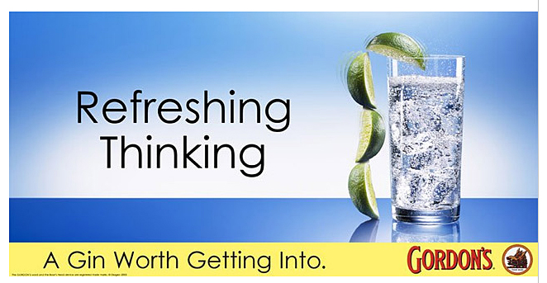
Flow and unity
Advertisers know this, and so try to put the element they want readers to remember in that lower right corner.
Often that will be the logo.

Slide 12

Flow and unity
Note you can use flow to keep viewers from exiting your design.
Dingbats can keep the eye from wandering away.

Slide 13

Flow and unity
Pointing hands and arrows, on the other hand, drag your readers’ eyes to a place you definitely want them to go.

Slide 14

Flow and unity
Also strongly leading a reader’s eye is a photo of a person looking somewhere. If that person is looking out of your design, that’s where a reader’s eye will go.

Slide 15
Flow and unity
A reader’s eyes will naturally go to the optical center of a page. Then he or she will scan using a basic Z-pattern.
We usually put our book or report titles on the optical center.
The optical center is above the mathematical center, possibly because when we look at a person’s face, we look at the eyes, which are slightly above center.

Slide 16
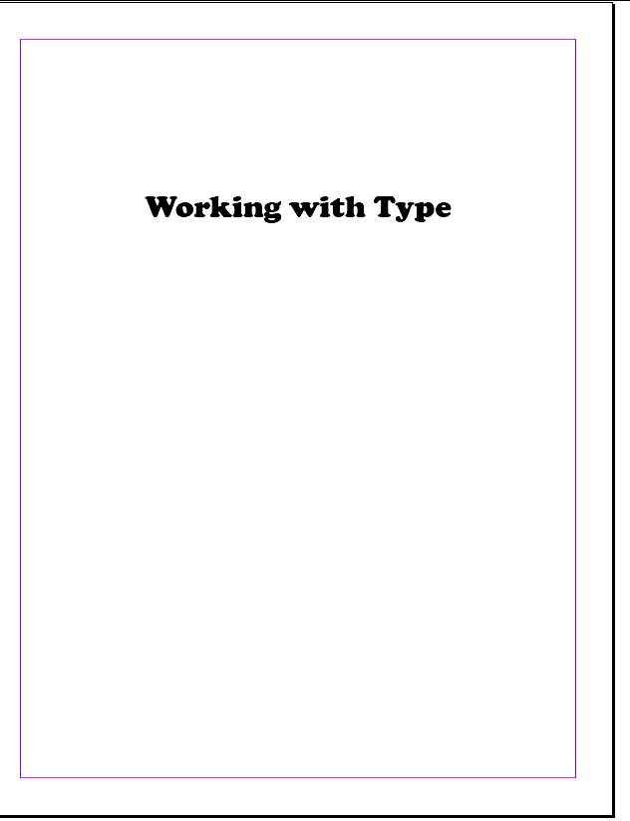
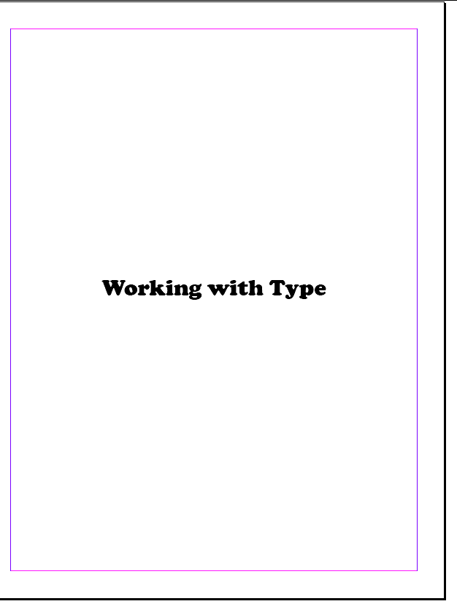
Flow and unity
Optical and mathematical center.

Slide 17
Flow and unity
Unity is a feeling that the design “hangs together,” that elements harmonize and enhance the Gestalt. According to one design author, this is unity:
design elements of a single purpose are grouped;
white space is concentrated;
each element complements the others.
(Tom Lichty)

Slide 18
Flow and unity
We can consider the Gestalt principles as they relate to unity:
Proximity of objects suggest a pattern.
Similarity of objects suggest relationships.
Continuity of line from one part of a design to another suggests grouping.

Slide 19
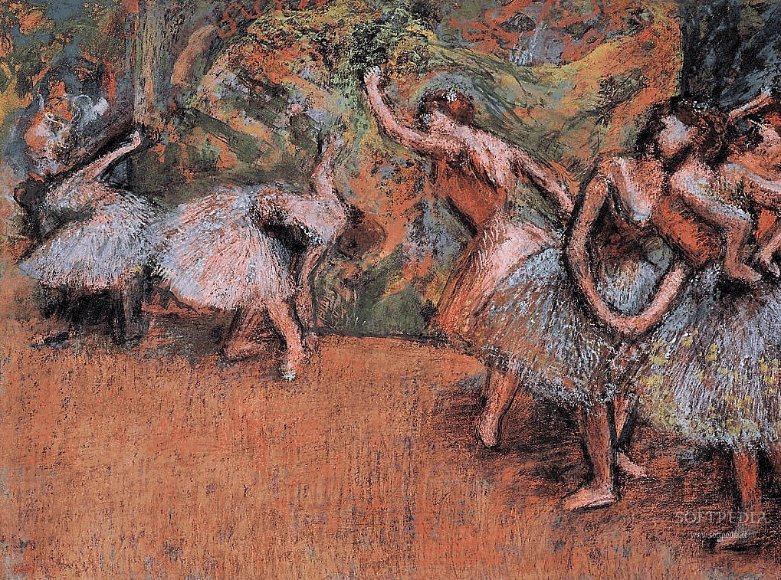
Flow and unity
Consider the subtle way the artist Degas has used these principles.

Slide 20
Flow and unity
Proximity: The dancers overlap, and so are considered as related. But the space between the two groups sets up two relationships. The two are linked by the continuity of the dancers to lead our eye between the groups.

Slide 21
Flow and unity
Similarity: The dancers wear similar clothing, have similar colors. The colors in the clothing are repeated in the background.

Slide 22
Flow and unity
Continuity: The curved arms of the dancers is repeated in the curves of the skirts, and the curve of the floor. Curves of color in the background emphasize those of the figures.

Slide 23
Flow and unity
In graphic design, choice of typeface is basic to unity.
Choose one typeface for body, one for headlines, and one standard for leading.
Choose one or two spot colors, use them for the same elements throughout.
Choose consistent spacing between headlines and text, photos and cutlines, and other elements.

Slide 24
Flow and unity
Try to make graphics complement each other:
ornamental borders with ornamental type;
angular borders with angular type;
bold illustrations and bold type.

Slide 25
Flow and unity
Consider the three-point layout method.
Group pictures, text blocks, subheads or graphics into three.
This reflects our psychological attraction to things in groups of three:
earth, fire, water;
father, son, holy ghost;
NDSU, MSUM and Concordia (okay, reaching on that last one...).

Slide 26

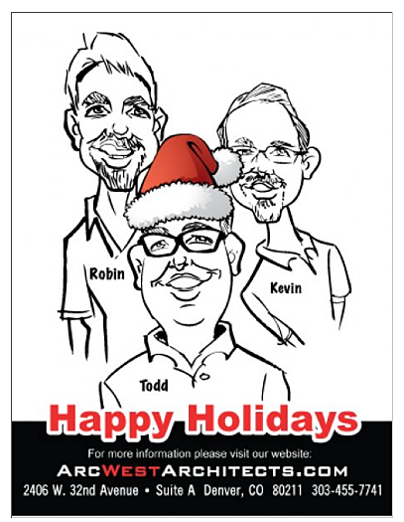
Flow and unity
Advertisers like groups of three.

Slide 27
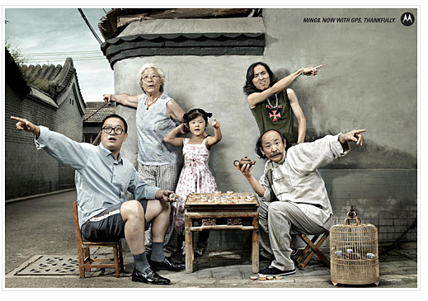
Flow and unity
Other odd-numbered groups of elements can add power and unity to a design.

Slide 28
Flow and unity
Other tips to enhance flow and unity:
Pull headlines near their articles;
All columns of text should have a headline above;
Avoid very wide or very narrow columns;
Avoid very wide or very narrow leading;
Keep list items together;
Don’t condense or expand text to fit.
Keep cutlines with their illustrations.

Slide 29
Flow and unity
Consider principles of flow and unity in improving the flyer on the next slide, including:
Unity of typography, attractive leading;
Z-pattern, optical center;
Groups of three;
Related items together;
Consistent spacing;
Flow direction, people facing inward;
Elements aligned with each other.

Slide 30
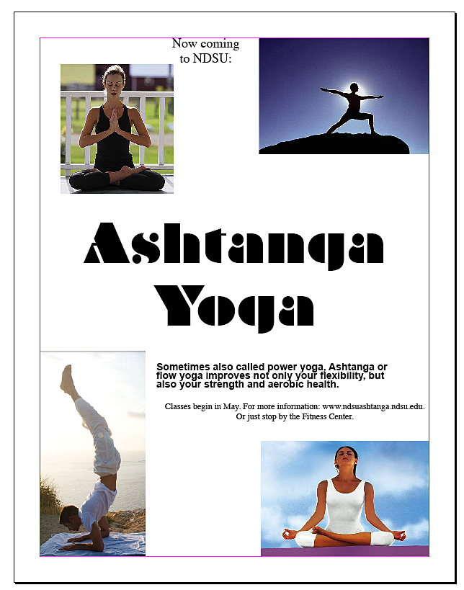
Flow and unity

