Slide 1
Dawn of the press
Before America

Slide 2
Dawn of the press
We now reach back to a time when America had no press, no printers, and no journalism:
The dawn of the press in the Old World.

Slide 3
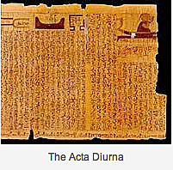
Dawn of the press
The ancient Romans might be credited with the original idea of collecting and distributing news.
The hand-lettered Acta Diarna, or Daily Gazette, circulated throughout the empire.
It didn’t really resemble a newspaper as we know it today, however.

Slide 4
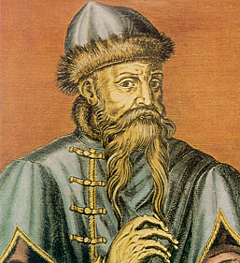
Dawn of the press
The newspaper had to wait for the invention of printing.
In 1455, Johann Gutenberg was credited with inventing movable type. http://www.youtube.com/watch?v=S-BEI_4D7tQ
If we can believe the picture, the poor man must have had terrible arthritis in his hands.

Slide 5
Dawn of the press
Gutenberg had the idea of making type from wood, laying ink on it, pressing it to paper, and reusing it.
Before that manuscripts were copied by hand, and illuminated—that is, pictures added.
Most of this took place in monastery scriptoriums.

Slide 6
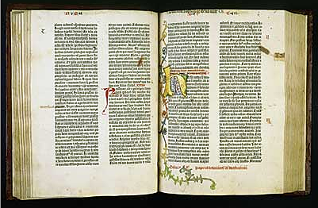
Dawn of the press
Books published during the first 50 years of moveable type, that is, before 1500, are called incunabula.
This is an example of Gutenberg’s Bible.

Slide 7
Dawn of the press
Newspapers, or news sheets, apparently did not appear until after the incunabula period.
The earliest found date from 1609, in Germany.
But earliest influences on American journalism came from Britain.

Slide 8
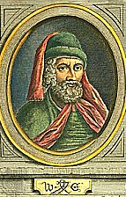
Dawn of the press
The press came to Britain in 1476.
William Caxton set up the first press.

Slide 9
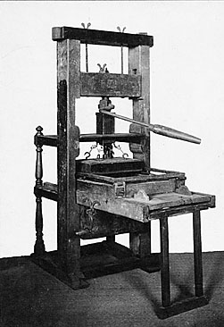
Dawn of the press
The printing press was new. Few people could read.
But the idea of producing information for a wide audience proved to be one of society’s greatest revolutions.

Slide 10
Dawn of the press
Originally the government, that is, the crown, did not see a threat from printing presses.
Like the dawn of the internet age, people at first did not understand its capabilities for good—and for harm.

Slide 11
Dawn of the press
No censorship existed for the first 50 or so years of British printing.
The War of the Roses, an English civil war, was of much more concern than the threat that printed paper could theoretically pose.

Slide 12
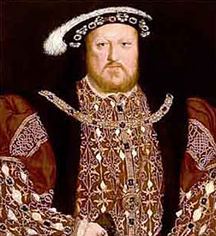
Dawn of the press
Henry VIII was first to discern the possible impact of the printed word.
He could see the growing power of ideas in printed form.

Slide 13
Dawn of the press
In 1529 Henry decided it was time to control the spread of ideas.
He distributed a list of prohibited books.
A few years later he required printers to get royal permission before setting up a shop.

Slide 14
Dawn of the press
This established the concept of “prior restraint”; that is, control of material before publication, as opposed to punishment for material already printed.

Slide 15
Dawn of the press
Early arrests were made for material covering political matters, of course, but also for street ballads.
Songs could be satirical and politically related.

Slide 16
Dawn of the press
Early attempts to control the press were met with early attempts to circumvent that control.
After Henry’s war with Scotland, vendors sneaked out broadsheets telling the news.
Broadsheets are large flyers, or small posters.

Slide 17
Dawn of the press
Henry was angry that the war news was published.
Not that the broadsheets lied. They did not, but “truth” was not a defense against publishing without crown permission.

Slide 18
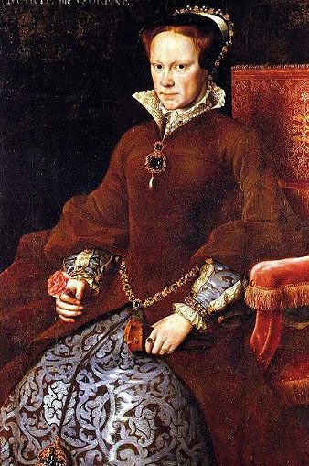
Dawn of the press
Queen Mary, Henry VIII’s successor, made a new attempt to control printers.
She established a printing monopoly run by the government.
If a printer were not a member, the press would be operating illegally.

Slide 19
Dawn of the press
This made it easier to control printers.
It was easier to control what was published, and easier to identify rogue printers.

Slide 20
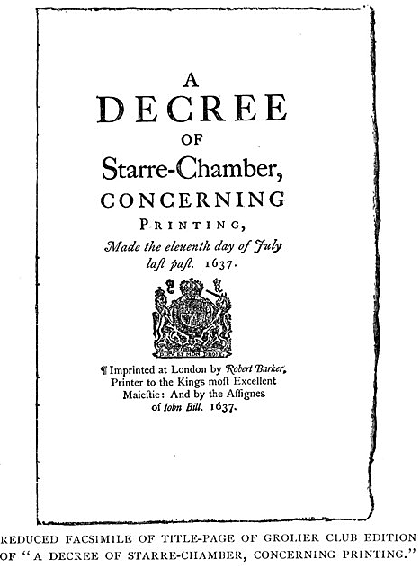
Dawn of the press
To further control the press, the crown used a special court: the Star Chamber.
The court’s control over printing, set up in the 1560s, operated for nearly a century.

Slide 21
Dawn of the press
The best description of the Star Chamber as it related to printers: an inquisition.
The punishment for offending the Star Chamber was more than a fine: a printer could be tortured an executed. In fact, many were.

Slide 22
Dawn of the press
Clearly the Star Chamber used its power to punish political enemies.
But for printers, it also used the argument of public safety.
Peace demanded the suppression of dissent.
Still, no real newspaper existed. But news was becoming more important.

Slide 23
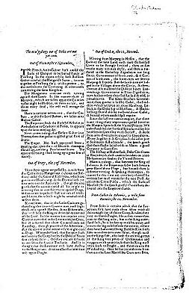
Dawn of the press
The first real newspapers arrived in England nearly a century and a half after the printing press.
They were called corantos, and more like flyers than newspapers.
They appeared irregularly.

Slide 24
Dawn of the press
Corantos had appeared on the continent far earlier than in Britain. The idea of a “newspaper” did not appear before the later 1600s.

Slide 25
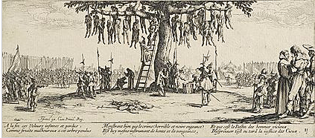
Dawn of the press
The Thirty Years’ War (1618-1648) encouraged greater interest in news—in fact, war has been a great generator of demand for news from the earliest days of journalism. As it continues to be today.

Slide 26
Dawn of the press
By the 1640s, parliamentary news became popular.
The supremacy of the crown was more in question.
The English civil war printed Puritans against the crown.

Slide 27
Dawn of the press
During civil strife, no one can keep absolute power.
In a power vacuum, the press is more free.
The Star Chamber was abolished in 1641.

Slide 28
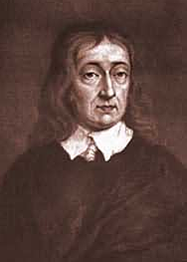
Dawn of the press
In 1644 the famous poet John Milton wrote his ode to a free press: Areopagitica.

Slide 29
Dawn of the press
Milton argued people had the right to discuss things.
“Though all the winds of doctrine were let loose to pay upon the earth, so truth be in the field, we do injuriously by licensing and prohibiting to misdoubt her strength. Let [truth] and falsehood grapple; who ever knew truth put to the worse, in a free and open encounter?”

Slide 30
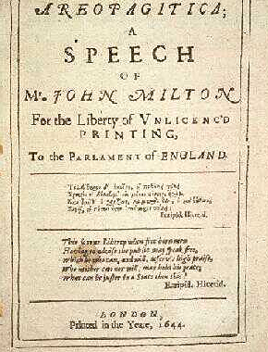
Dawn of the press
Milton’s words were pretty much ignored at the time.

Slide 31
Dawn of the press
But a century later, the American colonies picked up Milton’s words.
Milton became part of the intellectual heritage that drove the free press revolution in the colonies.
When you write something you never know how your words will be used—even long after you are gone.

Slide 32
Dawn of the press
But British authorities continued to control the press throughout the 1600s, in Britain as well as in the colonies.
But by 1700, the idea of prior restraint had died out in Britain.
It did not die out elsewhere. It remained in France until 1870s. It still remains in many countries today.

Slide 33
Dawn of the press
Control clearly hampers the quality and liveliness of the press.
Britain and the United States were actually every early in allowing a free press. This may be why the Anglo-Saxon press has become a world standard.

Slide 34
Dawn of the press
We’ve now gone on our archeological dig from 2000 to 1400. The farther we go back, the more difficult to find links to today.
Perhaps a link we can trace is the many attempts over centuries to limit rights to free expression.

Slide 35
Dawn of the press
Polls have shown many Americans do support limits to free expression:
Flag-burning amendment.
Secrecy in war.
Satirical or abusive attacks.
Sexually explicit material.
Racist epithets.

Slide 36
Dawn of the press
Some Americans would like to see more control of advertising, obscenity, neo-Nazi broadcasts, etc.
We tend to think what shocks us today is more significant than what shocked colonial Americans.

Slide 37
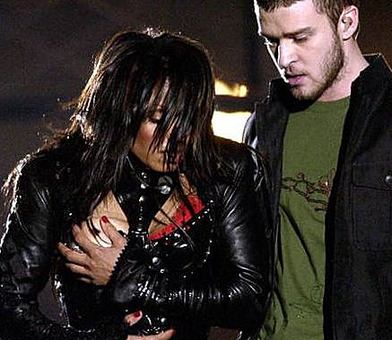
Dawn of the press
But is today’s “indecency on TV,” such as the Janet Jackson “wardrobe malfunction” more shocking than calling the king a buffoon in 1750 England?
I was in France at the time. French newspapers thought the prudery was ridiculous and showed the real photo, not this cover-up.

Slide 38
Dawn of the press
In fact, it might be argued that the last one is more significant—it could destabilize society and lead to war.
In fact, it did.

Slide 39
Dawn of the press
Such criticism of political matters also contributed to the War of 1812, U.S. Civil War, Spanish-American War, World War I, etc.
That’s a lot more significant consequences than nude people on television, which outrages so many today.

Slide 40
Dawn of the press
So a thread through media history seems to be this country’s struggle with the First Amendment.
Does “Congress shall make no law…” really mean no law?

Slide 41
Dawn of the press
Democracy is an experiment, and the press is an integral part of it.
The Sumerians lasted a thousand years.
The Romans lasted another thousand.
The Venicians lasted a thousand.
The United States has lasted about 235 so far.

Slide 42
Dawn of the press
But none has allowed the freedom expression available in the United States.
The way some groups attack this concept makes one wonder if it will last our lifetimes.
Democracy is fragile: it has always toppled into dictatorship or empire.

Slide 43
Dawn of the press
Why? It often begins with a fearful population.
For example, the end of the Venice democracy began with fearful citizens giving more power to government as protection against threats.
In today’s America, the threat seems to be terrorism. And it does seem people are all right with giving up rights to the government for protection against the threat.

Slide 44
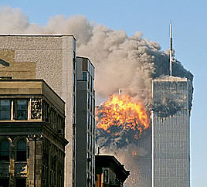
Dawn of the press
In studying press history, maybe we really are studying the central questions of the debate on what Americans think this country should be—and what it might become.

