Slide 1
Historical research
and writing

Slide 2
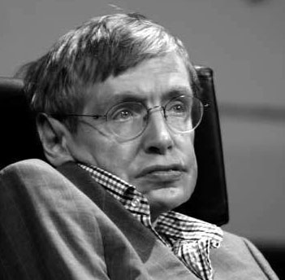
Historical research
“Time travel must be impossible, because otherwise we’d be annoyed with tourists from the future.”
—Stephen Hawking.

Slide 3
Time travel
Perhaps future generations just aren’t interested in us.
In any case, we can’t travel through time right now.
We can’t experience the feelings, the hopes, the fears of people across other times and other cultures.
Or can we?

Slide 4
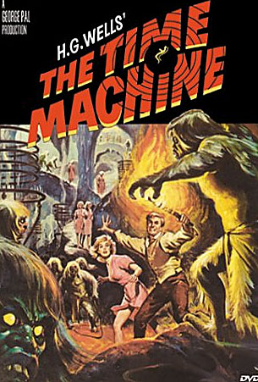
Traveling through time
The closest thing we have to time travel is the study of history.
We can travel back by studying what people thought in the past, what they said, what they did and what happened to them.

Slide 5
Wonder
For example, as a child I did not participate in a war.
I doubt you did either.
But in World Wars I and II, American children were asked to participate in many ways.

Slide 6
Curiosity
I wondered about that. What was it like for those children? What did authorities want them to do? How did they publicize this? What kind of propaganda was directed at children.
The first step to historical research is to be curious, to wonder: What was it like for people in the past? What did they do?

Slide 7
Find out more
If you are interested in knowing about your own past, you can try to recall events yourself.
You can ask other people about the past, “oral history.”
But we have to note people don’t necessarily remember things accurately.
Maybe you don’t even recall things accurately yourself!

Slide 8
Documents
Sometimes no one is around to interview. This is particularly true in historical research.
To bolster and verify oral history we rely on documents.

Slide 9
Documents
Example: In my curiosity about children and war, I came across some secondary material indicating propaganda was also aimed at children.
A “secondary source” is material written by someone who was not around during the time of the event, or did not witness or experience it.

Slide 10
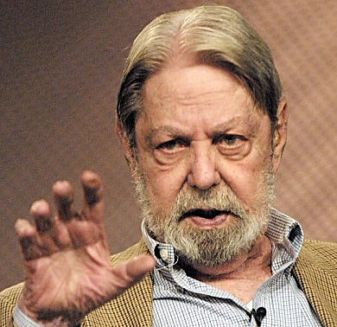
Secondary sources
Most secondary sources are history books and articles. For example, Shelby Foote, the famous U.S. Civil War historian, wrote a book and produced documentaries about the Civil War.
It is a secondary source, because obviously Foote was not around in 1865.

Slide 11
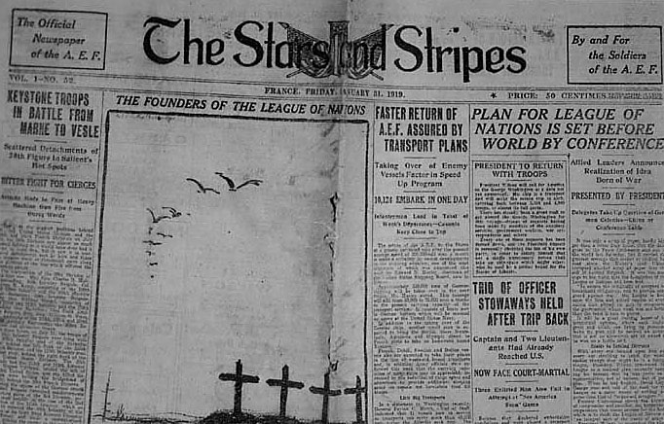
Newspapers
A newspaper, on the other hand, could be a good primary source.
A primary source is a document produced during the time period we’re considering.
For example, a newspaper article published in 1918 about the end of World War I would be a primary source.

Slide 12
Newspapers as secondary source
But if that same 1918 newspaper contained an article about the War of 1812, well, it may be old, but it’s still a secondary source.

Slide 13
Primary sources
Historians base their research mostly on primary sources. These may include:
newspapers.
magazines.
letters.
journals.
meeting minutes.
public documents.
photographs.

Slide 14
Secondary source reading
If I am interested in children during world war my first step is to do a lot of secondary source reading.
I need to know as much as I can about the period. This is both because I need to understand what’s significant, and because I need to know what others have said about it.
It’s also because secondary sources are based on primary sources—and can tell me what those sources are. I can “pillage the footnotes.”

Slide 15
Asking a question
From secondary source reading, I can try to put together a question to help guide my research.
For example: How was propaganda presented to children during World War I?

Slide 16
A hypothesis?
Historians seldom state hypotheses, though you may have learned about them related to other research methods, such as experiments.
A hypothesis is a statement, such as “Children learned about the war through government propaganda.”
We don’t know if that’s true. But we can’t set up a careful system to test this, to objectively disprove a null hypothesis.

Slide 17
Historical research
Historical research methods don’t give us the opportunity to use a method that scrupulously examines a hypothesis.
We can’t do experiments or surveys on the past.
We even have a hard time finding significance in textual analysis.

Slide 18
Historical research
Historians instead must rely on:
their knowledge of the era.
the quality of their primary sources.
the level of their critical thinking skills in ability to interpret their material.

Slide 19
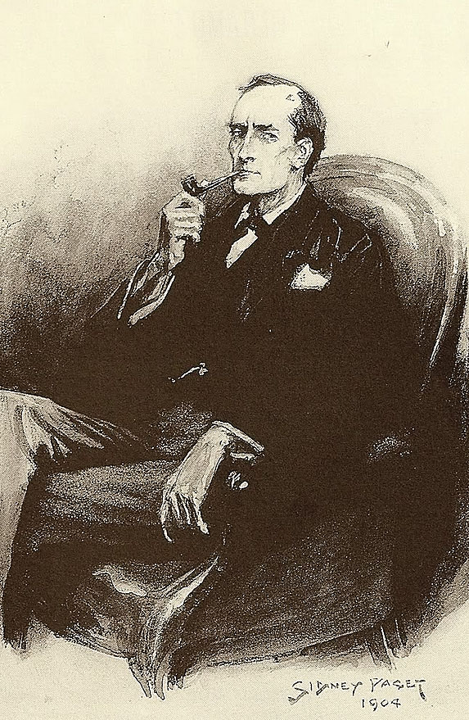
Danger of the hypothesis
Sherlock Holmes knew the danger of the hypothesis in non-statistical research, telling Dr. Watson:
“Never theorize before you have data. Invariably, you end up twisting facts to suit theories, instead of theories to suit facts.”

Slide 20
Don’t presume
So in our example of children and war, it’s a danger to presume propaganda, or presume the government accurately targeted children. Without data we don’t know that.
We have to look at the primary sources.
Where to go?

Slide 21
Primary sources
Well, let’s see. We do know during the world wars the government produced propaganda.
We know that material was used in different way by other groups.
Those groups could include those interested in children: youth organizations, juvenile publications, churches, businesses or education.
Let’s take a look at education.

Slide 22
Primary sources
Where to begin? How about at the national level?
I could start by looking at the proceedings of the National Education Association.
From there I can find names of specific educators whose comments I could then seek out in educational journals, newsletters, or other publications.
These might lead me to the federal department of education.
From there I could look at libraries and their documents.

Slide 23
Primary sources
We can discover primary sources by looking at other primary sources, and thinking creatively.
Our sources snowball.
Looking at these primary sources helped me to understand what authorities wanted children to know, and how it was presented to them.

Slide 24
Primary sources
What did I find out? Authorities emphasized that war was not a great evil, as we might expect.
Instead, war might be a good thing for kids. All sorts of opportunities, better health, better values, better work habits.
War as a virtue for children!

Slide 25
Present-mindedness
Here we see a second problem in doing historical research: present-mindedness.
We all live in a certain country at a certain period. Based on this, we have certain attitudes and presumptions.

Slide 26
Present-mindedness
Most people today would not think war is a good thing for children. War may be necessary, but it is violent, and children should not be involved with that.
We might sadly shake our heads and wonder, what kind of monsters could promote war to children as positive virtue?

Slide 27
Today’s attitudes on yesterday
This is an example of present-mindedness: applying today’s attitudes judgmentally to people from the past.
It’s not only unfair to people from the past. It’s unfair to us today trying to understand that past.
Before we judge, we have to try to consider what it might have been like for people in the past.

Slide 28
Bridging the gap to the past
For example, what might it have been like for a teacher in 1917?
The patriotic excitement of war.
The almost universal belief that this was a great battle of destiny.
A battle for world freedom and democracy.
“A war to end all wars!”

Slide 29
A past mindset
If a teacher then would know the troops were putting themselves not at risk for the present, but for a better future.
And the future is the children.
For whom much is given, much is required.
Children, too, had their duty.

Slide 30
A third challenge to historians
But even those historians who are able to break away from present-mindedness face another challenge: quality of writing.
History, more than almost any other discipline, values good writing.
History ought to be more than factual. It ought to be compelling.
It ought to pull the reader into a world of the past.

Slide 31
The narrative
Historians write narrative. They write stories. Because history is a story about people who did things in the past. They interpret the facts to help the reader understand the past.
Historians hope their work will be read by more than a specialized audience of other historians.
They want everyone to read their stories.

Slide 32
Jargon
Fortunately for that goal, history does not use specialized vocabulary. It uses plain everyday words everyone can understand.
This may be why historical research is not as prestigious as research in some disciplines.
Specialized vocabulary is exclusionary: to be in the club, you need the vocabulary.

Slide 33
Specialized vocabulary
For example, we don’t expect the public to understand biochemical research if people have not studied biochemical vocabulary. It’s impossible.
But everyone can read the stories historians tell.

Slide 34
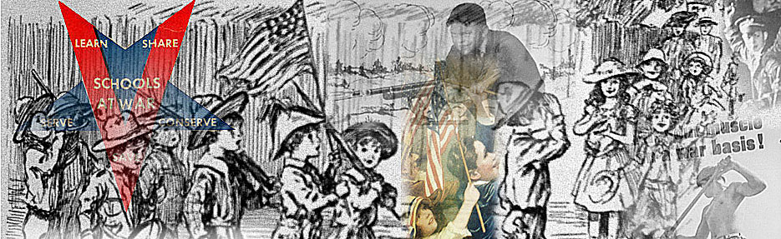
So what is historical research?
Evidence.
Interpretation.
Narrative.
And what about our example, children and war? Here’s what happened.

