Slide 1
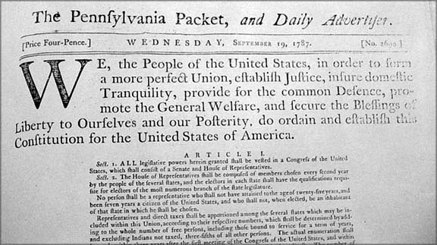
Journalism of a new nation
The Party Press

Slide 2
A new nation
One of the most important and often-cited parts of the U.S. Constitution: The First Amendment.
Congress shall make no law respecting an establishment of religion, or prohibiting the free exercise thereof; or abridging the freedom of speech, or of the press; or the right of the people peaceably to assemble, and to petition the Government for a redress of grievances.

Slide 3
A new nation
Journalists and others use the First Amendment almost daily, as a defense for publishing all kinds of media material.
As well, it defends free speech as it relates to pornography, Neo-Nazi marches, burning the Koran, and all kinds of related areas.

Slide 4
A new nation
As it seems so important, we presume it must have been heavily debated by the Founding Fathers in the 1780s.
But it wasn’t. The press seldom mentioned it.

Slide 5
A new nation
Why was it not debated? Probably because it was already part of American press freedoms.
British Common Law had ruled in the colonies; by this period it had evolved to already grant a wide variety of free-press rights.
But freedom of expression at this time did not include seditious libel. Criticizing the government had been still forbidden.

Slide 6
A new nation
As well, nine of the original 13 states already had free-press articles in their own constitutions.
Free press in the United States is constitutionally protected.
This is not necessarily true in other countries. In Britain, Parliament can change press freedoms. In the United States, is requires a constitutional amendment.

Slide 7
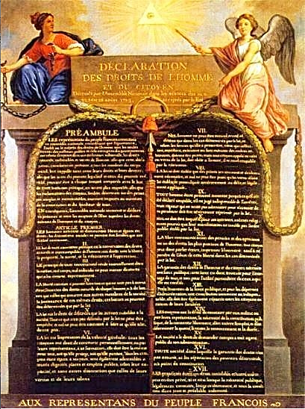
A new nation
This country’s free press law was the world’s most advanced for the period.
In France, after the French Revolution of 1789, the Rights of Man borrowed from the U.S. Constitution to provide a similar concept.

Slide 8
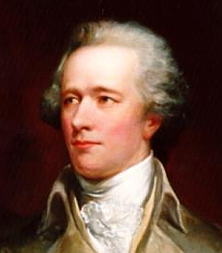
A new nation
Framers of the constitution were led by Alexander Hamilton.
He wrote editorials, later converted to pamphlets, to persuade states to ratify the new constitution.
In this way, he was an early journalist, a patriot and philosopher.

Slide 9
A new nation
Hamilton was not so unusual. Most politicians in the era around 1800 were also journalists when necessary.
Journalists then were often political figures who wrote to persuade.
And most newspapers and media of the time were designed as a persuasive vehicle.

Slide 10
A new nation
The was the era of the party press.
Hamilton was a Federalist. He believed in a stronger central government.
His main supporting party newspaper was the Gazette of the United States.

Slide 11
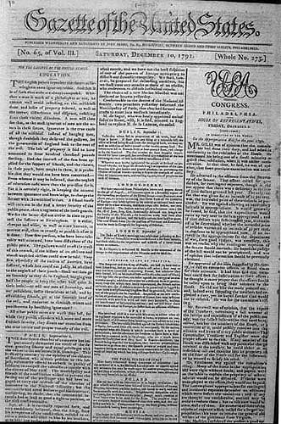
A new nation
The Gazette was edited by John Fenno, who was a schoolteacher.
This was unusual; most newspaper editors of the era began by serving as a print shop apprentice.

Slide 12
A new nation
This may be the beginning of development of journalist as separate profession.
Before this, “journalist” was a printer, a politician, a philosopher.
Fenno’s paper moved from New York to Philadelphia when it became seat of government in 1791.

Slide 13
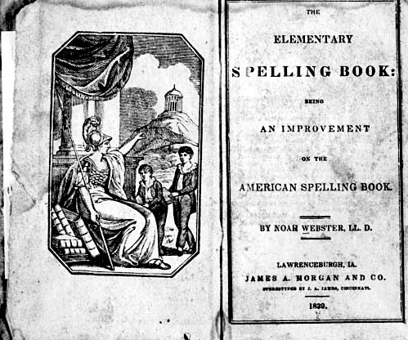
A new nation
Another editor of this era, Noah Webster, was responsible for changing British and Canadian spelling to “American style.”

Slide 14
A new nation
The 1790s saw development of a fundamental disagreement in American governmental philosophy:
Federalists vs. Anti-Federalists.

Slide 15
A new nation
Federalists like Alexander Hamilton believed in a strong central government, aristocrat controlled.
Anti-Federalists believed in a decentralized government, more agrarian, favoring the common man, and advocated by Thomas Jefferson.
This debate spilled into the press.

Slide 16
A new nation
The anti-Federalists feared the aristocratic, privileged viewpoint of the Federalists.
Developed as a voice against the perceived aristocratic control was the National Gazette.
Philip Freneau was editor.

Slide 17
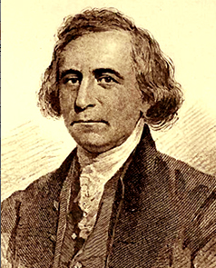
A new nation
Freneau wrote, “Public opinion sets the bounds to every government.”
The Federalists would not have agreed with this viewpoint.

Slide 18
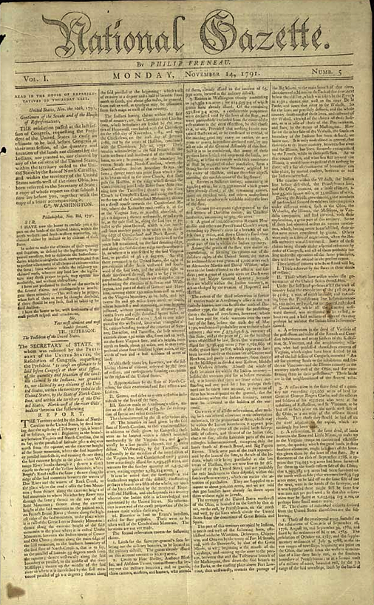
A new nation
Soon both sides were pouring torrents of abuse at each other through the party press.

Slide 19
A new nation
Freneau’s vituperative style led to a split within George Washington’s cabinet.
But Freneau himself made no money on his opinionated paper. It lasted two years.
Ready to take up the anti-Federalist role was Benjamin Franklin’s grandson, Benjamin Franklin Bache.

Slide 20
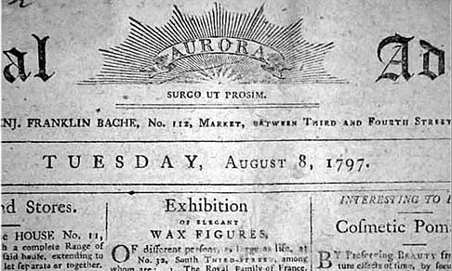
A new nation
Franklin Bache published the Philadelphia General Advertiser, also called Aurora.

Slide 21
A new nation
This debate came to cover a general definition of how the United States ought to be set up:
Aristocratic?
Or “Common Man?”
This was a familiar question in many countries, including France during its revolution, as people were questioning centuries of power held by monarchies.

Slide 22
A new nation
Being an editor in this age of strong opinions meant more than facing criticism.
John Fenno in a rage publicly caned Franklin Bache for criticizing George Washington.
His Aurora office was wrecked by Federalists.

Slide 23
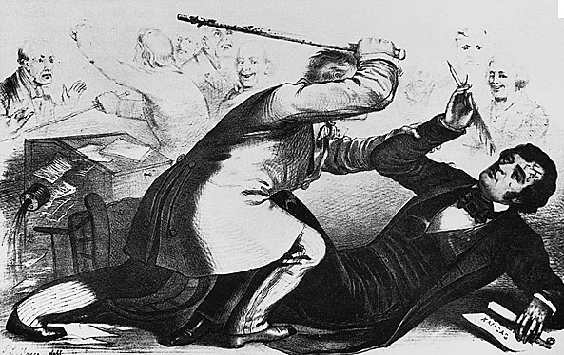
A new nation
What did Franklin Bache say? “The American nation was debauched by Washington,” 1796.

Slide 24
A new nation
In typical partisan journalism of the period, Franklin Bache was described as
“This atrocious wretch (worthy descendent of old Ben) knows that all men of any understanding put him down as an abandoned liar; as a tool and a hireling…. He is an ill-looking devil. His eyes never get above your knees. He is of sallow complexion, hollow-cheeked, dead-eyed….”—Cobbett, Porcupine’s Gazette, Nov. 16, 1797.

Slide 25
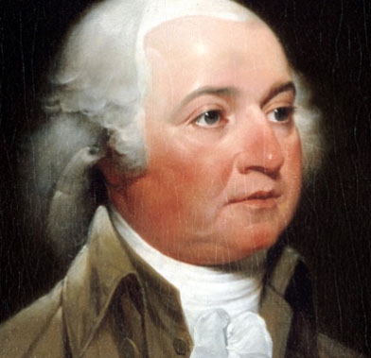
A new nation
So the kind of thing we see in today’s political advertising dates to the founding of the nation.
During this era, criticism of political enemies was particularly vicious and personal.
But in 1796 the Federalists stayed in power, and John Adams became president.

Slide 26
A new nation
To prepare an army for possible war with France, the Federalists imposed a new tax.
The tax fell heavily on farmers and small landowners, who protested strongly.
The Federalists decided it was time to do something about the violently partisan press of the anti-Federalists.

Slide 27
A new nation
In summer 1798, the Congress passed the Alien and Sedition Acts.
The Sedition Act aimed at anti-Federalist editors.
The Alien Act aimed at immigrants, generally poor, from authoritarian homelands, and so anti-Federalist. Many were Irish.
President Adams was given power to deport or punish. http://www.youtube.com/watch?v=7-PtozBKSBE

Slide 28
A new nation
“Sedition” means criticism of the government. In this case, only anti-Federalist newspapers were targeted.
Editors could be fined or imprisoned for “scandalous or malicious” statements “exciting…a hatred of the good people of the United States.”

Slide 29
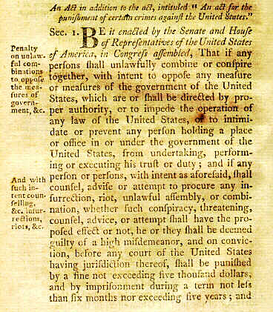
A new nation
The Alien and Sedition Acts lasted two years.
They clearly violated the spirit of American freedom to criticize the government and its political leaders.

Slide 30
A new nation
One advanced feature of the acts at the time: a defense against the press making malicious and false statements against government officials.
An editor could use two defenses: truth, and right to jury trial to determine both law and fact.
These defenses have become part of U.S. libel law today.

Slide 31
A new nation
The acts offered a great rallying cause for the Anti-Federalists.
The Sedition Act was used as revenge against opposition politicians.
An editor from Vermont was fined for accusing President Adams of “ridiculous pomp, foolish, adulation, and selfish avarice.”
Neighbors who rallied to his side were jailed.

Slide 32
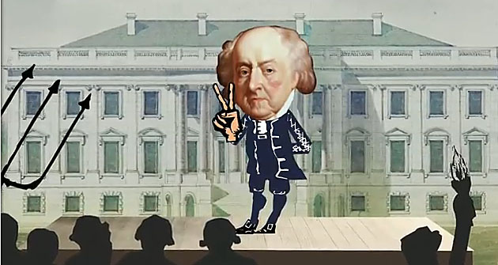
Adams
John Adams found himself unpopular, but the Alien and Sedition Acts clearly violated the Constitution. http://www.youtube.com/watch?v=xqAt8A0W204

Slide 33
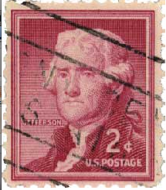
A new nation
But the obvious misuse and hypocrisy of these laws led to Federalists’ downfall.
Popular support for the Federalists dwindled.
Both Bache and opposing editor Fenno died in 1800. The laws expired in March 1801.
Thomas Jefferson, Anti-Federalist, was elected president.

Slide 34
A new nation
The Federalists still had power, however; the majority of the press was anti-Jefferson.
Alexander Hamilton funded a new anti-Jefferson newspaper, the New York Evening Post, William Coleman, editor. Hamilton wrote the editorials.

Slide 35
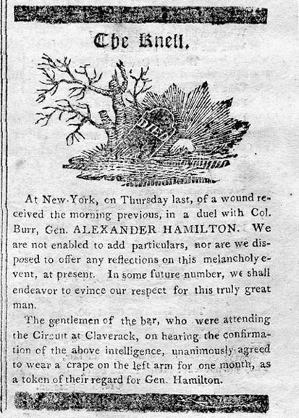
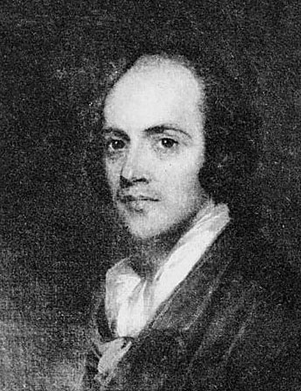
A new nation
But the strong voice for the Federalists was further weakened when in 1804 Hamilton died in a duel—with no less than the vice president of the United States, Aaron Burr.

Slide 36
A new nation
Jefferson strongly supported press freedom. But he became exasperated at the tone of the opposition press.
But he declared he would nevertheless “protect their lying and calumniating.”
His assistants did try to hound the press under state sedition or libel laws.

Slide 37
A new nation
The press itself was also growing in circulation during this period.
The first daily, Pennsylvania Evening Post, was established in Philadelphia in 1783. It lasted two years.
A second daily, the Pennsylvania Packet and Daily Advertiser, established the next years, was more successful. Co-editors were John Dunlap and David C. Claypoole.

Slide 38
A new nation
By 1800 most large American cities had dailies.
Dailies grew as coffeehouses became more popular—this was where many read newspapers at the time.
American dailies had to compete with the readily available London press.
They competed by offering shipping news an local and commercial material.

Slide 39
A new nation
By the first quarter of the nineteenth century, the ideal of timeliness seemed to become more and more important.
The New World of Philadelphia began publishing a morning and evening edition.

Slide 40
A new nation
Papers normally cost six cents. Same as the cost of one-fourth pound of bacon, or a pint of whiskey, two 1820s staples.
Circulations were small: 1,500 was considered high. By 1820, 24 dailies were published in the United States.

Slide 41
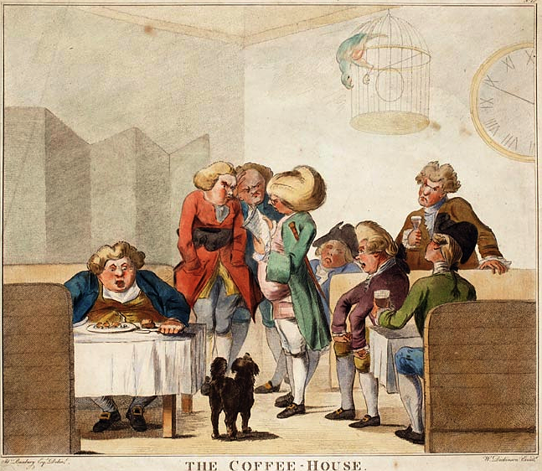
A new nation
These papers were still expensive, making the coffeehouse the common place to read them.

Slide 42
A new nation
The press was aggressively expanding westward with the new frontier.
Jefferson was opposed to imperialist expansion, but couldn’t pass up a great deal from Napoleon: the Louisiana Territory was up for sale!
Settlers poured into the southern territory. The northern part, such as North Dakota, took another half century to see settlement.

Slide 43
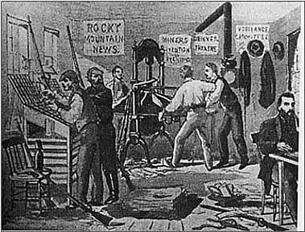
A new nation
One of the first businesses to set up in a new frontier town was the newspaper.
Editors were needed to promote the new village, to attract more settlers.

Slide 44
A new nation
The first paper west of the Appalachian Mountains was in Pittsburgh, 1786. The second, Lexington, Kentucky, 1787.
These had little local news, so borrowed from the East Coast or London.
Advertising was scarce, but the government used the paper to publish legal advertising. This often kept newspapers in business.
So, in effect, it was the government that supported the frontier press.

Slide 45
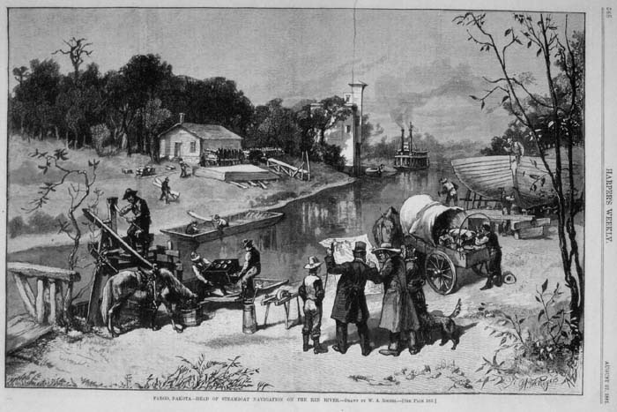
A new nation
Fargo as a frontier city arrived late, in 1871.

Slide 46
A new nation
The frontier press tended to be opinionated, with flamboyant editors and not much real news.
But the idea of reporting had grown from the late 1700s. The concept of allowing press to cover meetings began with the government in 1795 deciding to allow reporters to both House and Senate sessions.

Slide 47
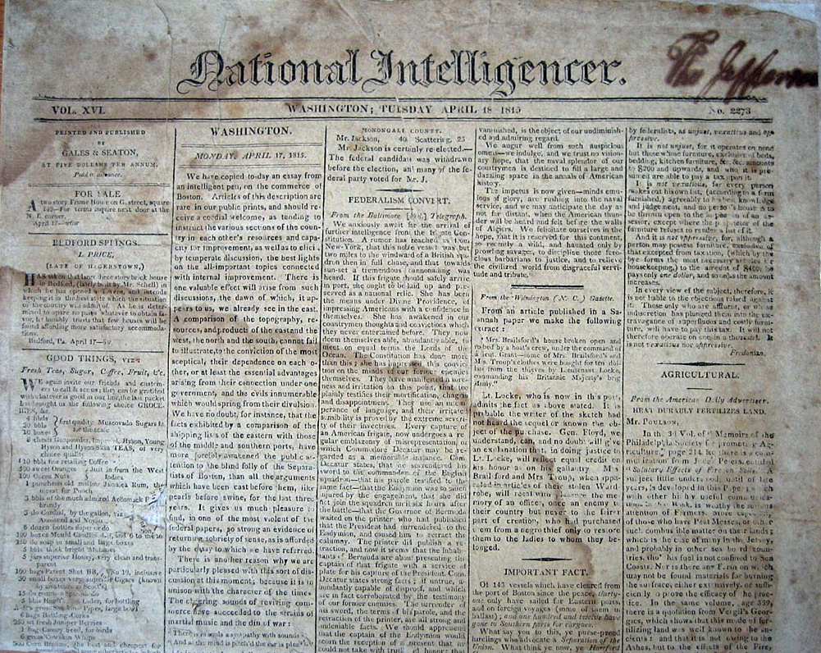
A new nation
The new paper in the new capital of Washington, D.C., was the National Intelligencer.
It was the semi-official voice of the Jefferson administration, but tried to avoid taking sides as common in the partisan press of the day.

Slide 48
A new nation
After 1810 state after state gave the “common man,” that is, the man without property, the right to vote. (Women and slaves were excluded.)
Newspapers were becoming more popular, and began to reach out to this new group of readers.
The 1828 election of Andrew Jackson as president is seen as the victory of the common folk.

Slide 49
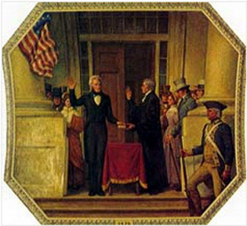
A new nation
Shortly after, a labor press was established. The stage was set for 1833, and the Penny Press.

Slide 50
A new nation
In short, the partisan press era of the 1780s-1820s:
Featured an outspoken, political press.
Was expensive, attracted elites.
And, in the West, a press to “boom” (promote) new settlements.
The aristocrats of the early United States failed to craft a country reflecting their ideals, although the struggle between “elites” and “common folk” seems to continue today.

