Slide 1
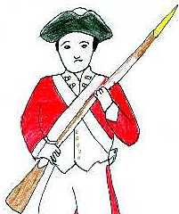
Revolution
And the press in America

Slide 2
Revolution & Press
Why the American revolution? The answer is not so simple.
The British exploited and restricted, but also protected, built, and bought.
Some historians contend disagreements certainly could have been settled without war.

Slide 3
Revolution & press
We need to look at the issues of the time, and how they related to the great force of written opinion through the press.
The 1765 Stamp Act alienated two influential colonial groups: lawyers and the press.
Lawyers paid through stamps on legal documents.
Editors paid through stamps on newspaper publishing.

Slide 4
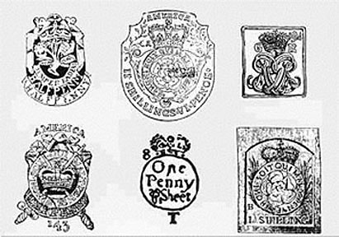
Revolution & press
The Stamp Tax placed a duty on every newspaper.
It was a way to recoup the cost of the French and Indian War (Seven Years’ War) between Britain and France. The colonies greatly benefited from British victory.

Slide 5
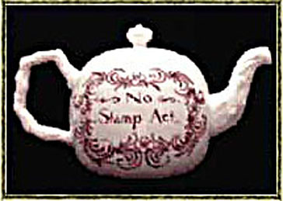
Revolution & press
Despite that, colonial editors vigorously opposed the tax on newspapers.
Editors responded by suspending publication, or printing without a title, thereby not being an “official publication.”

Slide 6
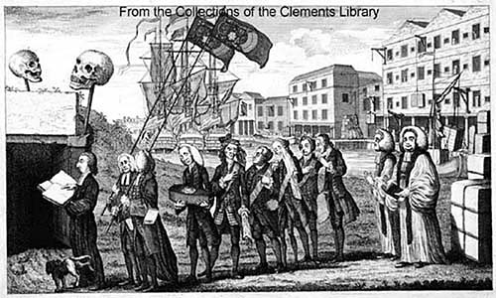
Revolution & press
Mobs sometimes kept newspapers from obtaining stamps.
Cartoons and editorial condemned the act.

Slide 7
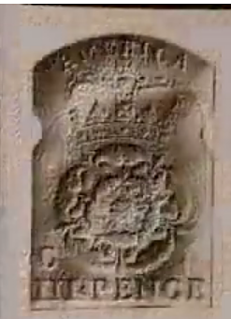
Revolution & press
The Stamp Act offended the right American colonists believed they enjoyed to have a voice in their governmental affairs http://www.youtube.com/watch?v=TYYwW7_zuYI
It was, however, one of several grievances.
The mercantile system restricted colonial commerce.

Slide 8
Revolution & Press
Colonials faced more and more taxes, more and more economic hardship.
But united efforts could see results without war. In fact, in 1766 the Stamp Act was repealed!
What was revolutionary was the ideas, the spirit of the time.

Slide 9
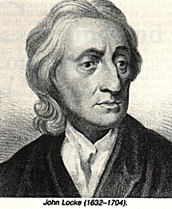
Revolution & Press
John Locke had declared a hundred years before that governments which took people’s money and property without their consent should be overthrown.
In the colonies, the basis of ideas was—journalism.

Slide 10
Revolution & Press
Journalistic opinion split into factions. Three great leaders rose for each:
James Rivington;
John Dickinson;
Samuel Adams.

Slide 11
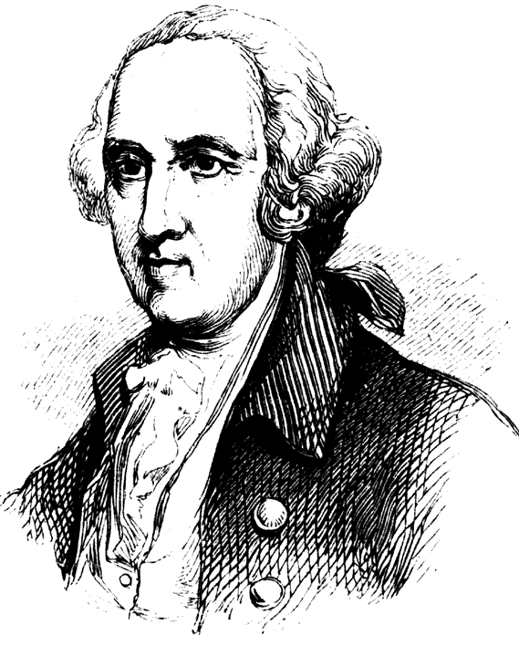
Revolution & Press
James Rivington spoke for the Tories, that is, those who supported British colonial rule.
He believed in law and order against rebel anarchy.
He had established the country’s first chain of bookstores before turning to newspaper journalism.

Slide 12
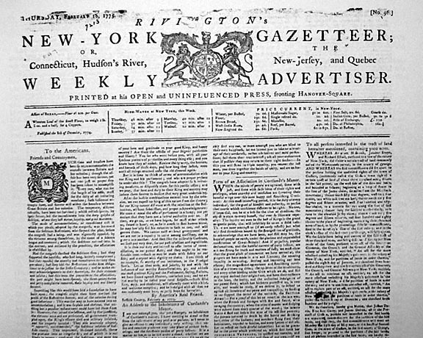
Revolution & Press
Rivington established his New York newspaper in 1773.

Slide 13
Revolution & Press
Rivington was unusual for the era—he was willing to discuss both sides of political issues.
Such “objectivity” was not part of the press generally during this period.
As well, anti-British “patriots,” as they called themselves, were not interested in fair and balanced reports.

Slide 14
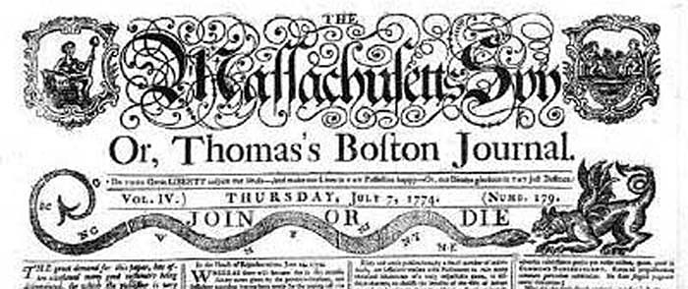
Revolution & Press
The loyalist (pro-British) press suffered as power slipped from British grip: Tory newspapers were hounded and threatened by anti-British mobs.
Neutrality was not accepted: it was Patriot side or nothing.

Slide 15
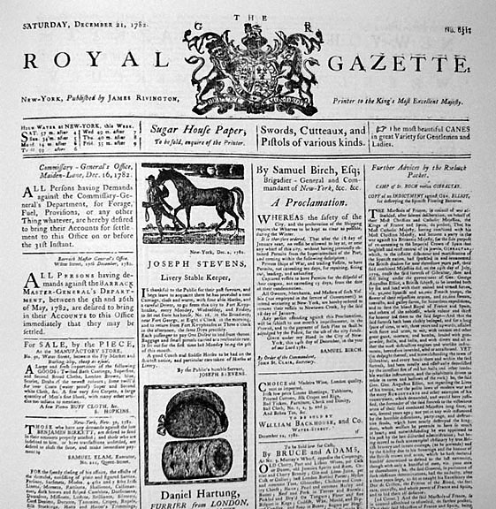
Revolution & Press
Rivington decided to drop objectivity. He renamed the paper the Royal Gazette.
He launched a campaign of vicious attacks against rebel leaders, factual or lies.

Slide 16
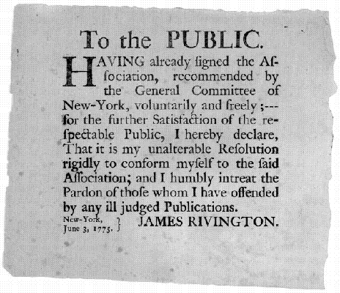
Revolution & Press
Rivington had already been attacked before the war, his shop raided twice. He was forced once to publish a public apology for voicing his opinion.

Slide 17
Revolution & Press
Rivington thought British rule by gentlemen would be better than rule by lawless rebels.
Many colonists certainly agreed with the elitist ideal at the time.
But many others opposed that ideal.

Slide 18
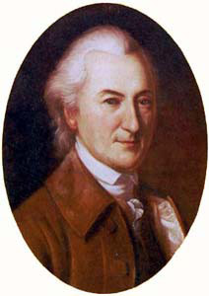
Revolution & Press
One who opposed was John Dickinson.
Dickinson was called “the penman of the revolution,” one of the great journalists of the period.
His famous opinions were called “Letters from a Farmer in Pennsylvania.”

Slide 19
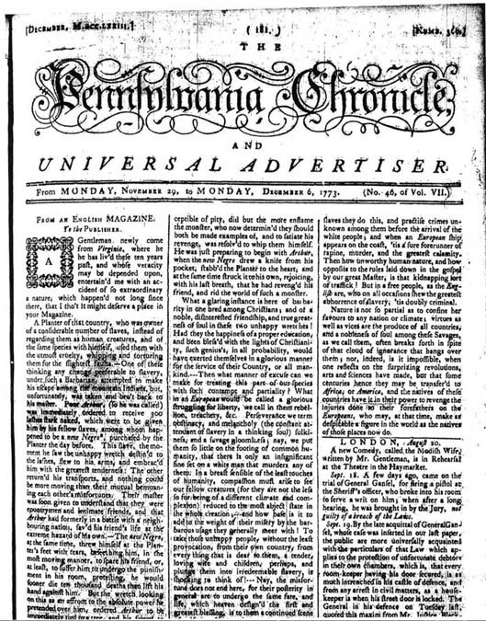
Revolution & Press
Dickinson’s most famous writings were published in the Pennsylvania Chronicle in 1767.
Dickinson actually was somewhat conservative. He was contemptuous of the radical Patriots.

Slide 20
Revolution & Press
Dickinson argued economics: No taxation without representation.
He thought in terms of property rights, was not interested in rights of the common man.
Dickinson was not pro-revolt.
When war came, Dickinson had to choose, and he chose to join the revolutionaries. He did not, however, sign the Declaration of Independence.

Slide 21
Revolution & Press
The third faction was most radical: the Patriots.
They were not interested in economic change per se, as the “colonial Whigs” such as Dickinson argued.
They wanted real change in society.

Slide 22
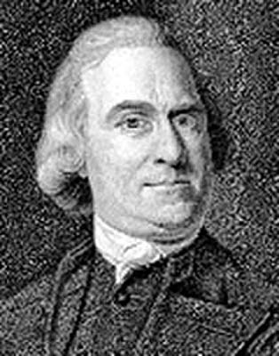
Revolution & Press
Why did the Patriot faction become so powerful?
They had a persuasive journalist as spokesman: Samuel Adams.

Slide 23
Revolution & Press
Sam Adams understood propaganda. He had five objectives, and planned to use the press to achieve them.
1. Justify the course advocated—revolution.
2. Advertise the advantages of victory. Say nothing about defeat.

Slide 24
Revolution & Press
3. Work to arouse people’s emotions. Whip up hatred of political enemies.
4. Neutralize logical and reasonable opposing arguments, even if by harassment.
5. Place all issues in black-and-white, simplistic context, attractive to common folk.

Slide 25
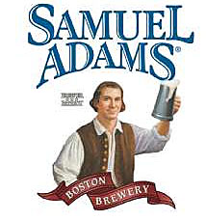
Revolution & Press
Adams believed revolution was justified because Britain continued to ignore basic rights of the people.
Samual Adams had tried the ministry, law, teaching—yes, beer brewing—before becoming an opinionated journalist.

Slide 26
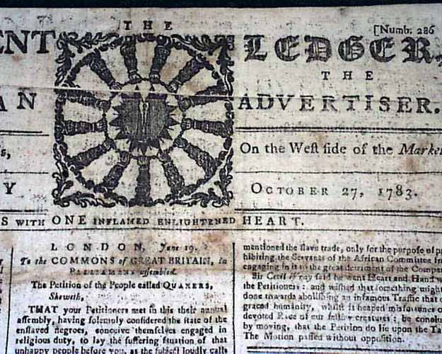
Revolution & Press
Adams became editor of the Independent Advertiser in Boston, a radical publication, at age 26.

Slide 27
Revolution & Press
He was opposed to the Stamp Act of 1765, but was considered only to be the leader of a noisy minority.
But Adams was a great gatherer of news.
To gather sentiment of the colonies, he set up a committee of correspondents to attend meetings and bring back news.
This was the first time an editor considered such correspondence.

Slide 28
Revolution & Press
In newspaper and pamphlet, Adams pounded away day after day against British power.
He wrote in a variety of publications, with at least 25 pen names.
Adams worked to conduct smear campaigns against authorities. He tried to bring down the respect of aristocracy, raise the respect of the common man.
His nickname: “Assassin of reputations.”

Slide 29
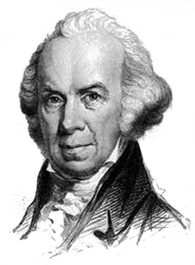
Revolution & Press
Isaiah Thomas also was one of the most important revolutionary printers.
Thomas was a revolutionary, and also a businessman and scholar—he wrote an important history of the colonial press.
He also had little formal education—he began as an apprentice printer at age 6. Nevertheless, he became learned by studying on his own.

Slide 30
Revolution & Press
Thomas said he learned to spell by setting type, and gained knowledge by reading galley proofs.
H founded the Massachusetts Spy in Boston in 1770. The paper lasted until 1904.
The Spy was originally non-partisan.

Slide 31
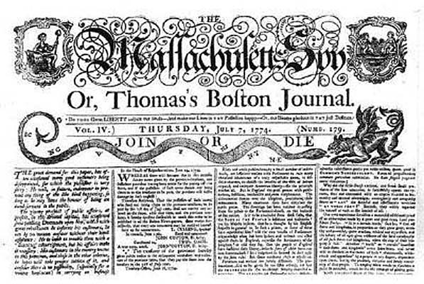
Revolution & Press
As it became impossible to be non-partisan, Thomas decided to join the pro-revolutionary side.

Slide 32
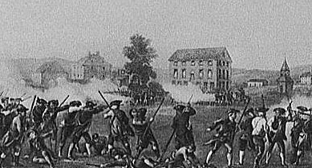
Revolution & press
Thomas witnessed and published an article about the first revolutionary battle, Lexington and Concord:

Slide 33
Revolution & Press
A company of militia, of about 80 men, mustered near the meeting-house, the troops came in to fight of them just before sun-rise; the militia upon seeing the troops began to disperse. The troops then sat out upon the run, hallowing and huzzaing, and coming within a few rods of them, the commanding officer accosted the militia in words to this effect, “Disperse ye damn’ed rebels! damn you disperse!” Upon which the troops again huzzaed, and immediately one or two officers discharged their pistols, which were instantaneously followed by the firing of four or five of the soldiers, and then there seemed to be a general discharge from the whole body. It is noticed they fired upon our people as they were dispersing, agreeable to their command, and that we did not even return the fire. Eight of our men were killed and nine wounded; The troops then laughed, and damned the Yankees, and said they could not bear the smell of gun-powder.

Slide 34
Revolution & Press
Thomas became the most important publisher of the revolutionary war period.
He had seven presses and 150 workers.
He had eight branch operations in other cities.
He had a paper mill and bindery.
He printed amore than 400 books over the decades of his operation.

Slide 35
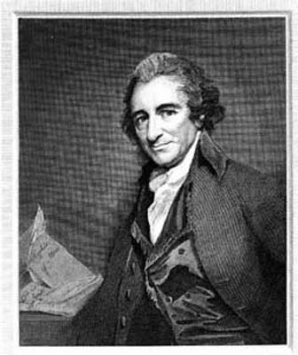
Revolution & Press
Other Patriots included Thomas Paine.
Paine was a political philosopher and writer but that overlapped with journalism.

Slide 36
Revolution & Press
Paine drifted through a few jobs until he hit a stroke of luck: he met Benjamin Franklin, who wrote a letter of reference.
At the time, Franklin was probably the world’s most famous person.
Paine’s fame rose as it became known he had written an influential pamphlet called Common Sense.

Slide 37
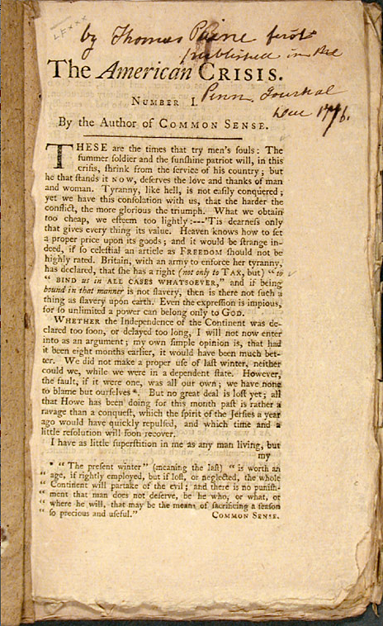
Revolution and Press
Joining Washington’s dispirited troops, Paine tried to rally the men by writing a series of “Crisis” papers.
This is the most famous:

Slide 38
Revolution & Press
“THESE are the times that try men’s souls. The summer soldier and the sunshine patriot will, in this crisis, shrink from the service of their country; but he that stands by it now, deserves the love and thanks of man and woman. Tyranny, like hell, is not easily conquered; yet we have this consolation with us, that the harder the conflict, the more glorious the triumph. What we obtain too cheap, we esteem too lightly: it is dearness only that gives every thing its value. Heaven knows how to put a proper price upon its goods; and it would be strange indeed if so celestial an article as FREEDOM should not be highly rated.”

Slide 39
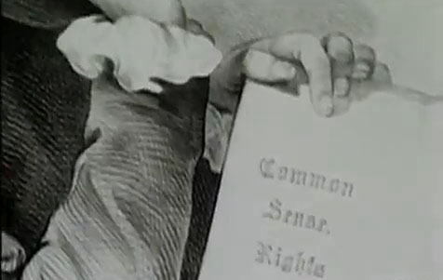
Revolution & PRess
Paine’s work was reprinted throughout the colonies to bolster morale. http://www.youtube.com/watch?v=ZfkBy4HV0lM
Paine saw the real significance of the revolution: social change. He later became part of another revolution, in France.

Slide 40
Revolution & Press
The revolutionary press was vigorous and well-read.
Total circulation was 40,000, and many more read each issue, every single line.
Paper was a big problem, in that all supplies had come from Britain. During the revolution, paper was made of all sorts of material.
George Washington issued a plea to women to save every scrap of fabric to convert to paper.

Slide 41
Revolution & Press
This was, of course, a strongly partisan press.
Abuses, exaggeration were excused by readers as necessary to strengthen argument.
Each group had a newspaper to reflect its sentiments, an ally for the cause.
Today we may not be able to find such powerful allies!
How do politicians today find their media and spokespeople for support?

