Slide 1
Watergate
and the press

Slide 2
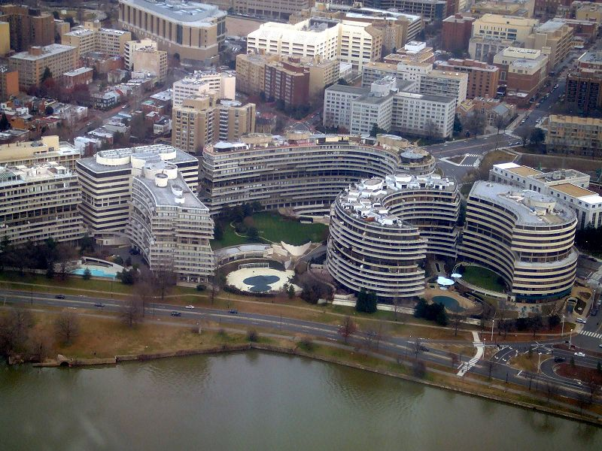
Watergate
Watergate has become a nickname for many big scandals: Iran-gate, Korea-gate, NDSU president’s house-gate…any controversial, embarrassing scandal.
The real Watergate was a building in Washington that was burgled on June 17, 1972.

Slide 3
Watergate
The unfolding story riveted the attention of a nation, and some say changed the way we look at journalism and government.
The press is good at reporting scandals. It is not as good at reporting complicated, ongoing stories.

Slide 4
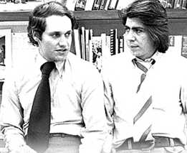
Watergate
No one paid much attention to the burglary at first. So what?
Young Washington Post reporters Carl Bernstein and Bob Woodward were assigned to the story.

Slide 5

Watergate
Woodward was in luck: he knew someone who knew a lot more about the case than he did.
But that someone insisted on strict secrecy.
The confidential source would be known for 30 years as “Deep Throat,” named after a porno movie of the time.
Searching for a “deep throat” image appropriate for class use proved to be a daunting task. No movie excerpts will be shown.

Slide 6
Watergate
Woodward met with “Deep Throat” based on a message system: Woodward would leave a red flag on a flower pot on his balcony. In return, his copy of the New York Times would contain a hand-drawn clock face on page 20 indicating the time of meeting in an underground parking garage.

Slide 7
Watergate
Deep Throat would not give information to Woodward. He would only confirm or deny what they had found on their own.
Deep Throat was certainly not the only source for the Watergate story. But his information was critical.
In 1976 and Dustin Hoffman and Robert Redford played Bernstein and Woodward in a fairly accurate portrayal of the story, “All the President’s Men.” http://www.youtube.com/watch?v=NVNU5jkOwzU

Slide 8
Waterate
For months Woodward and Bernstein worked alone on this story. Only the Washington Post seemed interested.
Why? No contacts, didn’t see significance, harassed by Nixon administration not to report the story.

Slide 9
Watergate
Increasing revelations, however, encouraged the U.S. Senate to form a committee to investigate White House corruption.
The committee decided to televise its hearing—a critical decision.

Slide 10
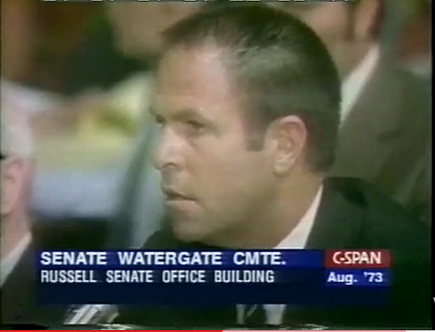
Watergate
Day after day, televised testimony against Nixon fascinated Americans. (Much of it is now available on YouTube.)

Slide 11
Watergate
A big surprise was the revelation that Nixon kept a tape recorder running continuously in the Oval Office, recording everything that transpired there.
The Senate investigators wanted the tape. Nixon refused. The U.S. Supreme Court finally said he had to give them up.

Slide 12
Watergate
Investigators received a tape with an 18 ½ minute gap, just buzzing.
Did someone deliberately erase it? Or did Nixon’s secretary, Rose Mary Woods, accidentally erase it?
Tech experts said the erasing had to have been done deliberately.

Slide 13
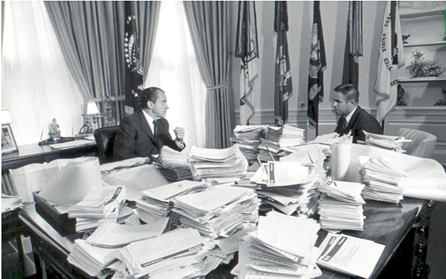
Watergate
The hundreds of hours of tapes included the “smoking gun” discussion between Nixon and Haldeman, in which the president clearly knew about the Watergate break-in, despite his denials. http://whitehousetapes.net/transcript/nixon/smoking-gun

Slide 14
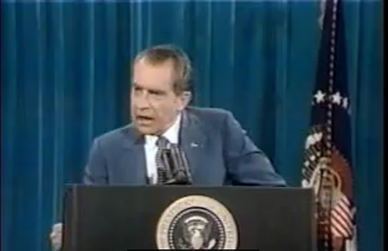
Watergate
On Nov. 17, 1973, Nixon gave his infamous “I am not a crook” speech. http://www.youtube.com/watch?v=sh163n1lJ4M&feature=related

Slide 15
Watergate
Nevertheless, the testimony and tapes shocked many Americans for their candid portrayals of the president: using profanity and racial slurs, filled with stupid or shallow ravings.
His approval rating reached the lowest of any president ever.
As Congress began impeachment proceedings, on August 8, 1974, Nixon resigned.

Slide 16
Watergate
What role did the media play in bringing down a president?
Woodward and Bernstein said it was not the media, but the democratic process.
Certainly the televised hearings played a role.
But an isolated break-in might not have blown into a presidential resignation had it not been for the press.

Slide 17
Watergate
Watergate seemed to change people’s expectations.
Before this, it was fairly easy for the government to work in secrecy.
We know John F. Kennedy also did some illegal things, but no journalist reported it.

Slide 18
Watergate
Perhaps experience with the Vietnam War changed Americans’ expectations.
Watergate seemed to have led to a long-term American distrust of Washington politics.
Term limits, “outside the Beltway” candidates, became common.
People became more cynical.

Slide 19
Watergate
In the Reagan administration of the 1980s, the “Iran-Contra” scandal possibly was more subversive than even Watergate.
Reagan survived that, however. Why? Possibly because the administration did not keep it a secret—but Oliver North even bragged about it. Reagan claimed he didn’t remember. And Reagan was such a likable guy! Nixon…not!
Possibly because people no longer had a high opinion of White House ethics.

Slide 20
Watergate
The Watergate affair also served to inspire of generation of college students to seek out work in investigative journalism. The credibility of the press was high.

Slide 21
Watergate
Thirty years later, in 2005, W. Mark Felt came forward to identify himself as “Deep Throat.”
He was a top FBI administrator, resentful he did not get the director’s job after J. Edgar Hoover died.
Nixon instead appointed L. Patrick Gray. Gray was instructed to stall on Watergate investigations.

Slide 22
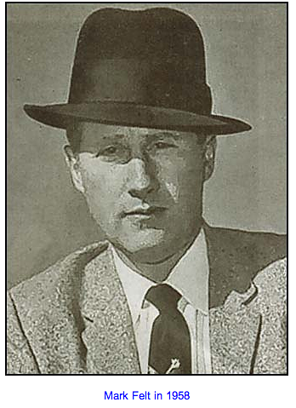
Watergate
Now that we know W. Mark Felt was Woodward’s informer, it’s interesting to go back to the tapes.

Slide 23
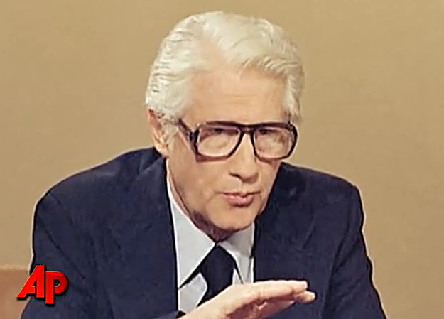
W. Mark Felt
Felt died at 95, shortly after revealing he was “Deep Throat.” https://www.youtube.com/watch?v=y2SLvOhLGZo

Slide 24
Watergate
Note in the transcript below of the “Smoking Gun” tape. Felt obviously knew everything. And the president had no idea.
President Nixon: What’s the matter with Pat Gray. You mean he doesn’t want to?Haldeman: Pat doesn’t want to. He doesn’t know how to, and he doesn’t have any basis for doing it. Given this, he will then have the basis. He’ll call Mark Felt in, and the two of them—and Mark Felt wants to cooperate because he’s ambitious.
President Nixon: Yeah. Yeah.
Haldeman: He’ll call them in and say, “We’ve gotten a signal from across the river to put the hold on this.” And that’ll fit rather well because the FBI agents who are working the case, at this point, feel that’s what it is: [that] this is CIA.

Slide 25
Watergate
Felt was the ultimate anonymous source.
Journalists since have debated the merits of such sources. Some argue they are absolutely necessary to get information.
Others say in other cases it’s easy to make up sources, and readers can’t judge the credibility of the information.

Slide 26
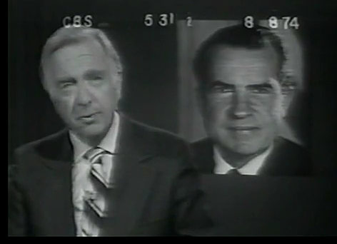
Watergate
But in this case, print journalism gave power to a voice, amplified by television, and in the end proved the downfall of the what some call the world’s most powerful leader. http://www.youtube.com/watch?v=BouCsOqMzEM&feature=related

Slide 27
What was it like?
What was it like to be a journalist during the Watergate era? Consider:
You are covering a possibly dangerous story. Confidentiality and secrecy are essential.
How could you assure security for your work in an age of typewriters and telephones?
How could you assure security in an age of digital media?
In which situation would you feel most secure?

