Slide 1
Printing
Letterpress to Laser

Slide 2
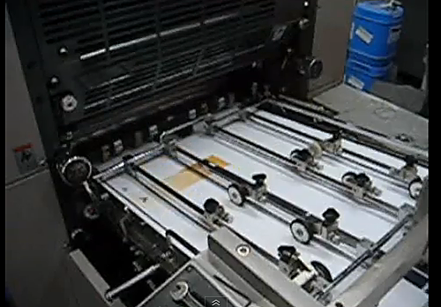
Printing
A modern flat-bed printing press
http://www.youtube.com/watch?v=cT37vwQuBvs

Slide 3
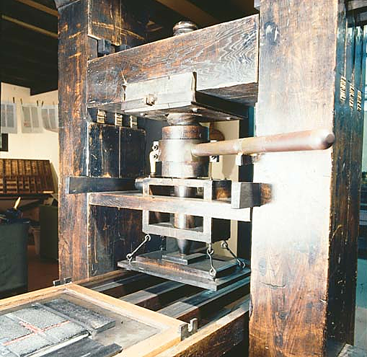
Printing
The oldest method of printing, as we learned before, dates to about 1450.
Gutenberg is credited with inventing moveable type.

Slide 4
Printing
The system, called letterpress, remained for 300 years the only way to print.
Even after other methods were developed, letterpress remained the most common printing technique until about 1970.
Offset became the standard after that, as it still is today.

Slide 5
Printing
Letterpress printing relies on actual rollers applying ink to raised letters.
After inking, a page is set on the letters and a press applies pressure to tranfer the image.
This concept is similar to a rubber stamp.
Note: type and other elements must be set backwards for them to appear correctly on the page.

Slide 6
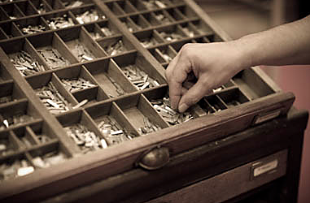
Printing
Traditionally the letters were stored in a case. It was called a California job case.
The upper case held the capitals; the lower case, small letters. The system was letter changed, but the terminology stuck.

Slide 7
printing
Metal letters of one font (from fount, based on type foundary), are set one by one in a composing stick.
The type is transferred to a metal frame, called a chase, and clamped in with wedges, called quoins.
The chase is transferred to a press; the type hopefully won’t fall out.
Ink is applied, and the page is pressed against the type.

Slide 8
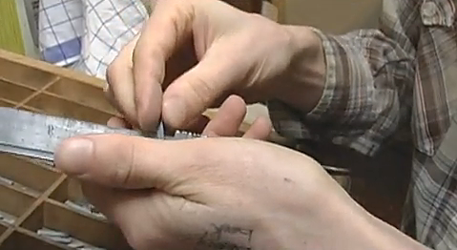
Printing
Letterpress printing still is part of the art print industry. It’s used when you want a top-quality look for invitations, broadsides, or book covers.
Here’s an idea of how it works. Imagine daily newspapers printed using this method. [http://www.youtube.com/watch?v=yE0OoWX6TQ]

Slide 9
Printing
This method could not be used for mass media, as you might imagine—even with a whole building of presses, it was too slow.
Three inventions in the 19th century made mass media printing possible:
cheap wood-pulp based paper.
web-feed press.
Linotype typesetting machine.

Slide 10
Printing
Wood-based paper was much cheaper than traditional rag-based paper—although not as good quality, and subject to degrading over time.
The web-based press used a large roll of paper instead of individual sheets.
The paper was run through a curved plate on a metal cylinder.
The type on the curved cylinder was inked and pressed against the paper.

Slide 11
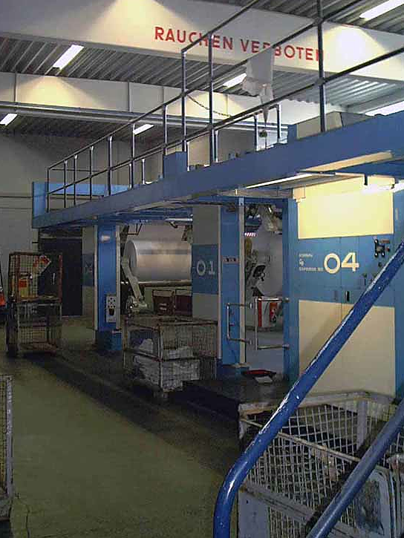
Printing
The paper was trimmed to size afterwards.
Curved lead plates were created using a process of molten lead called stereotyping.
Believe me, old-time newspaper composing rooms were hot!
Newspapers relied on this process even into the late 1980s. Presses often came from Germany.

Slide 12
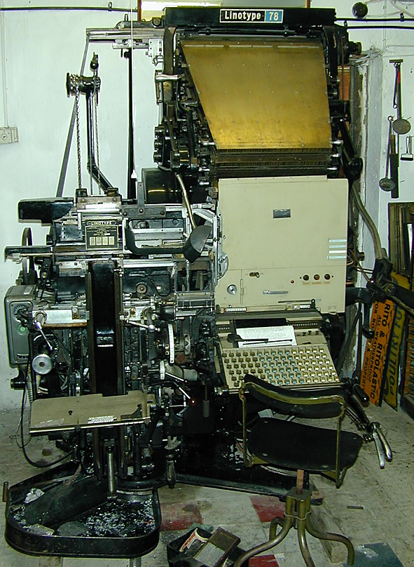
Printing
The linotype machine printed entire lines of type. This meant compositors no longer had to laboriously set each letter by hand.
Again, a lead/tin alloy was melted in a machine to form the letters.

Slide 13
Printing
Offset lithography, today the dominant process for mass media printing, dates from the 19th century.
It didn’t begin to generally replace letterpress, however, until about 1970.
Offset is based in this principle: oil and water do not mix.

Slide 14
Printing
The offset method begins by producing a photograph—now usually a digital facsimile—of a page.
The facsimile is transferred to a thin aluminum plate.
That plate is attached to the press. The image areas hold the ink; the non-image areas are washed with a water-based fountain solution.
Because the greasy ink repels the water, it prints on the paper while the rest stays blank.

Slide 15
Printing
But there’s one problem: what happens when an image is transferred to paper? Think of the rubber stamp analogy: it’s backwards.
So do we do the same thing the old letterpress did, use backwards type for a correct image?
Possible, but cumbersome. Offset press developers came up with a better method.

Slide 16
printing
The offset press adds a third cylinder to the process.
The plate cylinder transfers, or offsets the image to that second cylinder, called the blanket cylinder.
That image, now backwards, is then transferred to the paper, so tah-dah! It’s correct again.
The third cylinder, the impression cylinder, pushes the paper from below for a better impression.

Slide 17
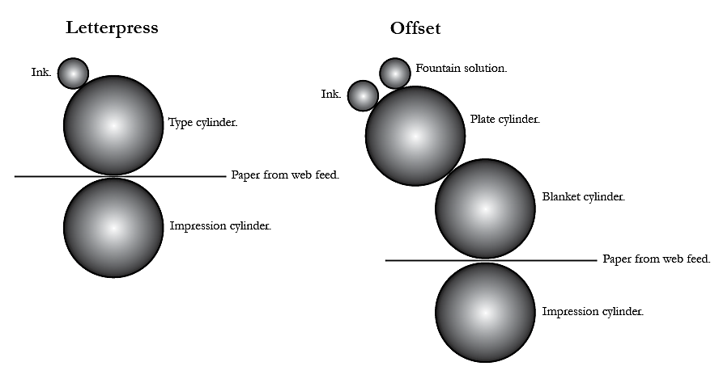
Printing

Slide 18
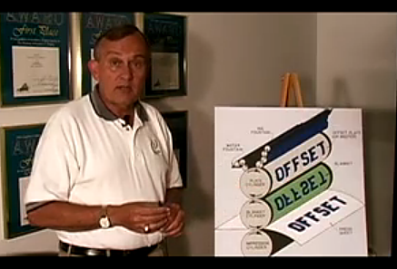
Printing
Here’s a demonstration of the process you’ll likely use as a graphic designer. It does not, you’ll note, use a web-feed press—that’s usually used for large-format work, specifically newspapers. [http://www.youtube.com/watch?v=XUlBueqStg4]

Slide 19
Printing
Two other types of printing are also used for commercial mass media work, although they are less common than offset:
Photocopy/laser and ink jet printing (sometimes called digital printing).
Intaglio (gravure) printing.

Slide 20
Printing
Laser printing is designed mostly for short runs.
Dry ink in cartridges (toner) is attracted to a blank page through a series of positive or negative electrostatic charges.
This method has come a long way, however, and some printers are offering it as a cheaper alternative to offset for runs of a few hundred copies.
Some publishers use digital technology for “print on demand” services.

Slide 21
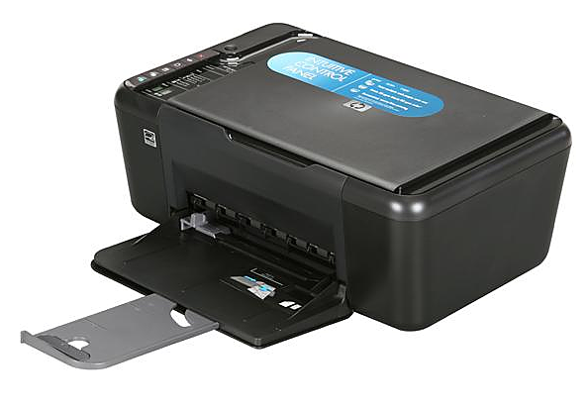
Printing
Ink jet printers spray ink on the page to print.
They are cheap to buy, but expensive to maintain, based on high ink cost.
They are designed for small runs, and not generally used for mass media jobs.

Slide 22
Printing
Intaglio (pronounced “intalyo”) printing is used for high quality art, books and magazines.
Instead of inking raised letters, the ink is applied to depressions on the plate.
It is transferred to the paper from these depressions.

Slide 23
Printing
High-speed printing using this process is called gravure, or if using a web feed, rotogravure.
In this process, ink is scraped in a squeegee-like way using a Doctor Blade.
Gravure is also used for large runs, often a million or more.
Quality is high, but a disadvantage is that all ink, including solid color, is broken into dots.

Slide 24
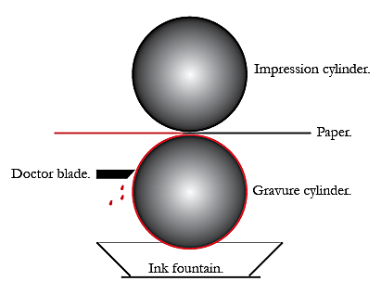
Printing
Gravure.

Slide 25
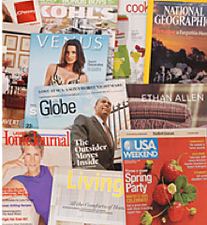
Printing
Some famous magazines and ad supplements produced using rotogravure printing.

Slide 26
Printing
A warmup video: Citizen Kane: http://www.youtube.com/watch?v=tzhb3U2cONs

